Slide 1
New System Updates continued
TE Central Staff
March 2024

Slide 2
Today’s focus
Member program requirements and expectations
Primary TELO
School Profile
Annual Aid year
Deadline maintenance
Export/Import Enrollment Fees
New system requirements & expectations review
Current TELO system closeout
Calendar of happenings
Student account and application process July 1 and beyond
Recap

Slide 3
Member program requirements & expectations
Primary TELO Requirements:
Must appoint a primary and secondary TELO.
These must be different individuals.
The Primary TELO is responsible for maintaining all user accounts (slides 4 and 5).
Every school must maintain its School Profile (slide 6).
Complete the Annual Aid Year School information (slides 7-10).
Maintain the Deadline for Export applications and Import applications (slide 11).
Maintain the details for the Percentage of Award Offers (slide 8).
Determine if mid-year/transfer student starts are accepted (slide 8).

Slide 4
Primary TELO access
The Users screen details users and their role in the TE system.
Training will continue via webinars. Attendees must register with the same email that is in the TE system to connect the records.

Slide 5
Primary TELO access
The Primary TELO adds other users as needed. Users can have full access, limited access, or READ Only access. Training is required for anyone with full or limited access.

Slide 6
School Profile maintenance
The TELO can update general information as needed,
rather than emailing TE Central.

Slide 7
Annual Aid year information
Three aid years will be available for display. If information is incomplete,
the school will be greyed out. The student will not be able to select your school for
TE scholarship EXPORT or IMPORT.
A change log will track actions performed in the system and by whom.

Slide 8
Changes to the Annual Aid year profile
Will you provide more than 8 semesters of tuition? Yes or No
Select all student categories your school will consider offering TE scholarships.
Allow mid-year/transfer students? Yes or No
All TE scholars must complete the Free Application for Federal Student Aid (FAFSA) Annually or Not required
The Primary TELO provides the Percentage of Award Offers detail.

Slide 9
Changes to the Annual Aid year profile
We broadened the language regarding what is included in the TE scholarship:
If the student is eligible for a state grant, the grant is included as a part of the TE award.
Academic scholarships are included as a part of the TE scholarship award.
Talent scholarships such as Art, Music, Theatre or Athletics are included in the TE scholarship award.
Outside scholarships are included as a part of the TE scholarship award.
Tuition Exchange scholarships are required to live on campus.

Slide 10
Changes to the Annual Aid year profile
We broadened the language regarding programs that could be considered for a TE scholarship at your school:
All undergraduate programs.
All undergraduate programs except: – you fill in the blank
Off-campus/study abroad semester.
All Online programs.
All Online programs except: – you fill in the blank
All Certificate programs.
All Certificate programs except: – you fill in the blank
Master’s degrees.
Doctoral degrees.
You can select one or several – items can be adjusted throughout the year.
A change log will track actions performed in the system and why whom.

Slide 11
Deadline Maintenance
Deadlines must be entered for your school to appear on the school listings.
You will enter two separate deadlines – yes, they can be the same but…
A deadline for receipt of Export candidate applications.
A deadline for receipt of Import candidate applications.
The deadlines are flexible and can be updated or changed.
The Daily Digest keeps you informed.

Slide 12
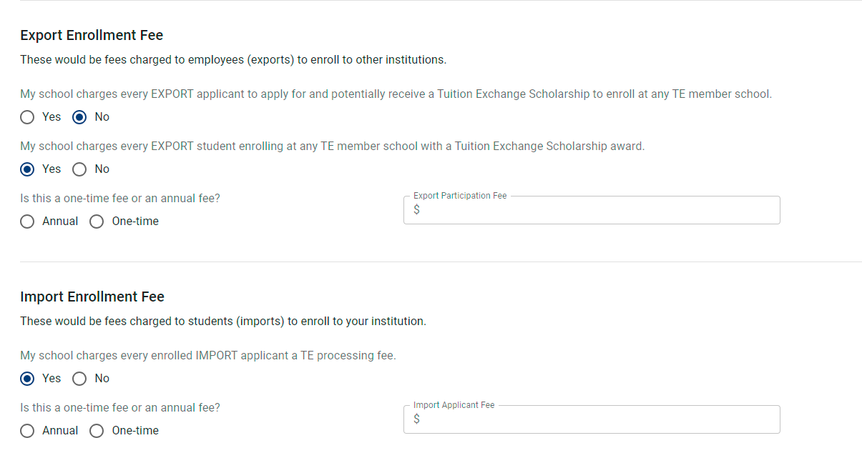
Export or Import Enrollment Fee
Tuition Exchange does not oppose charging a reasonable and justifiable Export or Import Enrollment fee.
School may charge Exports or Imports a fee.
Consumer Information guidelines require that the information be disclosed in advance. Answering the questions as shown on the right does not meet federal Consumer Information requirements.
If the answer is yes, the question of annual or one-time is asked.
A dollar amount is required.

Slide 13
New system expectations and requirements review
Primary TELO maintains the system’s information and users.
Secondary TELO required; in case the primary TELO is unavailable.
Maintain School Profile, including Program settings and utilizing the three custom fields.
Adds and maintains all TE system users.
remove inactive or individuals no longer employed by the college.
Complete the Annual Aid year School Information timely.
Attend Annual Training and system update training sessions.
All training is recorded and posted on the TE website, inside the Liaison Officers section.
Remit promptly the annual membership dues and participation fees.

Slide 14
So, exactly what is the Daily Digest email?
The daily digest email will:
Remind TELOs of tasks to complete.
Determined by actions that happened in the system the previous day.
For example:
Application changes that occurred;
Detail reminders such as there are exports to work;
There are still outstanding Imports to work;
A student is no longer eligible;
And so on.
This Photo by Unknown Author is licensed under CC BY

Slide 15
Brain break!

Slide 16
Current TELO system closeout
What data transfers?
When does the data transfer?
Member school responsibilities.
TE Central and IT responsibilities.
Communication plan.

Slide 17
Let’s create positive action by being pro-active

Slide 18
What data transfers?
Individual school biographical information.
Accounts will be set-up for the listed primary TELO and secondary TELO.
Emails will be launched to the primary and secondary TELO containing the login address and temporary password.
Email address continues to be info@tuitionexchange.org.
Student information:
Current students enrolled and funded.
Approved New 2024-2025 students.
Those applications not funded or approved will require a new application after July 1.

Slide 19
Calendar of events related to the launch
Daily – approve or deny 2024-2025 new students.
By May 15 – all re-certifications must be completed.
By June 1 – all continuing students must be funded, or expiration date updated.
June 14 – every school must print one final and clean Enrollment Report and Balance Sheet for your records.
June 17 – 21(or June 24 – 28) the Tuition Exchange Liaison Portal and TE-EZ Online app process will be unavailable.
Depending on date above, the new Tuition Exchange System will be launched.
Throughout July and August – new system mandatory training will be provided.
Every Primary and Secondary TELO must attend at least one live session.

Slide 20
Student account and application process July 1 and beyond
This Photo by Unknown Author is licensed under CC BY-NC

Slide 21
Application process – first time creating a student account
A special place to login to create a student account.
Student uses his personal email account.
Encourage students to obtain a non-school account.
Student clicks Create Account.
Employee address is not used unless the employee is the student.

Slide 22
Application process – first time creating a student account
The information is all about the student.
The student should never have to create a new account.
Checking the FERPA box allows you to visit with the employee listed about the student’s TE account only.
The student must click CREATE ACCOUNT to activate.

Slide 23
Application process – after log in details are established read the directions!
Only first-time students seeking TE for the first-time or a student who is planning to transfer to a different TE school must complete the TE-EZ Online app.
All student information is about the student.
All employee information is about the parent/step-parent/student.*
*if you are the employee wishing to secure a TE scholarship, check first with your employer regarding eligibility guidelines. Not all TE schools provide TE opportunities for employees seeking an initial or advanced degree.
Application information details the student’s classification – please read each of the seven categories. Your funding is dependent upon your answer.
Applying To: this is where the student selects a maximum of ten (10) schools. Students can modify the list to delete or add schools until the student has been enrolled at one of their choices.
School choices are displayed. If the school is greyed out, that means the school’s deadline has passed.
Be sure to check the box confirming you read and understand the instructions and program requirements.

Slide 24
The TE-EZ online app sections
The information is in this section is all about the student.
The academic year the student is applying for the initial TE scholarship.
Where the student lives, the student’s phone number, and the student’s birthdate.

Slide 25
The TE-EZ online app sections
This section is about the eligible employee. The employee must provide his @nameofschool.edu address.* None of the information can be modified by the student. However, some of the information may be modifiable by the employee’s school of employment.
*Some schools have eligibility rules for retirees. Always use the school email address if available.

Slide 26
The TE-EZ Online app sections
Only available after the box is clicked

Slide 27
Student TE-EZ Online app tracking
The student selected five schools on her initial application. All schools are listed here. If the student did not intend to select one or more, the student can return to the application by clicking update application to make modifications. The maximum is ten school choices.

Slide 28
Options for updating TE-EZ Online app after initial submission
The STUDENT opens the account and clicks at the bottom of the record (see slide 26) UPDATE APPLICATION.
The student can update biographical information, including the birthdate.
Nothing in the Employee information can be modified by the student.
The student cannot update the student classification once the app is submitted.
The student can add or delete the schools selected. The maximum number of schools is ten (10).
Once any changes are made, the student must again click the I have read box and click submit.
The submit box does not become active until the student checks the I have read box.
Even if the student just looks, the I have read box is a requirement.

Slide 29
Student Account sign in
Once the student creates the account, the email provided is the email used to log in.
TE Central encourages students to create a Gmail, Yahoo!, etc. email account.
Be sure to use your name – nothing silly or obnoxious for this account. It stays with you until you graduate from college.
Do not use a high school email account as most of those expire shortly after graduation.

Slide 30
Hey, my password isn’t working

Slide 31
Temporary password email
Once you receive the temporary password email from info@tuitionexchange.org.
Login to your account with the temporary password.

Slide 32
Logging in after resetting my password
Students will always land on this informational
page.
The Import school choices can be modified as long
as the student’s app is open. Once an Import school
claims the student, the app is closed, as is the
student’s option to modify.

Slide 33
Hey, I might want to transfer

Slide 34
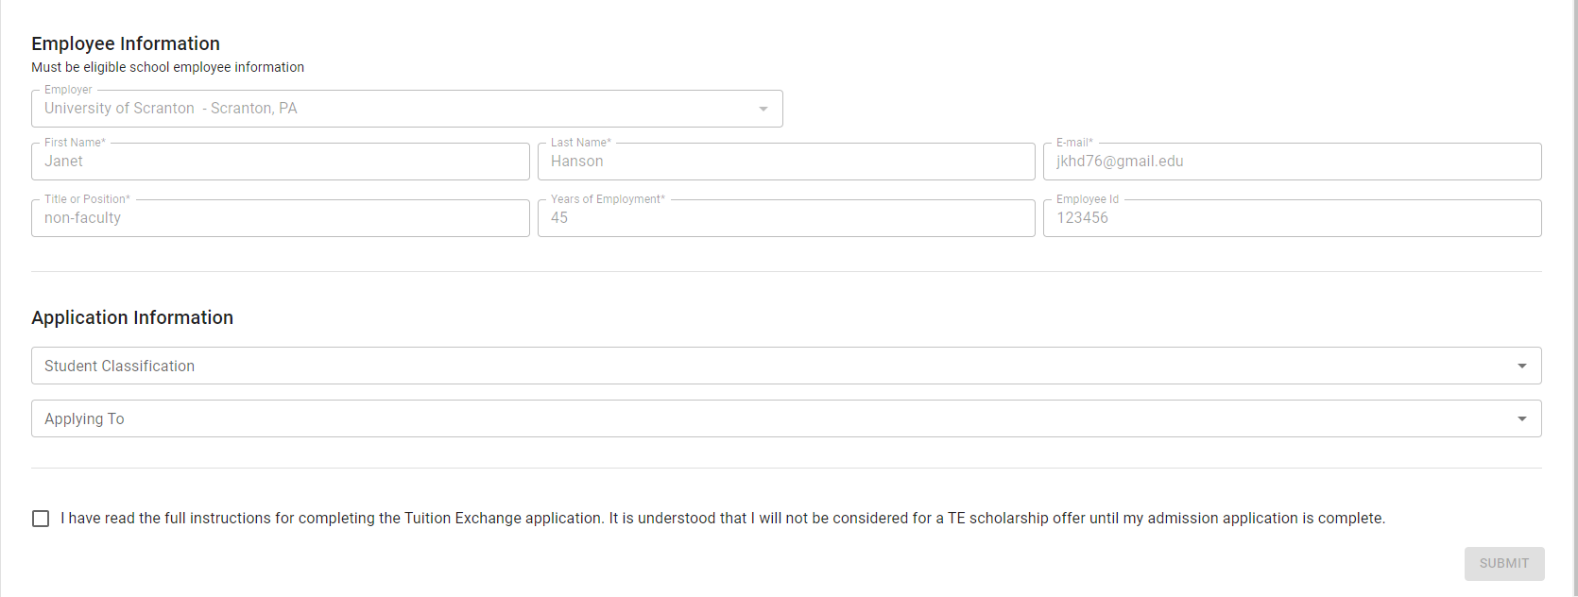
Student transfer action
Student selects Application year

Slide 35
Student transfer action
Once the application year is selected, the Employee information populates.
The student selects his Student Classification.
The student selects the schools he is considering Applying to as a transfer student.
The student clicks the box confirming I have read.
The Submit button enables and the student clicks submit.
EXPORT TELO the application is automatically approved since there is an active application in the system.
NEW IMPORT TELOs receive the application and proceed as usual.
The current IMPORT school is unaware until the new IMPORT school attempts to enrolled the student.

Slide 36
What does the employer TELO see?

Slide 37
What does the employer TELO see?

Slide 38
Three custom fields
The three custom fields can be whatever the school wants to know.
The employee or student respond, and the answers are available for
the school to review.
As a reminder, the responses are not sortable.

Slide 39
TE Overview upon sign-in
Upon sign-in you will be welcomed with messages.
Some messages will be constant, such as the Set-Rate is $42,000 for 2024-2025.
Directional messages will direct you to the TE website for instructions on how to do something.
Other messages may be ACTION messages, such as announcing a new TE member.
Please take a minute to look for directional and action messages, as the information may impact you.

Slide 40
Let’s recap
Member program requirements and expectations
Primary TELO
School Profile
Annual Aid year
Deadline maintenance
Export/Import Enrollment Fees
New system requirements & expectations review
Current TELO system closeout
Calendar of happenings
Student account and application process July 1 and beyond

Slide 41
We are so thankful for all that you do every day to provide education to worthy students.

