Slide 1
Steps for Approving New Students
Janet Hanson

Slide 2
Step 1
Contact Admissions
Not all admitted students receive a TE scholarship
Determine from Admissions
Who is admitted
Who do Admissions want to scholarship
What is the amount for all new students

Slide 3
Step 2
Open TELO portal
Click on Applications see next slide
Decision Pending 2023-24
Review the list received from Admissions and approve only those applications listed by Admissions
All others are rejected
WARNING If you approve someone who is not approved, you cannot go back and remove the approval.
Instantly approved students receive an email of approval thus the reason for no removal option
Denied/Rejected students receive email notifications of the status change

Slide 5
Decision Pending
All new students are found in Decision Pending, as shown on slide 4
Only for those approved by Admission follow slide 5
Those denied/rejected by Admission for a TE scholarship follow slide 6
TE is not a guarantee.
Those denied will call, write, and complain be sure you understand why so when the complaint comes, you can explain why
Remember FERPA rules apply. Visit only with the student.
FERPA is non-forgiving
Imports always deny/reject students
Exports always withdraw students.

Slide 6
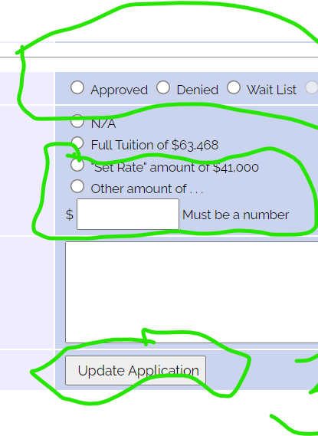
Approving the application

Slide 7
Denying the application

