Slide 1
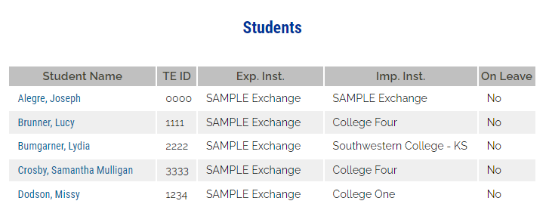
2022-2023 TE recipient informs the TELO at either that the student is NOT returning to the IMPORT school.
Follow the directions below
Open your 2022-2023 Enrollment Report
Click on the student’s name
2
3
And click on the student’s name again.

Slide 2
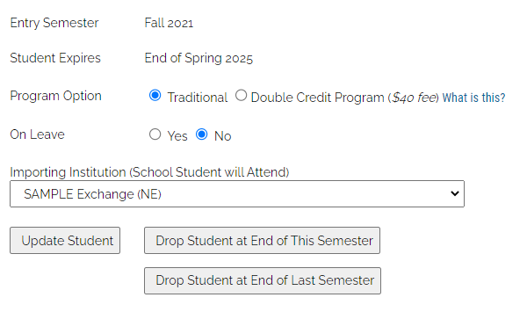
4
Select Drop at the End of LAST semester if the student did not return after the winter semester/term.
Select DROP at the End of THIS semester if the student is graduating or stopping out at the end of the current semester/term.
Check out the Enrollment Report, as the student’s expiration date should have been updated.
The ability to re-certify should no longer be a valid option.

