Slide 1
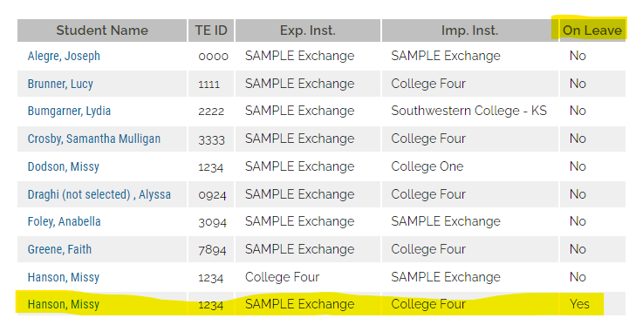
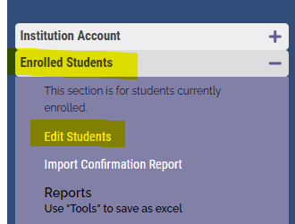
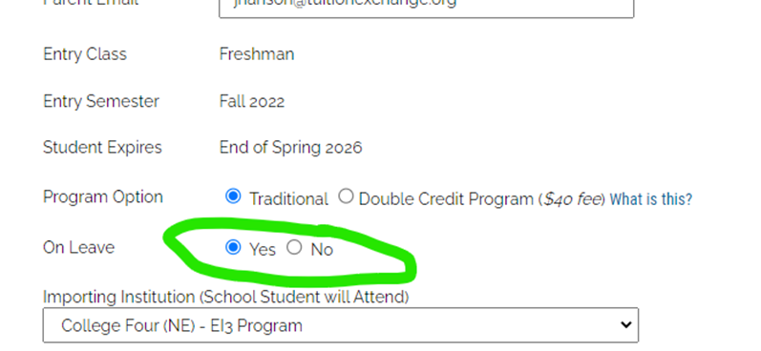
TE Central tells me I have more students to Re-certify, but all eligible Export students on
the enrollment Report are re-certified. Then you need to review the Enrolled Student
Section – Edit Students for Leave of Absence students.
1
1b
Click on the student’s name to open the record.
Scroll to the bottom and change YES to NO, then click UPDATE.
Go to your Enrollment Report – find the student, and if eligible,
Re-certify.
Return to the Enrolled Student – Edit Student tab and return the Student’s record to YES on LOA.
1c
2

Slide 2
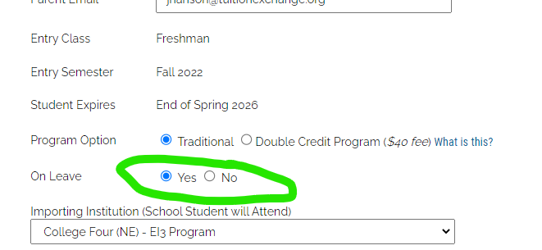
Click on the student’s name to open the record.
Scroll to the bottom and change YES to NO, then click UPDATE.
Go to your Enrollment Report – find the student, and if eligible,
Re-certify.
Return to the Enrolled Student – Edit Student tab and change the
Student’s record back to YES on LOA.

