Slide 1
Leave of Absence
Import schools
&
Export schools

Slide 2
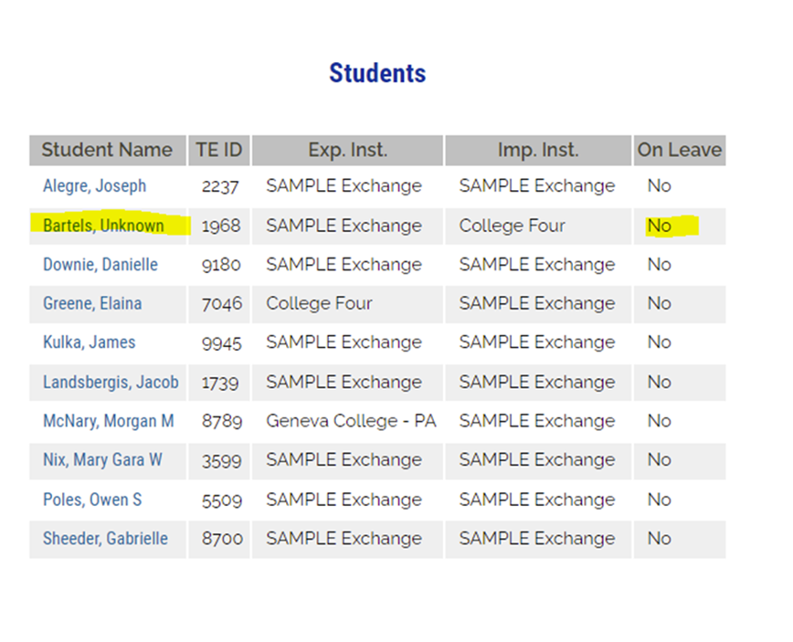
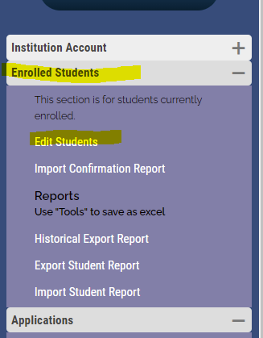
Leave of Absence – Import schools
The Import TELO locates the name of the student taking a Leave of Absence(LOA) and click on the student’s name

Slide 3
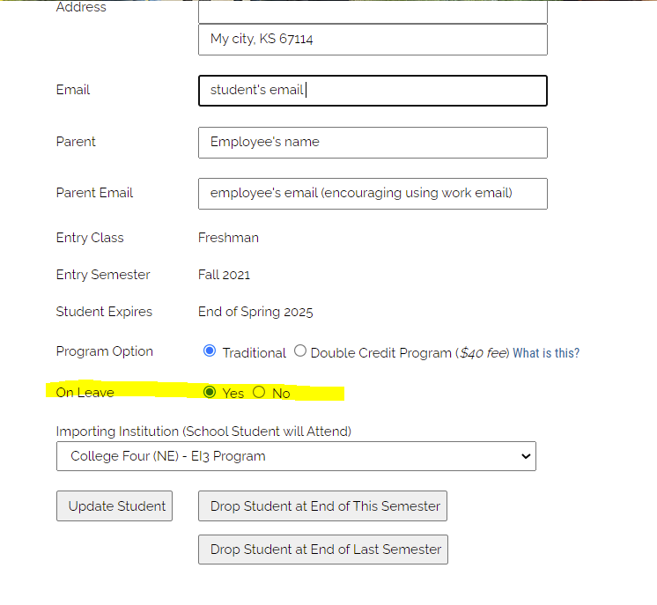
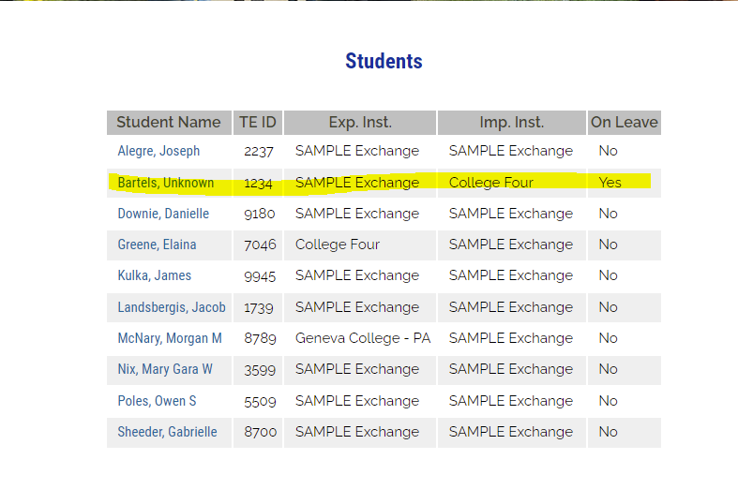
The On Leave option should be marked YES only for students taking an approved leave of absence.
In the Edit Student section, the student is YES on leave at the Import School.

Slide 4
The examples below are the same school and same year’s Enrollment Report.
No student on LOA
Student marked as LOA by Import School
The student falls off the Enrollment Report. However, all students, including those on LOA, can be found in the Enrolled Student folder, then select Edit Student. Just another reason to always print your Enrollment Report every time a change is made.

Slide 5
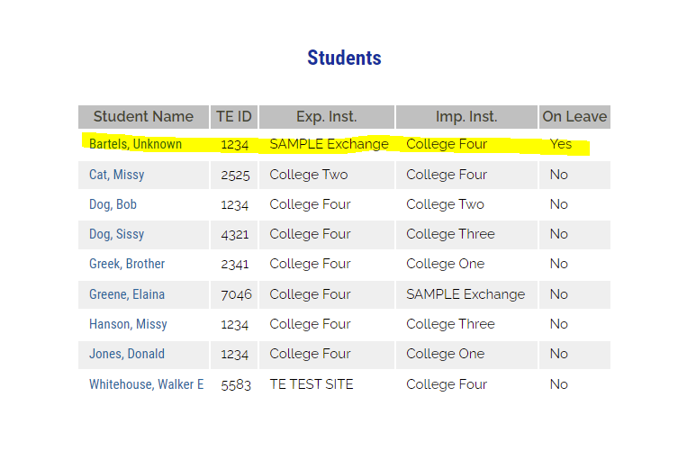
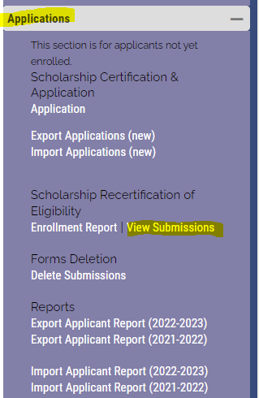
Leave of Absence – Export schools
Students on Leave of Absence fall off the current year’s Enrollment Report.
All certified students for the current academic year are listed alphabetically in the Enrolled Students, edit student option

Slide 6
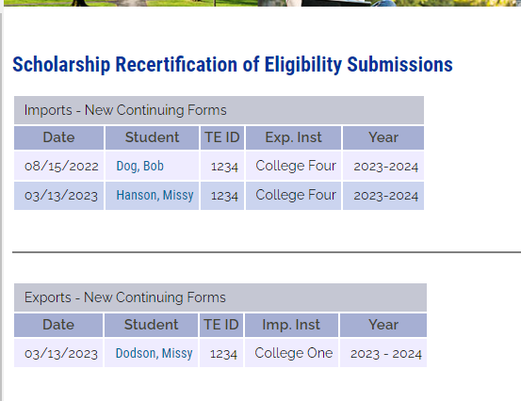
Eligible continuing students not re-certified do not move to the following academic year.
Alegre, Brunner, and Crosby have not been re-certified.

Slide 7
Re-certifying an LOA student
Enrolled Student
Edit student
Look for the YES on the right
Change the Yes to No
Go to the Enrollment Report & Re-certify the student
Go back and update the LOA status to YES

