Slide 1

End-of-year closeout
Tuition Exchange –
Spring 2023
Janet Hanson - Director of Communications
Bob Shorb – Executive Director/CEO

Slide 2

Today’s focus
TE Closeout
  Re-certification
  Participation Fees
Review of 2022-23 Enrollment Report
Re-certify & Funding continuing 2023-24 students
Balance Sheet Reminders
TE Seats Available
Recap

Slide 3

Closeout
Responsibilities
Export Schools
Responsible for clicking the RE-CERTIFY Button on the Enrollment Report
Import Schools
Responsible for funding eligible individual student record
This Photo by Unknown Author is licensed under CC BY

Slide 4
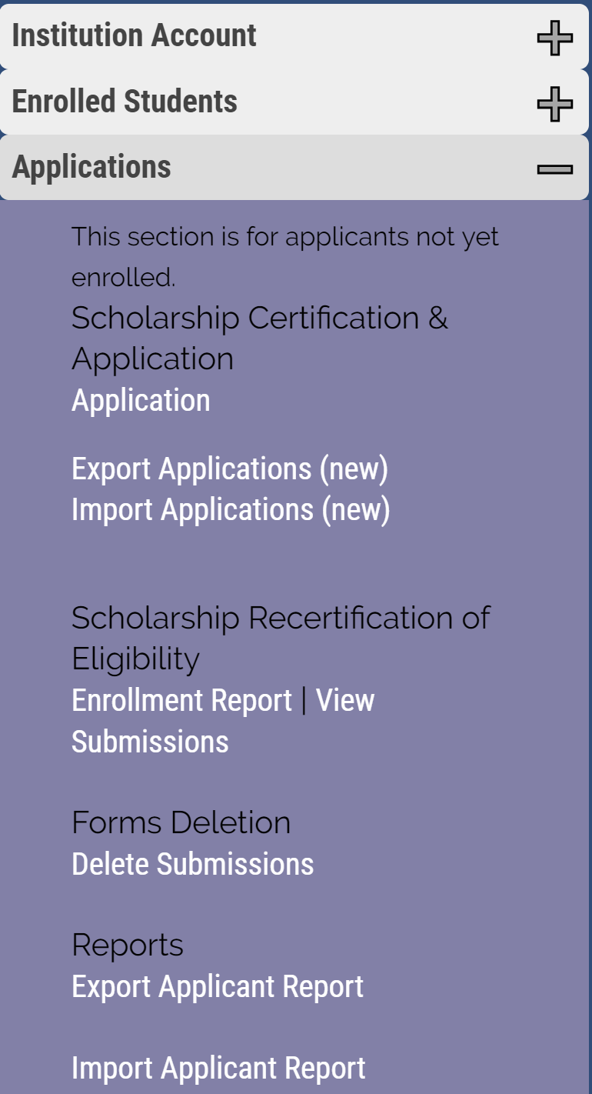
TE Closeout
Enrollment Report
  Changes occur when either the EXPORT or IMPORT school updates a shared student record
  EXPORT Schools
    Re-certification of current eligible employee students
REMEMBER: Re-certification refers to Continuing students

Slide 5

Enrollment report 2022-2023
Print and save a final copy of your records before June 1

Slide 6
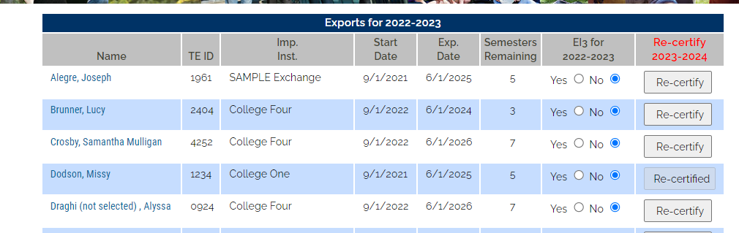
Closeout
If you have not already re-certified your continuing students – please do so ASAP
Families should never complete a NEW TE-EZ Online app when the student plans to return to the same school next year.
The Re-certification process is the renewal application process for 23-24.
Please update each student now. If the student loses eligibility, update the expiration date.
Re-certified means all is complete
Re-certify requires attention

Slide 7
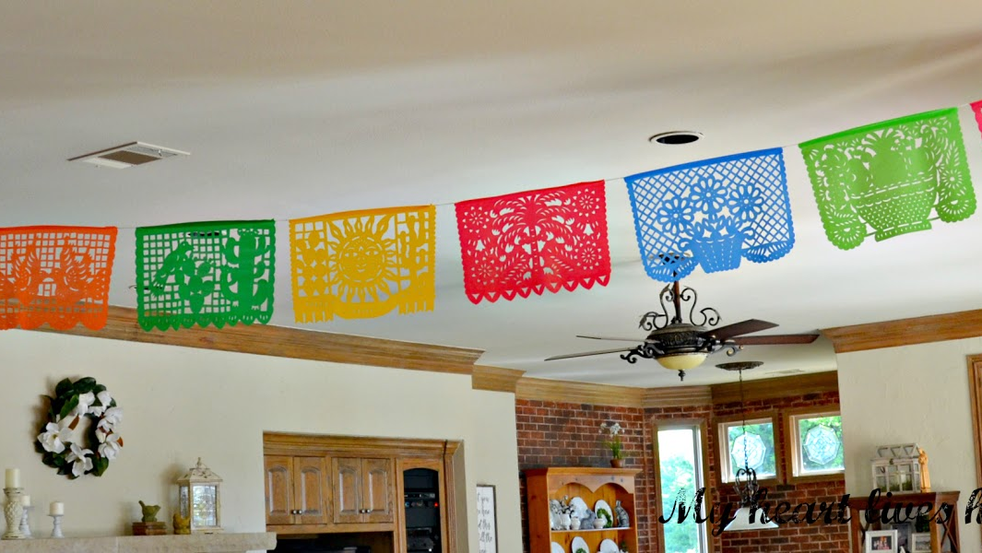
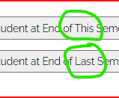
Updating Expiration Date within the 2022-23 academic year
On the 22-23 Enrollment Report
Click on the student’s name
Then click on the name again
Scroll to the bottom of the student’s record and click
Either Drop at the END of THIS semester or Drop at the
end LAST semester and follow the prompts
This Photo by Unknown Author is licensed under CC BY-NC-ND

Slide 8
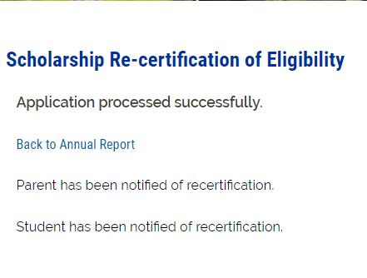
TE Closeout
The EXPORT school re-certifies.
The Export school is only confirming the eligibility of the employee.
The student must meet the Import school academic requirements .

Slide 9

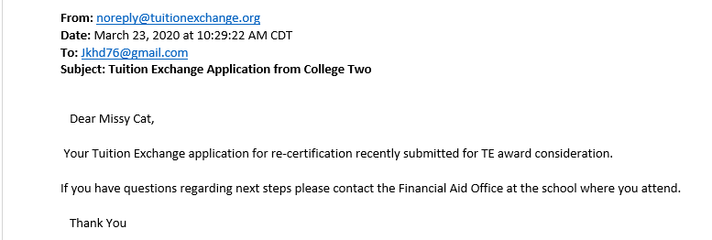
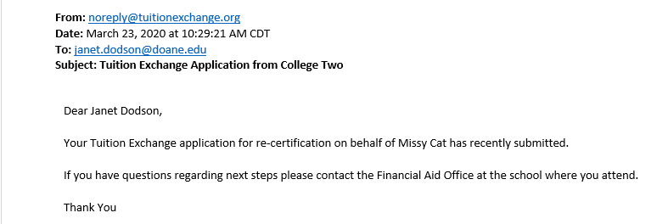
Re-certification Emails to Family
The Parent
The Student
This Photo by Unknown Author is licensed under CC BY

Slide 10


Slide 11
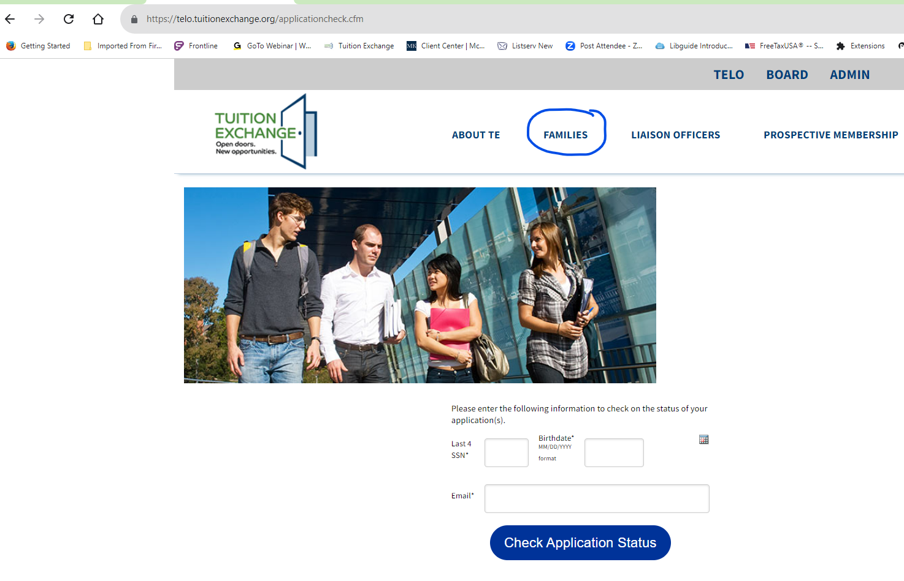
Application Status option
When checking the status, all three items must match.
TE Central does not assist the family.
You can share a copy of the application with the student only.

Slide 12
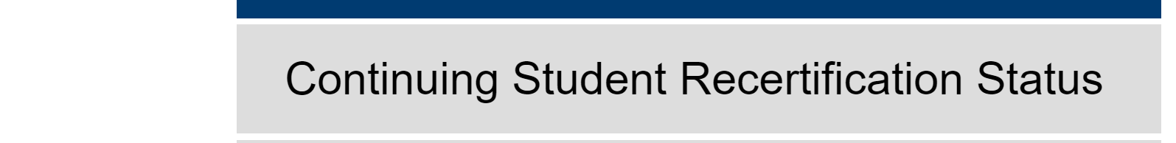
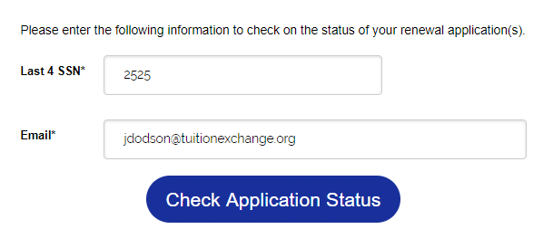
Families can view the continuing student’s re-certification status
in the Family section on the TE homepage
This information must match 100% with the initial TE application
Families often email or call TE Central. We do not provide information to anyone but the TELO. Calls & emails are forwarded to the Export TELO.

Slide 13

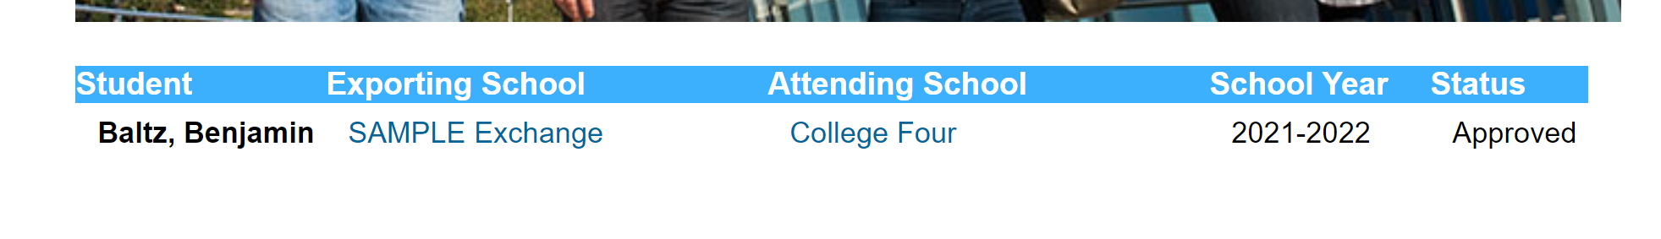
Understanding the status from the family’s viewpoint

Slide 14
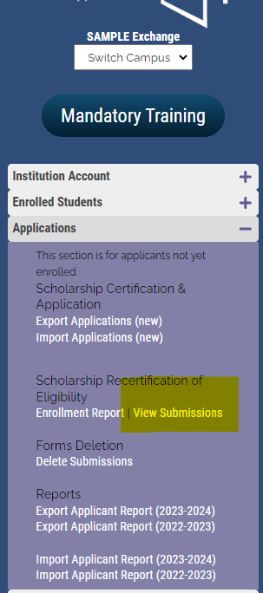
Funding Continuing Students

Slide 15
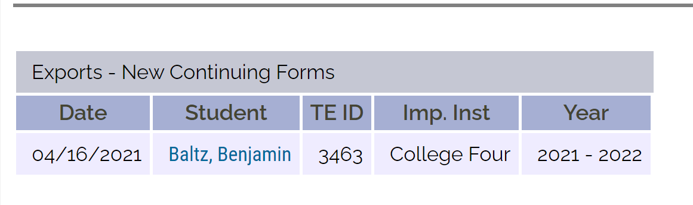
TE Closeout
For eligible continuing students to appear in the VIEW Submissions area, the EXPORT school must re-certify the student.
Export – New Continuing Form is created for every RE-CERTIFIED Export.
Scholarship Re-certification of Eligibility Submission
Imports – New* Continuing Forms
&
Exports – New* Continuing Forms
*New refers to the type of form, not new students.

Slide 16
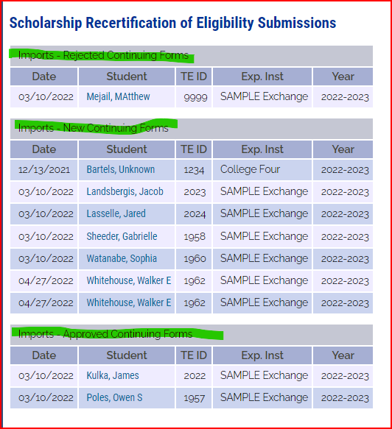
Import school continuing students
Imports – Rejected Continuing Forms – these students will not be funded for the 2023-2024 academic year. You can open the record to review any comments provided.
Imports – New Continuing Forms – these students await IMPORT school funding.
Imports – Approved Continuing Forms – these students are funded for AY 2023-2024

Slide 17
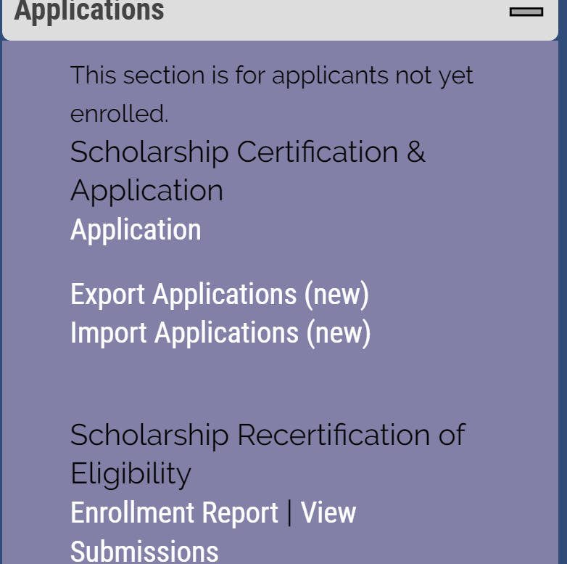
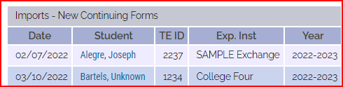

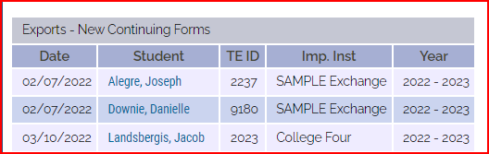
TE Closeout
For eligible continuing students to appear on the 2023-2024 Enrollment Report, the Import school must fund the student.
Imports – New Continuing Form is created when the export school re-certifies the student.
Imports – Approved Continuing Form is created when the IMPORT school completes the funding process in the TE system.

Slide 18
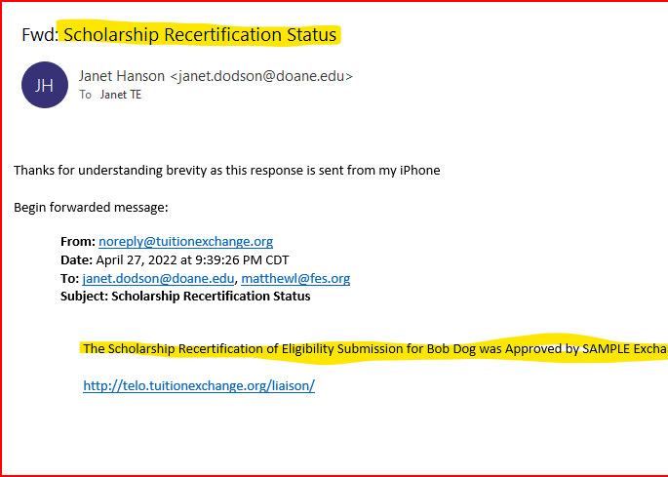
TE Closeout email to IMPORT TELO
The email is shared with the IMPORT school.
The IMPORT school now has a valid continuing application for the 2023-2024 academic year.
DO NOT FORWARD THIS EMAIL TO FAMILIES – it only causes confusion.

Slide 19
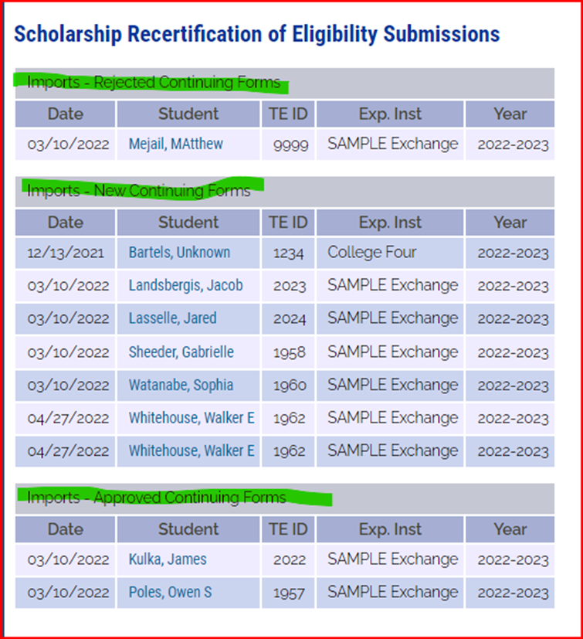
Import school’s required action
Imports – New Continuing Forms
Import school funds eligible continuing students.
Students can monitor the application progress online at www.tuitionexchange.org

Slide 20
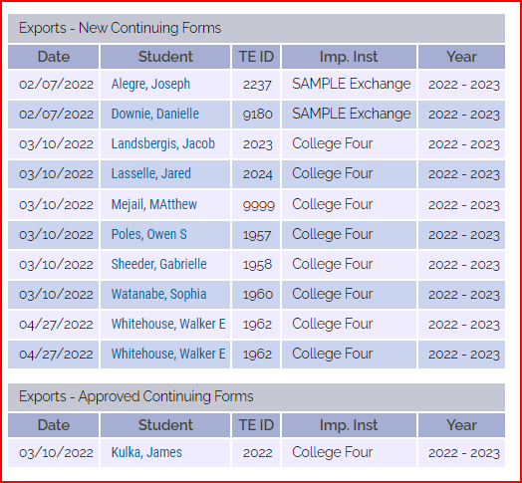
TE Closeout
Export
Look at Owen Poles. The EXPORT school re-certified his continuing application.
He is now in the NEW Continuing Forms section.
This means Poles IMPORT School is responsible for funding or rejecting the 2023-2024 TE scholarship.
The TE set rate for 2023-2024 is $41,000.
As a reminder – IMPORT schools confirm continuing student awards once Spring grades are available.
Current FIRST-YEAR parents are anxious. Remind them that TE scholarship awards now hinge on the student’s academic success and the employee’s continued eligibility.

Slide 21
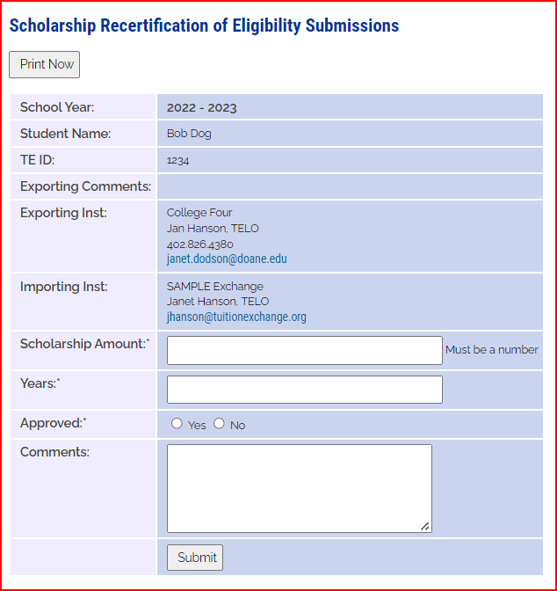





Import
Re-certification
*Enter 2 for all graduate students.

Slide 22
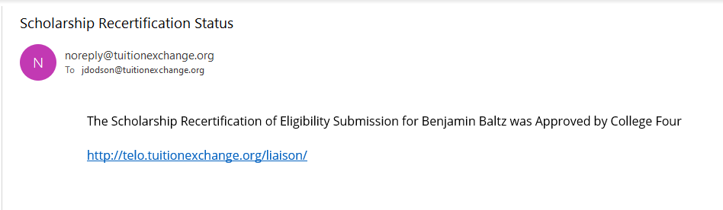
TE Closeout
When the IMPORT school funds continuing students for the 2023-2024 academic year, the EXPORT school receives an email.
TELOs do not share this email with families – it only confuses them.
Note the Subject

Slide 23
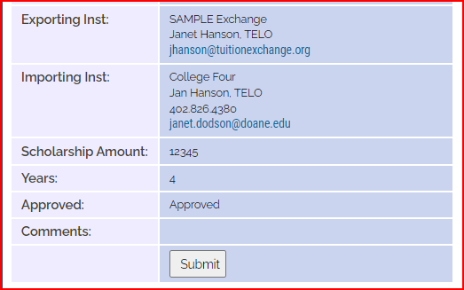
Set-rate for 2023-2024 is $41,000
Once the IMPORT school funds the eligible continuing student –both schools can see the funded student.
If a family calls the EXPORT school regarding a lack of TE scholarship on their 23-24 bill, remind the family that the STUDENT needs to call the IMPORT school.
The Export school does not know.
Reminder to all that FERPA rules apply!

Slide 24
TE Closeout – upcoming tasks and reminders
If you have students in the status of re-certify, you will receive an email reminder from INFO@tuitionexchange.org weekly until all eligible students are re-certified, or the expiration date is updated.
Eligible 2022-2023 students should be re-certified via the Enrollment Report in the Export sections. The report is in the Liaison Portal.

Slide 25

New 2023-2024 scholar reminder
Do not mark the Enrolled Button for new students until Fall 2023.
Mandatory training will cover this starting in June!

Slide 26


Slide 27

June 15 important task!
Print and save a final copy of your 2022-2023 Enrollment Report and Balance Sheet.

Slide 28
TE Closeout
Participation Fees
Every time you click Submit on your Enrollment Report a new Participation Fee Statement generates
01
Review your Participation Fee Statement carefully
02
If you owe – please remit payment upon receipt
03
If you have a zero balance – THANK YOU!
04

Slide 29
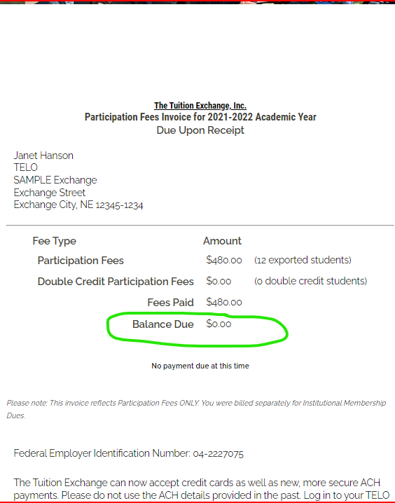
2022-2023
Participation Fee Invoice Currently $45 per enrolled EXPORT and any Double Credit 3 student associated with your school
Participation Fee payments are due upon submission of the Enrollment Report
The initial Enrollment Report was due September 30
As a reminder, every time a change is made to the Enrollment Report, the Export school is responsible for prompt payment of all additional Participation Fees
A new invoice creates every time you submit your Enrollment Report

Slide 30
Membership Dues and Participation Fees for 2023-2024
Membership dues invoices will be emailed to the TE Liaison Officer, backup TE Liaison Officer, and Invoice contact on Tuesday, June 20.
Membership dues are $600 for the 2023-2024 Academic year.
Membership dues are considered late after July 15.
You can pay via check or credit card.
Participation Fees invoices are available for the first time after September 15, when the initial Enrollment Report is submitted and due upon receipt.
Participation Fees are considered later after November 15.
You can pay via check or credit card.

Slide 31

Balance Sheet Reminder
October 2020 Balance Sheet President's Letter
Balance is no more
Expectation is at least three Import offers and more if you export more than three

Slide 32

Balance Sheet reminder
Effective November 1, 2020, Tuition Exchange eliminates the balance sheet requirement.
What does this mean for your employees?
  Your institution can certify all eligible export applicants for TE scholarship consideration. Yes, unlimited export certifications.
  When determining eligible employees, your institution retains its internal institutional guidelines, such as minimum years of service, full-time employee position, etc.
The changes will provide your institution with future success in two ways:
  Potentially, more student applications will be generated through the change in export options, and
  Employees and their families will receive more TE scholarship opportunities.
This Photo by Unknown Author is licensed under CC BY-NC-ND

Slide 33
TE Closeout
Balance Sheet
Your Balance Sheet helps you to understand your current program import and exports.
The Balance Sheet adjusts with each Enrollment Report modification.
When you review your Enrollment Report, be sure to review your Balance Sheet too.

Slide 34
TE Seats Available Survey
Shared with TELOs mid April
Shared on the website May 1
If your school is participating – please consider sharing the information with families still looking for TE options for the fall.
Encourage all families to download the TE APP in the Apple and Google stores.
Every time a new school is added to the TE Seats Available List, an update is sent via the App
If you have not responded and are unsure, contact your Director of Admission or check out NACAC at:
https://www.nacacnet.org/news--publications/Research/openings/

Slide 35

Recap
TE Closeout
Re-certification
Participation Fees
Review of 2022-23 Enrollment Report
Funding 2023-24 students
Balance Sheet Reminders
TE Seats Available
Recap

Slide 36

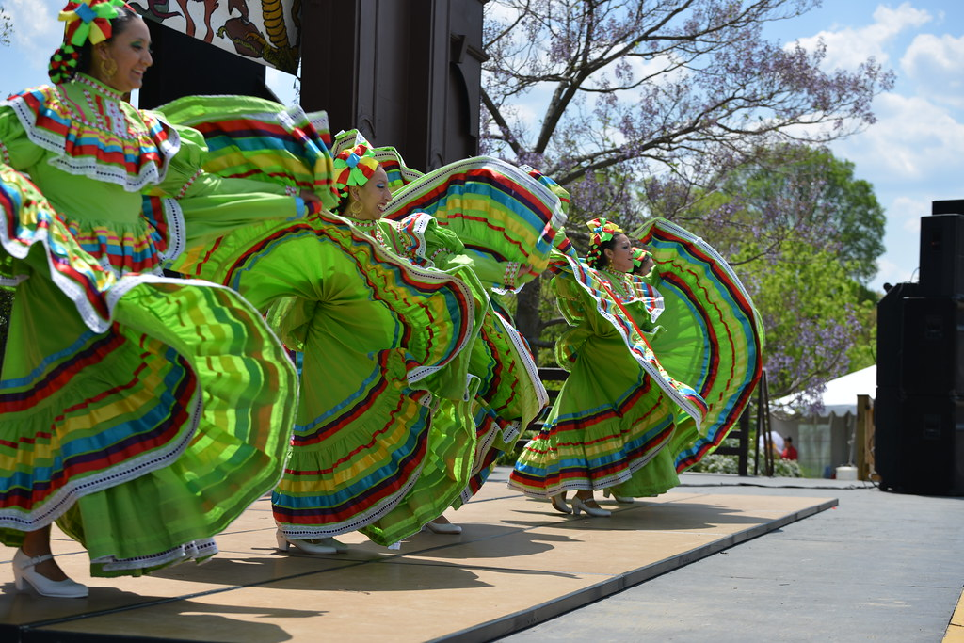
Thank you for another successful year.
What heritage celebration is coming soon?
The first 15 people who email Janet the correct answer will receive a treat!
jhanson@tuitionexchange.org
This Photo by Unknown Author is licensed under CC BY-SA-NC
This Photo by Unknown Author is licensed under CC BY

