Slide 1
Share the Green March 2023 Tuition Exchange
Janet Hanson, Bob Shorb, & Kristine Lev

Slide 2
Today’s Focus
Approving new students
Funding current students
Enrollment Report reminders
Confirmation Report
Transfer Tuition Exchange Grant Award
May 1 Reminders

Slide 3
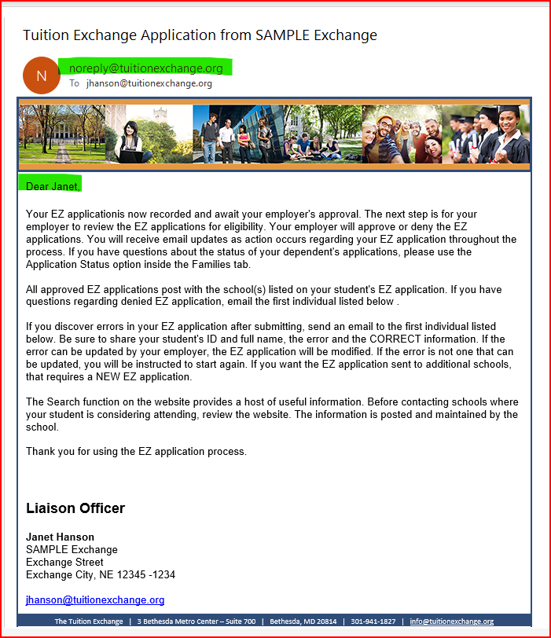
Approving new students - Exports
Employee email
EXPORT TELO notification

Slide 4
Approving new students - Exports
Export TELO – either click approve or deny, then scroll to the bottom and click Update Application.
The EXPORT TELO generally does nothing more with the application(s) until Fall.
Export schools always withdraw.
Exception – the eligible parent switches jobs or is no longer eligible. The EXPORT TELO will withdraw the application and comment.

Slide 5
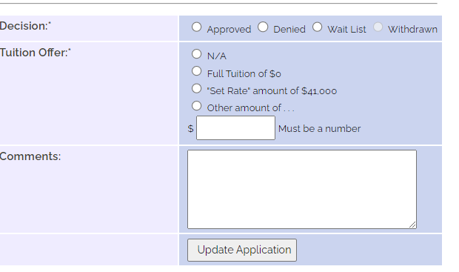
Approving new students - Imports
Employee email
Import TELO notification

Slide 6
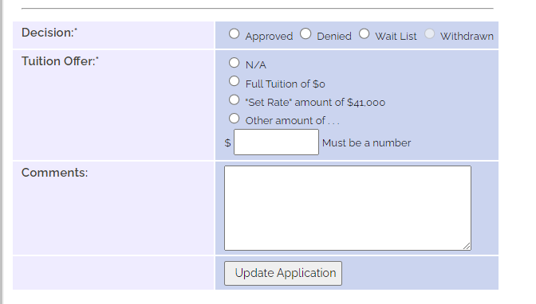
Approving new students - Imports
Import TELO – clicks approve, reject, or waitlist. Scroll to the bottom and click Update Application.
The Import TELO generally does nothing more with the application(s) until Fall.
Exception – if the student decides not to attend your school or the Export school notifies you that the parent is no longer eligible.
IMPORTS are always denied/rejected – be sure to comment on why.

Slide 7
Enrollment Report reminders
Current Students

Slide 8
Expiration Dates & Recertification

Slide 9
Expiration Date issues
If the expiration is wrong and requires an extension, email TE Central with the student’s name, TEID, and the new expiration date.
Confirm with the other school first.
If the student is no longer eligible, click on the name, scroll to the bottom, and select Drop at the END of LAST semester – December 2022 (1/1/23) or at the end of THIS semester, May 2022 (6/1/23).

Slide 10
Recertification issues
If the student is eligible for the TE scholarship for the 23-24 academic year, click on the word RE-certify and follow the prompts.
All students must be Re-certified before June 15.
As a reminder, the expiration date trumps everything – so if you recertify and the student does not return, no problem; update the expiration date.

Slide 11
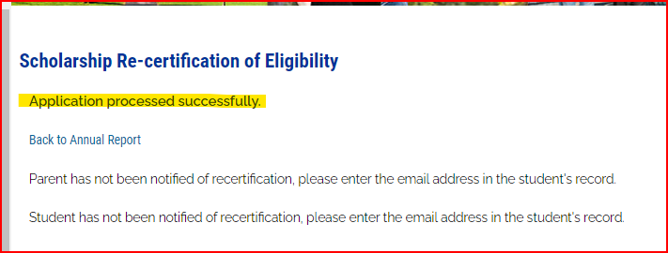
Recertification issues

Slide 12
View Submissions
Export school responsibility
Import school responsibility
Recertify every eligible employee’s dependent timely
Confirm every TE scholar meets the continuing eligibility requirements and fund as soon as possible after the second semester concludes
Grade Point Average (GPA)
Academic progress (hours enrolled)
Social deportment
On-campus housing, if stipulated

Slide 13
Funding current students
This Photo by Unknown Author is licensed under CC BY-SA

Slide 14
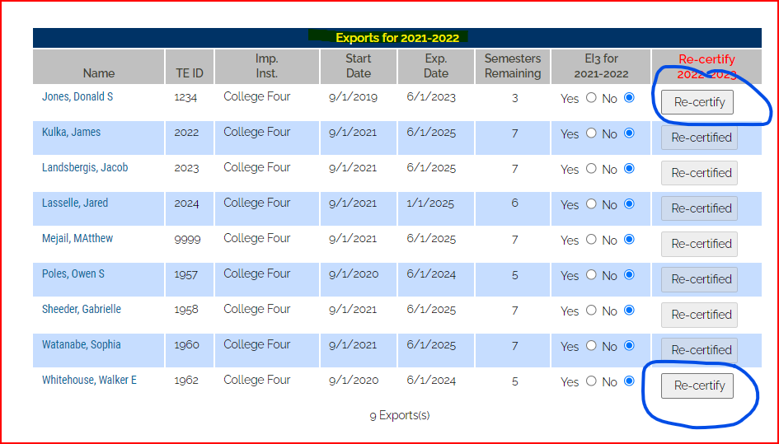
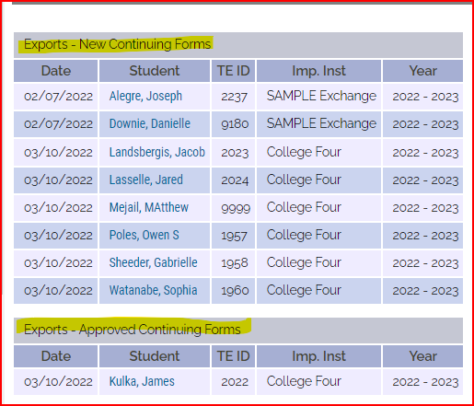
Funding - Exports
Current Year Enrollment Report
Exports– NEW Continuing

Slide 15
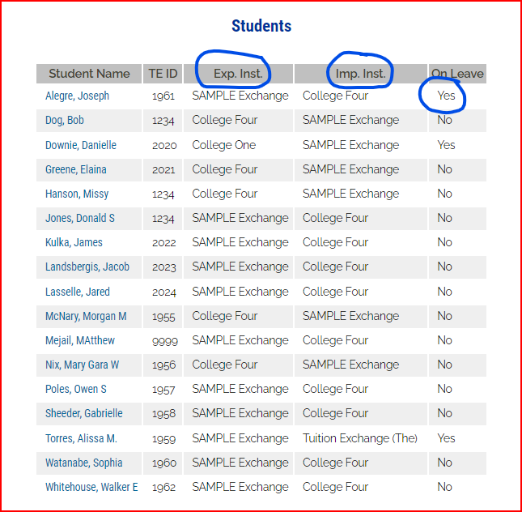
Funding - Exports
Export school responsibility
Confirm all eligible students are recertified
Check the number of eligible exports against the number of Export New Continuing and Export Approved Continuing to confirm that all is correct.
Hint – if the Import school is also the name of YOUR school, you have an issue.
Someone missing? Check Enrolled Students, Edit Students – What names are listed on Leave of Absence?

Slide 16
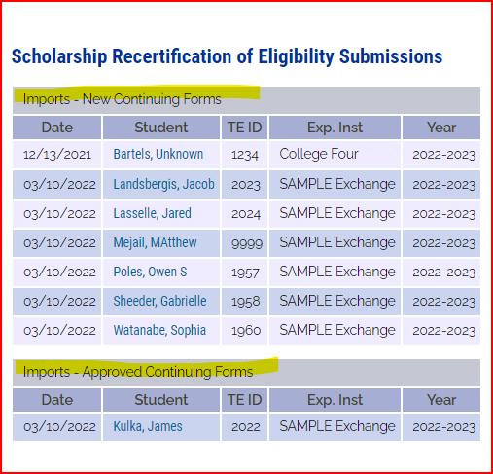
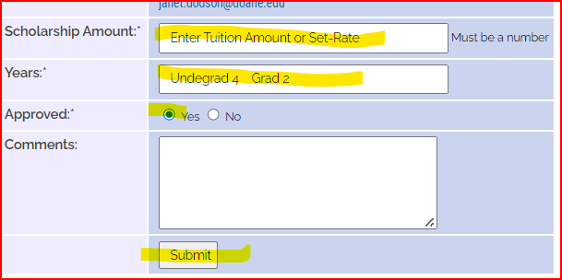
Funding - Imports
Imports – NEW Continuing
Each eligible Import requires funding.
Funded Students:
Click on the student’s name and complete the highlighted areas and click Submit.
Student will move to Approved

Slide 17
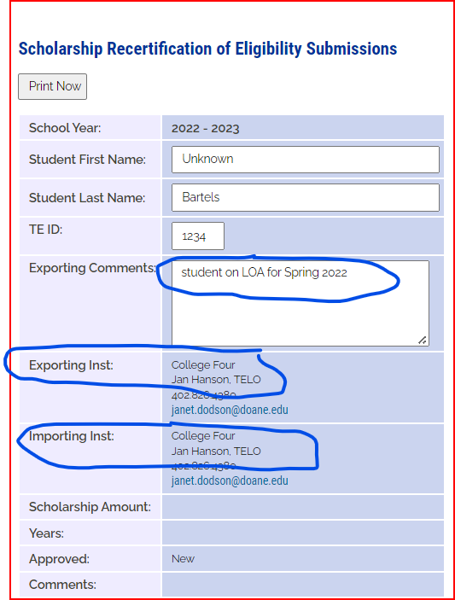
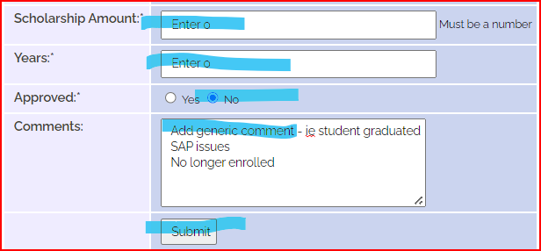
Funding, continued
Oddities
How to Update
Students no longer eligible
Update Expiration Date –
Email TE Central with the student’s TE ID, Export and Import school, and any exporting comments.
For the student who is no longer eligible,
enter 0 for the scholarship,
0 for years,
Click NO for approved, and
provide generic comments, and click SUBMIT to save

Slide 18
Timeline
March 15
By March 15, Export schools should Re-certify all eligible Employee dependents
June 1
By June 1, Import schools should Fund or Reject all eligible TE Import continuing scholars
May 5
By May 5, Import schools should Approve or Deny all offered NEW TE scholars
July 15
Census Day
TE Membership Invoice due
Import schools will click the Enrolled button. Export schools will ADD student

Slide 19
Communicate
Edna – Export TELO
Ian – Import TELO
Adam – Admission Counselor
Franny – Financial Aid Officer

Slide 20
Confirming current student funding
This Photo by Unknown Author is licensed under CC BY-SA

Slide 21
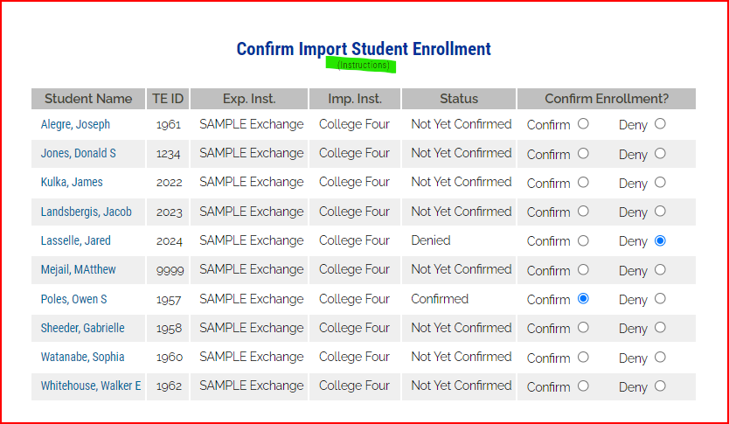
Enrolled Students Import Confirmation Report
Collaborate with your Financial Aid Office – asking for confirmation that each student listed was funded.
Each student needs the status of Confirmed or Denied.
Confirmed means the student received a TE scholarship sometime during the 22-23 academic year.
Denied means the student did not receive a TE scholarship anytime during the 22-23 academic year.
The Report

Slide 22
Transfer Tuition Exchange Grant Award
This Photo by Unknown Author is licensed under CC BY-SA

Slide 23
Transfer Tuition Exchange Grant
The Details
Candidate consideration for the 2023-24 academic year is limited to TE scholar applicants transferring to a new TE member institution.
Transfer students have earned college course credit after high-school graduation and transfer the previously earned course credit to the new institution. Award selection will be based on the highest college GPA ranking and lowest expected family contribution (EFC), as evidenced by the processed 2023-24 Free Application for Federal Student Aid (FAFSA).
Candidates go online at www.fafsa.ed.gov to complete the 2023-24 FAFSA and determine the EFC.

Slide 24
Transfer Tuition Exchange Grant
The Timeline
Now - TELO identifies certified exports/imports eligible for TTEG nomination. Friday, July 14, 2023 - Nomination deadline. The TELO’s responsibility is to email the nominee's name, best email address, and last four digits of TE ID as listed on the student’s TE application to rshorb@tuitionexchange.org. Now - July 2023 - TTEG nominees receive an information request from TE Headquarters for college(s) attended, GPA, and EFC information. The information is returned to TE Headquarters as posted on the information. Friday, July 28, 2023 - Deadline for nominee's response to information request returned electronically to Rshorb@tuitionexchange.org Now – August 11, 2023 - TTEG nominees will consider and accept TE award offers at TE transfer institutions. August 25, 2023 – TTEG recipients announced by TE Headquarters. September 2023 - Schools will receive a $1,000 check for the TTEG recipient, payable to the school, and sent to the Financial Aid Director's attention.

Slide 25
May 1
An additional Import strategy

Slide 26
May 1
The Details
Tool for Tuition Exchange Liaison Officers and TE member employees to assist students who have not yet completed their college admission and TE process.
After May 1, colleges can assess if they have space to accommodate additional applications from potential students. We encourage you to visit with your Admissions and Enrollment staff, your Financial Aid Office, and Human Resources to confirm that spaces and funding are still available.
On May 3, TE Central will post an announcement on the front page of our website.

Slide 27
The TE app
Encourage your families to download the TE app to stay engaged and updated

Slide 28
May 1
The Details
My school will or will not participate.
If yes, the TE scholarship amount, the number of available TE scholarships, the school's name and address, and the contact's name and email for the May 1 Available Scholarship listing.
All participating schools will be listed on a searchable EXCEL spreadsheet.
TE Central will not publish the number of available scholarships.
The list will be available until August 15.

Slide 29
Reminders from Janet
​Keep your TE Liaison information up to date
Import schools – stay in touch with Admissions and Financial Aid
Export schools – families are still completing 22-23 applications, please approve apps as received
This Photo by Unknown Author is licensed under CC BY-NC-ND

Slide 30
Reminders from Kristine
​Participation Fees are due upon receipt of the Invoice – If you received an email with a Participation Fee invoice Monday, March 13 please pay the balance immediately
2023-2024 Membership Dues Invoice will be emailed around June 20th to the primary TELO, the backup TELO, and the Invoice Contact

Slide 31
Reminders from Bob
Balance Sheet
Updated TE Guidelines template
Member Recruitment

Slide 32
Today’s Focus
Approving new students
Funding current students
Enrollment Report reminders
Confirmation Report
Transfer Tuition Exchange Grant Award
May 1 Reminder

Slide 33
There are lots of This month's winners are the first 15 TE Liaison Officers who email Janet with the slide numbers showing off their shamrocks!
Janet Hanson jhanson@tuitionexchange.org
402.418.1081 – please don’t share with families

