Slide 1
Tuition Exchange
Answering questions and providing solutions

Slide 2
Today’s focus
Introduction to Tuition Exchange
Meet the Tuition Exchange staff
Planning and development
Membership responsibilities
Website overview

Slide 3
Introduction to Tuition Exchange
Founded 1954
Reciprocal tuition scholarship
Tuition
Set-rate
Public school option
No actual exchange of dollars
Employees
Faculty
Staff
Other as defined by the TE Export member school
Dependents
Children
Spouse/partner
Others as defined by the TE EXPORT member school
Non-profit organization
Over 700 school choices
Scholarship program
A school choice for all

Slide 4
Introduction to Tuition Exchange
Exports
The member school is offering an EXPORT opportunity
All admissible students meeting the EXPORT school criteria should be considered by the Import school
Available at any TE school accepting imports for the applicable academic school year
No guarantee the TE applicant will be offered a tuition exchange scholarship at the Import school
Student must apply and be admitted as a regular student to the Import school
Imports
Any admissible and approved EXPORT deserves consideration
Consideration does not mean offering a TE scholarship
Undergraduate students should be awarded eight semesters or graduation, whichever comes first
Graduate students should be awarded four semesters or degree completion, whichever comes first

Slide 5
Introduction to Tuition Exchange
Member schools determine
Who is eligible
Employee
What academic programs are eligible
Undergraduate
Online
On campus
Graduate
Non-tradition campus offerings, etc.
For whom will you confirm an award
Any accepted or current student
Only new students
Degree seeking
Full-time
How the TE award is communicated
Admissions Office
Financial Aid Office
Tuition Exchange Liaison (TELO) via letter or email

Slide 6
Introduction to Tuition Exchange
The Value of the award
Tuition, Set-Rate or Other
Will you allow federal and/or state grants in addition to the TE scholarship?
What about academic or co-curricular awards?
Do you freeze tuition for each entering class?
What about fees?
Room and board?
What institutional budget will fund TE scholarships?
Communication is key
Tuition Exchange Membership Services provides help and examples

Slide 7
Meet the Staff
/
Robert (Bob) D. Shorb -
Executive Director and CEO
Lives and works remotely from Texas
30+ years experience in higher education
Bob is responsible for all the moving parts of the Tuition Exchange
State and regional financial aid leader and trainer
He serves as the primary voice for all new member recruitment and program oversite

Slide 8
Meet the Staff
Janet Hanson, Director of Communications
Lives and works remotely from South Central Kansas
42+ years of higher education experience
State, regional, and national financial aid leader and trainer
Adjunct instructor in higher education
Janet’s primary responsibility is membership services
Janet creates, conducts, and delivers Tuition Exchange training
She responds to emails from TELO’s
Janet’s other duties include attending conferences, maintaining the TE website, and working with IT to keep the system running

Slide 9
Meet the Staff
Kristine Lev, Director of Administration
Works in the Bethesda, Maryland office
15+ years of Tuition Exchange experience
Kristine is responsible for all things administrative
Kristine helps coordinate all membership dues and fees
Sends out monthly reminders regarding payments
Assists with database management

Slide 10
Planning and Development
Identifying the rewards of joining Tuition Exchange
Enhancing educational opportunities available to your employees and their dependents
The opportunity for dependents to choose from 700+ TE member institutions
A potential faculty/staff recruiting tool
What your institution can accomplish by joining Tuition Exchange
Expanding your institutional footprint
Providing best fit-educational opportunities for your employee's dependents
The opportunity to recruit the best and the brightest students to your programs

Slide 11
Planning and Development
Key Decision Makers
Cabinet
Human Resources
Enrollment Management/Admissions
Financial Aid
The implementers
Department Heads
Staff
Communication is the key to a successful Tuition Exchange program!

Slide 12
Membership Responsibilities
Establish
Establish Tuition Exchange Guidelines
Suggest mirroring your Tuition Assistance or Remission guidelines
Establish
Establish a process
Imports – Admissions
Exports – Human Resources
Financial Aid is a great junction box
Determine and appoint
Determine and appoint an institutional Tuition Exchange Liaison Officer (TELO)
Financial Aid knows how to communicate with families and understands their angst
Set
Set funding budget and annual allocations
Tuition
Set-rate
Public school option

Slide 13
Membership Responsibilities
Maintain
Maintain respectful program balance
Exports are debits to your balance sheet
Imports are credits and provide you power to increase your export options
Create
Create solid communication channels
Communication is the best key to happy employees and administrators
Honor
Honor continuing student awards
Expect to fund the undergraduate student for 8 semesters or graduation, whichever comes first
Different program rules may be set for graduate or non-traditional programs
Be sure to communicate academic expectations

Slide 14
Membership Responsibilities
Annual Dues and Fees
Annual Dues are $550 and due July 1
Participation fees are $45 per export and due upon receipt
One-time initiation fee of $350 must accompany your TE application contract

Slide 15
Tuition Exchange Website Overview

Slide 16
Tuition Exchange Website Overview
www.tuitionexchange.org
Organic
Fluid
Robust
Helpful
Sites created specifically for individual user types

Slide 17
Re-cap
Tuition Exchange is a solid organization
Tuition Exchange provides program flexibility
Tuition Exchange can offer my employees a variety of over 700+ educational options
My institution and its mission and values are a perfect fit with the mission and values of the Tuition Exchange
My institution will contact Bob Shorb or Janet Hanson soon for additional information and a membership agreement packet
Bob’s contact information: rshorb@tuitionexchange.org
Janet’s contact information: jhanson@tuitionexchange.org

Slide 18
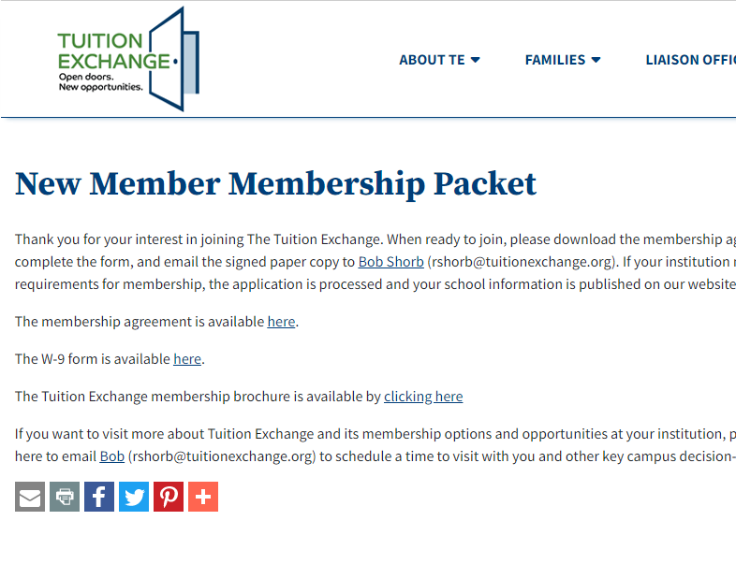
Tuition Exchange Call to Action
Review, sign, and submit the Tuition Exchange Membership Agreement and Contract
Remit the $350 one-time initiation fee
Appoint a Tuition Exchange Liaison Officer (TELO) and committee
Communicate your approved membership with faculty and staff

