Slide 1
2021-22 Enrollment Report Overview
Janet Hanson
Director of Communications
September 2021

Slide 2
Today’s Focus
Enrollment Report
Dues and Fees
Capacity

Slide 3
Completing the Enrollment Report
Import responsibilities
Export responsibilities
The Enrollment Report is organic and requires at least two additional full reviews.
Beginning of Spring term/semester
End of the school year
As a reminder print and save a copy of the Report each time you review it.

Slide 4
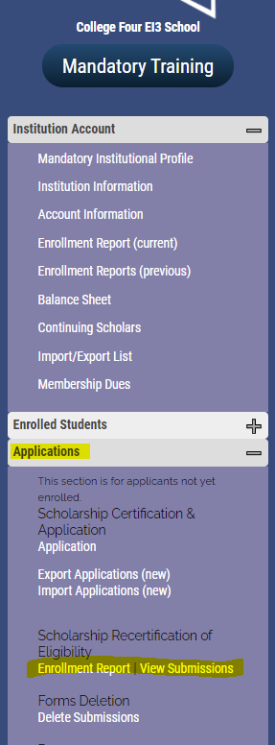
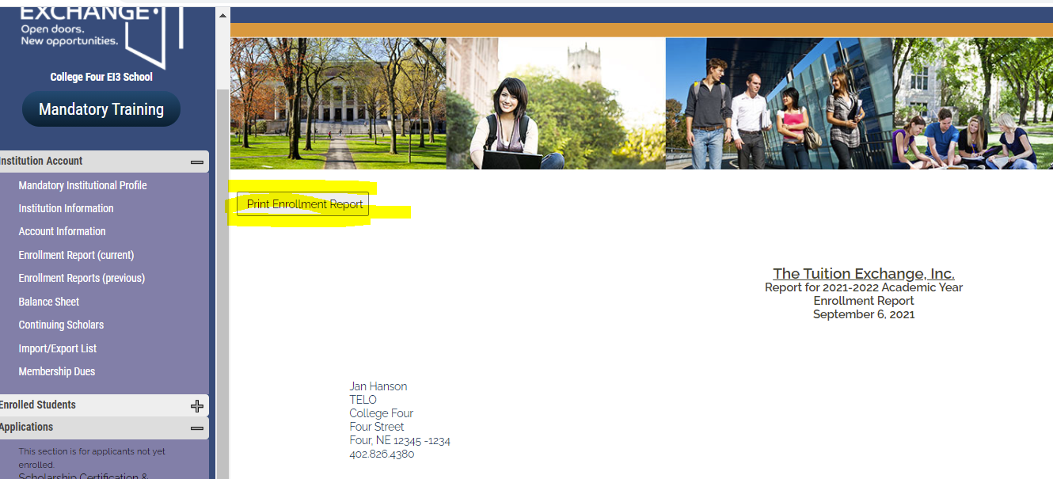
Completing the Enrollment Report – Import schools
Import schools if you completed Mandatory Training, you have access to your Enrollment Report.
Click to open the report and print a working copy. The print button is at the top of the report to the left below the sidewalk

Slide 5
Completing the Enrollment Report – Import schools
Working with the Financial Aid and the Registrar’s Office confirm the students listed as imports are still enrolled. If yes, no further action is needed. If no longer enrolled, the student’s expiration date needs updating.
Remember to print and save a copy of your Enrollment Report each time you make a change.

Slide 6
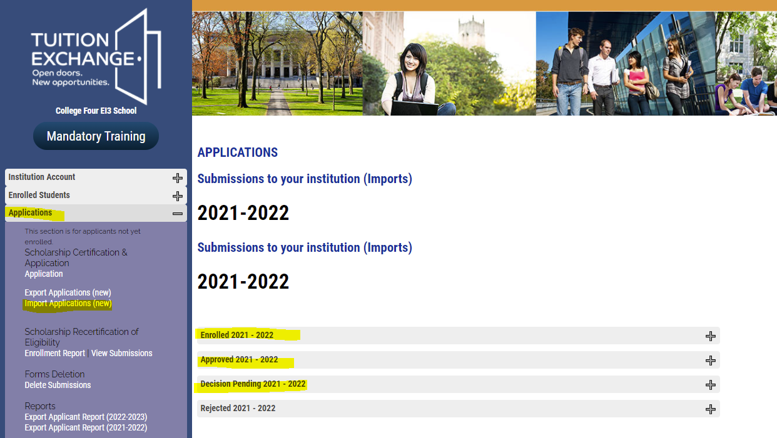
Enrollment Report Action – Import school
Decision Pending students – Few if any students should be in this category. Please clean them up. The student is either attending without a TE scholarship or is not a student at your school. In all cases, the Import school clicks DENIED for each student in this category not receiving a TE scholarship at your school. Remember to click Update Application to save your work.
Remember – Import schools DENY and Export schools WITHDRAW

Slide 7
Email Notifications Student moved to APPROVED by Import school

Slide 8
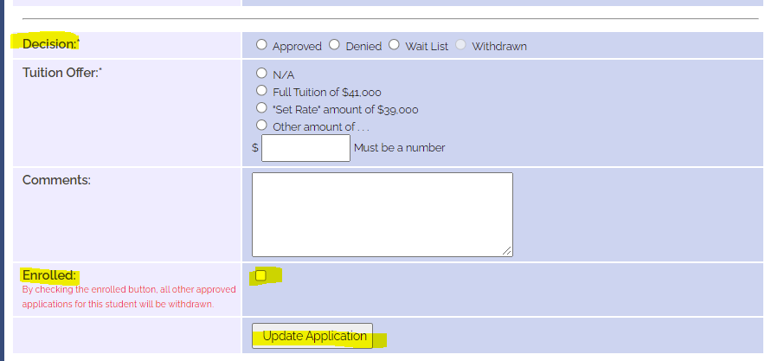
Enrollment Report Action – Import school
Approved Students – there are NEW students to your Tuition Exchange program. Is the student enrolled? Check with either the Registrar’s Office or the Financial Aid Office to confirm the student’s attendance.
If enrolled – open the student’s record, scroll to the Decision Section and click the Enrolled box. See below
If the student is NOT enrolled at your school, update the student’s record to denied. I suggest a note in the comment section, such as – student not enrolled Fall 2021. Be sure to click Update Application

Slide 9
Enrollment Report Action – Import School
When the IMPORT school marks the student as enrolled – the student moves to the category of Enrolled.
The Export school is notified via email that action is required to ADD the student to the Enrollment Report.
The student WILL NOT appear on the Enrollment Report until the EXPORT school adds the student.

Slide 10
Email Notification Student marked ENROLLED by the Import school

Slide 11
Completing the Enrollment Report – Export schools
Export schools if you completed Mandatory Training, you have access to your Enrollment Report.
Click to open the report and print a working copy. The print button is at the top of the report to the left below the sidewalk

Slide 12
Completing the Enrollment Report – Export schools
Working with the Human Resource Office confirm the students listed as exports are still eligible. Meaning, is the parent still employed? If yes, no further action is needed. If no longer enrolled, the student’s expiration date needs updating.
Notify the IMPORT school immediately as the student is receiving the scholarship under potentially false pretenses.

Slide 13
Enrollment Report Action – Export school
Decision Pending students – please clean them up. The student is either attending without a TE scholarship or is not an enrolled student. In all cases, each student records needs updated. Click DENIED for each student in this category if you are aware that the student is receiving a TE scholarship.
Remember to click Update Application to save your work.

Slide 14
Enrollment Report Action – Export School
When the IMPORT school marks the student as enrolled – the student moves to the category of Enrolled.
The Export school is notified via email that action is required to ADD the student to the Enrollment Report.
The student WILL NOT appear on the Enrollment Report until the EXPORT school adds the student.
Remember – Import schools DENY and Export schools WITHDRAW

Slide 15
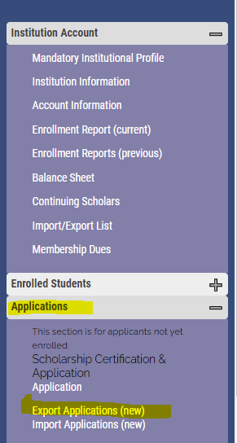
Enrollment Report Action – Export school
Export schools have one additional category – To Be Enrolled – 2021-2022.
An email alerts the EXPORT TELO(s) to required action.
Review each student in the To Be Enrolled – 2021-2022 category when the status is ADD STUDENT

Slide 16
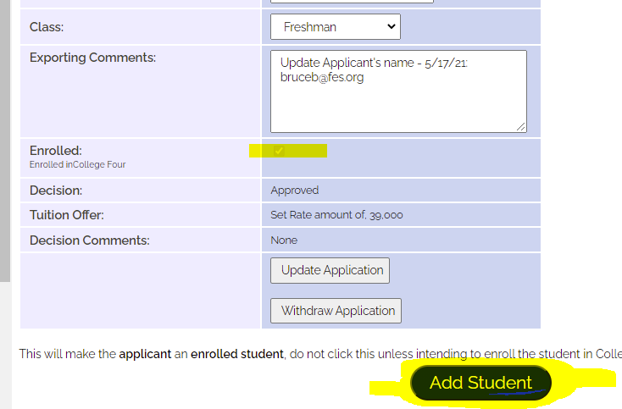
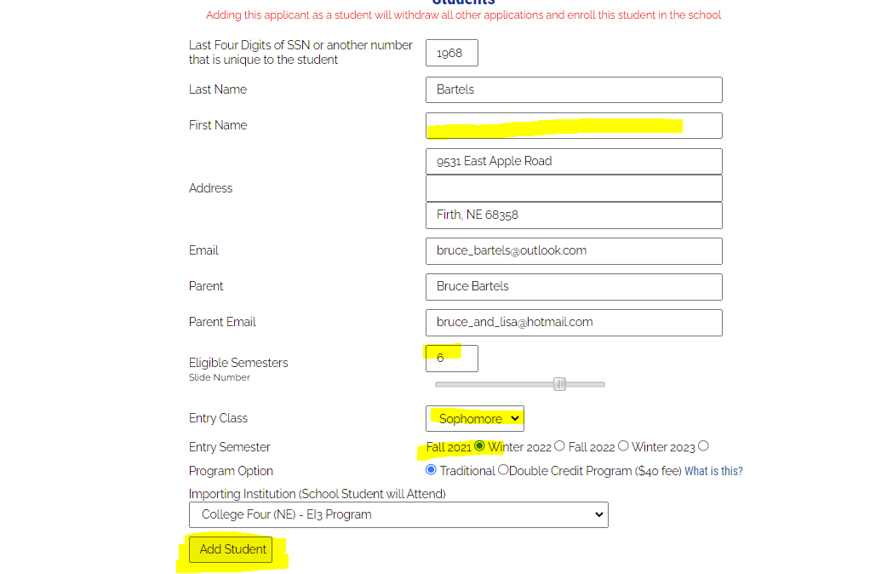
Enrollment Report Action – Export school
Confirm with Human Resources the employee is still eligible and click ADD STUDENT
Confirm the student has a first name. If no, EXPORT schools can add the first name.
Double check eligible semesters and entry class. Do they match? Export schools can modify the information
Click Fall 2021
Click Add STUDENT

Slide 17
Updates, modifications and reminders
Missing first name – the EXPORT school can add a missing first name
Only EXPORT schools can ADD the record. Import schools ENROLL the student
Leave of Absence – see snippet for visual directions
Not returning – see snippet for visual directions
Never enrolled – contact Janet for help

Slide 18
Deep breath

Slide 19
Annual Dues – 2021-22
645 members have paid their 21-22 annual Membership Dues Receipts are emailed upon receipt of payment
You can always check by looking for a PAID date on your online Dues Invoice
Please reach out to Kristine if you have any issues/questions about Membership Dues - KLEV@tuitionexchange.org

Slide 20
Participation Fees
On September 16, the Participation Fee Invoice will be available.
Once your Enrollment Report is complete, submit on your Enrollment Report, the Participation Fee Invoice will generate
Select the online payment button at that point (credit card or ACH), or print invoice for payment by check
Receipts are emailed upon receipt of payment - you can always check by looking for a PAID date on your online P-Fees Invoice
Please reach out to Kristine if you have any issues/questions about Participation Fees - KLEV@tuitionexchange.org

Slide 21
Capacity
Be bold
Consider the options
Recognize the enrollment pattern at your school
Collaboration is the key to TE success

Slide 22
Capacity
Empty seats in the classroom?
Available beds in the residence halls?
How many are using the dining hall?
What is your overall student headcount v full time equivalents (FTE)

Slide 23
Capacity
There is no reason to not offer a TE scholarship to all eligible applicants.
Work with Admissions to help the student understand the value of graduating from your school.
Review the average YIELD rate with Admissions.
Be sure to keep Financial Aid in the loop.
Many students shop – do your best to help the student make the right decision

Slide 24
Recap
Enrollment Report
Dues and Fees
Capacity
What did Kristine and her family do this summer?
The first 14 correct answers are extra special winners. Email Janet with your answer.

Slide 25
Thank you!

Slide 26
TE Staff Contact Information
Contact Janet for program questions
jhanson@tuitionexchange.org
402.418.1081
Contact Kristine for questions related to dues and fees
klev@tuitionexchange.org
Contact Bob if you have new member suggestions
Rshorb@tuitionexchange.org

