Slide 1
Communication, funding and capacity
Lynn Bynum, Bellarmine University
John Palmucci, Loyola University, Maryland, retired
Michael Scott, Texas Christian University

Slide 2
Focus
Communication
Funding
Capacity

Slide 3
Communication
Who promotes Tuition Exchange?
Internal Annual Report concept
Internal Fall Workshop hosted by Financial Aid and Admissions
Tuition Remission
Tuition Exchange
Frequently Asked Questions
Internal
External
Promotion and program materials available through TE Central
Membership services
Professional materials
Online and mobile apps

Slide 4
Funding
Institutional overall budget
Employee Compensation
Financial Aid
Tuition Discount Rate
Endowment income
Tuition Exchange program costs
Administrative
Scholarship
Low Cost – High Value opportunity

Slide 5
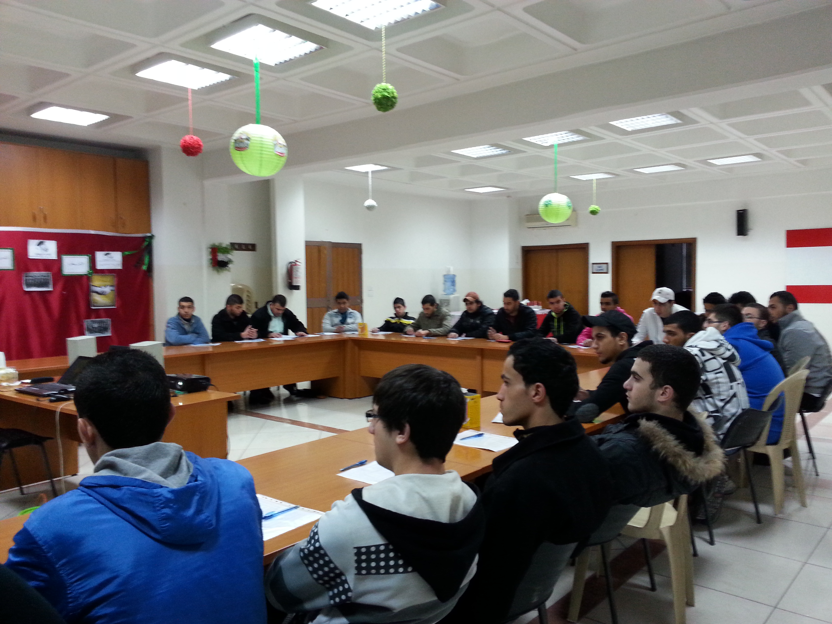
Capacity
Empty classroom seats
Empty residence hall beds
Impacted Auxiliary income
Different students in the seats
Expanded geographic footprint
Increased student exchanges
New and energizing program expansion
Celebrating retention
Ability to offer TE to dependents, the employee and their spouse/partner
Don’t forget online programs, graduate, and professional programs
This Photo by Unknown Author is licensed under CC BY-NC
This Photo by Unknown Author is licensed under CC BY

Slide 6
Program Mission and Value
This Photo by Unknown Author is licensed under CC BY
Recruitment of institutional employees
Retention of institutional employees
Recruitment of students
Retention of students
Promotion of your institution
Ability to increase your institutional profile and name recognition

Slide 7
A message from successful programs
Does your institution understand the value of TE?
How does your institution promote TE?
Explain the import/export approval process at your institution?
What does yield mean at your school?
How does your school determine export and import numbers?
Who is responsible for communicating the award, the wait list, and/or the denial?

Slide 8
Keys for success
Working together creates positive program outcomes – communication
Appointing the best individual for the TELO position – communication
Understanding the budget implications and the real program costs – funding
Knowing the institution’s true discount rate - funding
Appreciation and understanding the program’s lasting value, enrollment, retention, graduation - capacity
Recognition of robust programs with great people – students and employees – capacity
Acknowledging Tuition Exchange provides a school for every student and a student for every school!
This Photo by Unknown Author is licensed under CC BY-SA

Slide 9
Sample Materials list
Annual Report
Sharing Tuition Exchange information with families
University of Southern California Import and Export Frequently Asked Questions
How do I order promotional materials?
TELO Tuition Exchange PowerPoint presentation
This Photo by Unknown Author is licensed under CC BY-ND

Slide 10
For joining us today. We hope you found the information useful and thought-provoking. See you soon!
This Photo by Unknown Author is licensed under CC BY-NC-ND

