Slide 1
2019-20 TE recipient review 2020-21 approval and processing reminders TE reports te central updates
December 2019
104 (F) Tuition exchange Webinar
Janet Hanson, Director of Communications

Slide 2
Today’s focus
2019-20 Recipient Review
2020-21 Approval and Processing
TE Reports
TE Central Updates
Recap

Slide 3
Enrollment Report Review
Open your Enrollment Report

Slide 4
2019-20 Enrollment Report Review
Confirm your 2019-20 Enrollment Report is correct and current
Are all listed students still enrolled and eligible
If no, update the student’s expiration date
Enrollment Report – click on student’s name, then again and update the expiration date
End of this semester is 6.1.2020
End of last semester is 1.1.2020

Slide 5
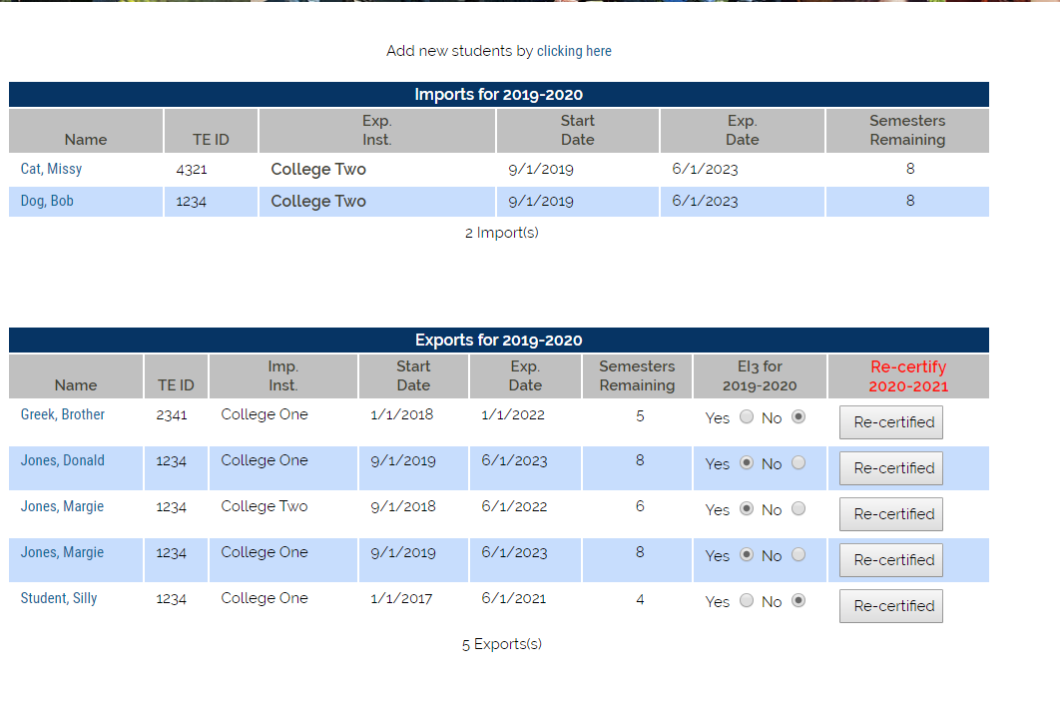
Enrollment Report Review
Confirm each enrolled IMPORT continues enrollment at your school
Confirm each Export dependent family member employed at your school remains eligible

Slide 6
Enrollment report review - Imports
Print your Enrollment Report
Confirm with the Registrar’s Office all IMPORT students successfully completed the Fall semester and are enrolled full-time for the Winter/Spring semester
If not update the student’s Expiration date (refer to slide 4 or 7)

Slide 7
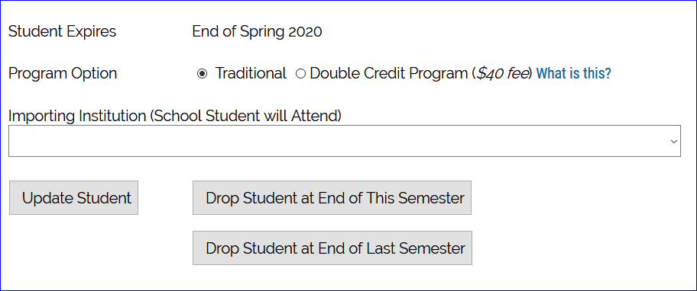
Enrollment Report Review - imports
The Registrar informs you that Nancy Doe is no longer enrolled at your school
Inside your Enrollment Report, click on Nancy’s name, then again, now, scroll to the bottom of Nancy’s record and select Drop at the END of XXX semester to update her record
A tip if in the current semester drop at the END of THIS
A second tip – if in the next semester drop at the END of LAST

Slide 8
Enrollment report review - imports
Return to your Enrollment Report and review Nancy’s record. Her expiration date is updated and her remaining semesters are 0
Emails are launched from NOINFO@ sharing a change in the student’s eligibility

Slide 9
Enrollment report review - exports
Confirm with Human Resources all employees retain their eligibility
If not update the student’s Expiration date (see slide 4 or 7) AND notify the Import school TELO immediately
Emails launch when changes are made. However, TE Central always suggest the proactive approach

Slide 10
Enrollment Report Review
Should your review result in a student not appearing on your Enrollment Report and your school is funding the student with a TE scholarship – contact Janet for further assistance
If the student attended any time during the current school year, you update the student’s expiration date
See Slide 4 or 7 for visual directions
Do not DELETE a student record as this eliminates the record completely
Should you discover a student NEVER enrolled – contact Janet for further options

Slide 11
Enrollment Report Review
Incorrect expiration dates continue to plague the system
The system calculates expiration dates based on the entering class
The system only understands whole numbers
The system doesn’t understand words in fields that expect numbers
For example – you select the student’s class as FRESHMAN – the system calculates the expected graduation date four years out
If your school awards TE for less than 8 semesters, be sure you are in contact with the importing school

Slide 12
Enrollment Report Review
Once you confirm the Enrollment Report is correct for second semester SUBMIT IT
Print a copy for your records
Your Participation Fees statement is immediately presented; and is due upon receipt.
If the Participation Fee statement shows:
a balance due, remit immediately
Note – students transferring to a different TE school second semester the EXPORT school is charged another $40 participation fee
The participation fee is no longer waived
The Enrollment Report is fluid and changes when shared student records are modified
Print your Balance Sheet
Be sure to print and save your Enrollment Report and Balance Sheet each time you modify the report

Slide 13
Enrollment Report Review
Second semester new students
Brand new student to TE
Contact the other school to confirm support
Export school must add the NEW second semester student to their Enrollment Report
Adding new second semester scholars means changes to the Enrollment Report, Balance Sheet and Participation Fees statement so be sure to review, confirm, pay, print and save the documents
Should a current student decide to transfer, the student
completes a new application with the EXPORT school.
The IMPORT school approved the request.
EXPORT school ADDS student and pays the new $40 fee

Slide 14
Enrollment Report upcoming reminders
February 2020
Financial Aid Offices will be asked to confirm all IMPORT students funded on your current academic year Enrollment Report
This confirmation is due back to TE Central by April 15
The Financial Aid Office and the TELO will work together to make any necessary corrections
As always, TELO’s are copied on all notices
Remember to review your Enrollment Report at the conclusion of Spring semester 2020
The 2019-20 Enrollment Report information is removed from the system 6.30.20
Please be prompt with your final review

Slide 15
2020-21 Application process
Application pertains to new students and Scholarship Recertification pertains to continuing students
View Submissions is were all continuing students are housed. Exports schools should recertify so that Import schools can fund the record as soon as the winter/spring term concludes

Slide 16
2020-21 recertification process – exports
Scholarship Recertification applies to continuing students
The recertification process is quick and easy
Open the Enrollment Report and check the Recertify box for each student
If the box reads Re-certified your work is done
If it reads RECERTIFY – click the button for all eligible students
If the box reads N/A review the expiration date for accuracy
Parents and Imports are anxiously awaiting current TE recipient recertifications – please recertify soon!

Slide 17
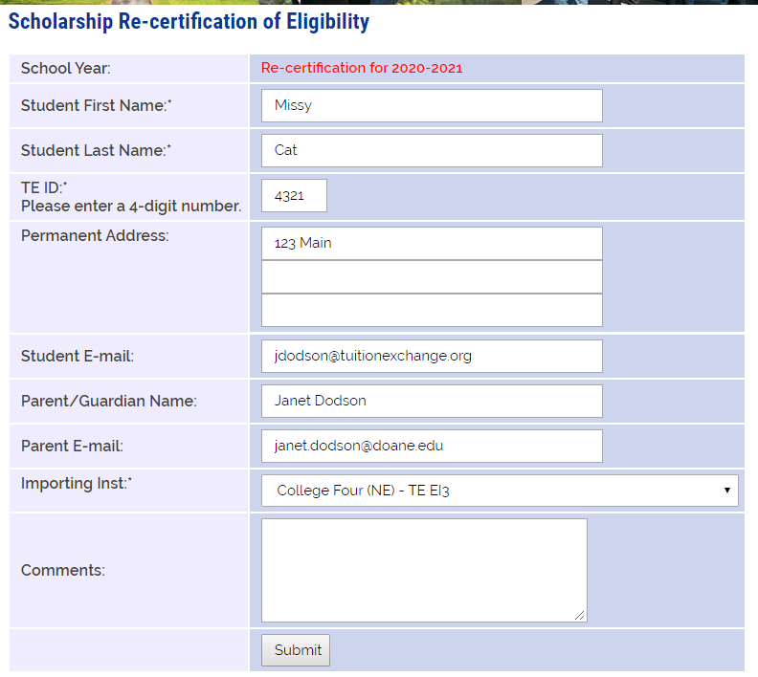
2020-21 recertification process - exports
Inside the Enrollment Report, click the Recertify button
The screen to the left opens, scroll to the bottom and click submit
The IMPORT TELO receives a notification email; and,
Provided the parent and student emails are valid emails are sent to them too

Slide 18
2020-21 recertification process - exports
IMPORT TELO EMAIL
Once the submit button in clicked, this notice appears
If there are no valid emails the message alerts you that the parent/student were not provided an update
Do not forward this email to the family!

Slide 19
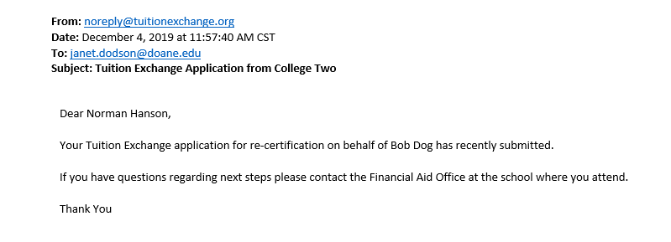
2020-21 recertification process – export email notifications
Export school recertified 20-21 record
Parent email update for 20-21 recertification record

Slide 20
2020-21 recertification process
If a Re-certified student is no longer eligible – update the student’s expiration date
Updating the expiration date trumps the original re-certification process
Review slide 4 or 7 for visual directions to update the student’s expiration date

Slide 21
2020-21 recertification process - imports
Imports require action too.
Review the View Submissions section for continuing student IMPORTS and EXPORTS who have been recertified in the current academic year for next year

Slide 22
2020-21 recertification process - imports
Click on the student’s name you wish to recertify for 2020-21
This opens up the student’s 2020-21 record
If you do not recertify each eligible student, the student will NOT appear on your 2020-21 Enrollment Report

Slide 23
2020-21recertification process - imports
Each IMPORT school must complete the information for EACH eligible import
The scholarship amount is the dollar amount the student will receive in TE funds for the 20-21
Whole numbers only and NO $ signs, commas, periods or cent signs
Years is the total number of years you expect to support the student (if unclear, enter 4)
Approved click Yes
Comments are shared with the other school
Be sure to click SUBMIT

Slide 24
2020-21 Application process – new student
Engage the EZ application option
The EZ app can free up your time for other important tasks
If you engage the EZ app you still control the approval process
TE Central is curious why your school is not using the EZ app process. If you are currently not using the process, be on the lookout for a survey
We want to be sure all understand the value of the EZ app.
Complete the application via the Application option in your TELO portal
When you add the application you are automatically approving the application when you click submit!
Remember you must click preview, close the preview screen and then click submit

Slide 25
2020-21 application process – new student
Often students want their applications sent to many schools. To accommodate their request use the following instructions
Students may ask that you submit TE applications after their original application is submitted
The TE System has school specific tables rather than student specific tables
This means that when students ask you to add more schools to their application
– you start again with a NEW APPLICATION or the student completes another EZ App

Slide 26
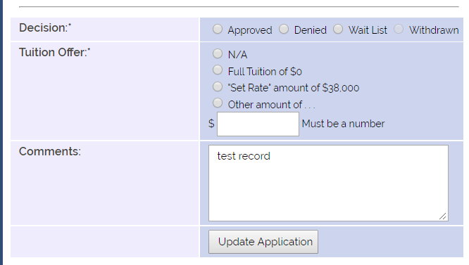
2020-21 application process - import
The Import school needs to review the Decision Pending section often and…
APPROVE - means your school will fund the student or
DENY – is a multi-purpose word
either the school denies the student the award OR
the student declines the award by saying no OR not completing the admission application process or
WAITLIST – means you will consider the student should a spot become available

Slide 27
2020-21 TE EZ application email confirmation

Slide 28
2020-21 application process – import
When approving an IMPORT application you click Approved, one of the three tuition options AND the tuition amount
Comments are shared with the EXPORT school
Be sure to click Update Application
This Photo by Unknown Author is licensed under CC BY

Slide 29
2020-21 application process – email communication
Parent email
Student email
Above is an example of a NEW TE scholar email. These emails are mailed from a NoReply email address.
This email box is not monitored. No emails for deny, withdraw, or waitlist are sent to families.

Slide 30
Telo report options
Firefox or Chrome work best with the TE portal
Reports can be downloaded and then uploaded to your CSM system
The details presented in the report are the details entered on the application either by the family or TELO

Slide 31
Telo report imports/exports
Click Tools for download options
Click the + to expand the year
The school year is reflective of the end of the academic year. For example, 2017 is 2016-17

Slide 32
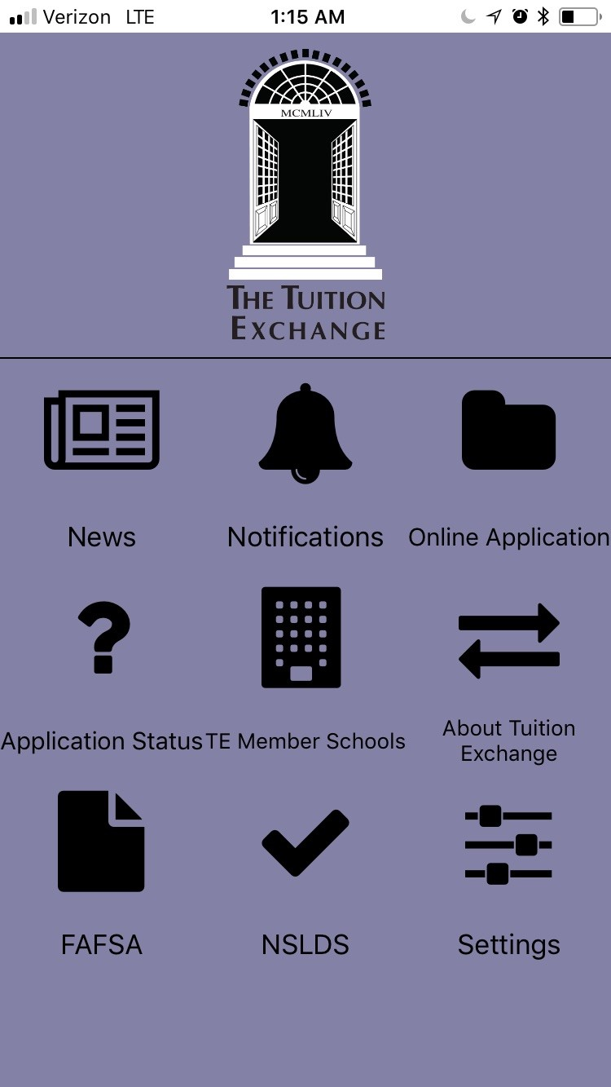
TE Central updates
Set-Rate
2019-20 is 37,000
2020-21 is 38,000
Schools 2020-21 tuition can be updated in January
Tuition Exchange – there’s an app for that…
Apple Store – search Tuition Exchange
Google Play Store – search Tuition Exchange

Slide 33
Te Central updates
Check out the latest addition to the Families section
Each TE member school can be found on the google map
TE assumes no responsibility for your school’s Google rating

Slide 34
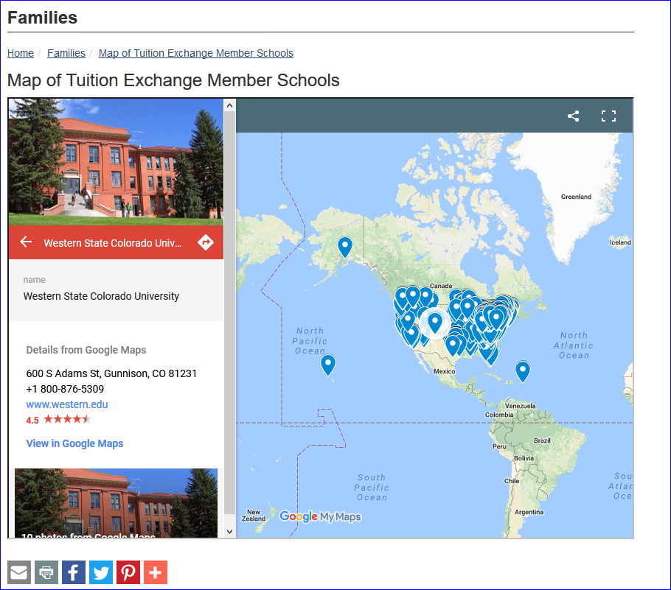
Te central updates

Slide 35
Calendar reminders
TE-GO details announced
Training calendar will be updated with Spring dates soon http://www.tuitionexchange.org/vcalendar/
TE Holiday schedule
TE Central will be closing at 5:00 p.m. December 20
TE Central will reopen at 9:00 a.m. January 6
Email and phone calls will be reviewed sporadically
This Photo by Unknown Author is licensed under CC BY-SA-NC

Slide 36
Let’s Recap
2019-20 Recipient Review
2020-21 Approval and Processing
TE Reports
TE Central Updates
Recap

