Slide 1
TE 103
Janet Hanson and Bob Shorb
April 2020

Slide 2
Today’s Focus
TE Guidelines
What’s in yours?
Balance Sheet scenarios
Let’s do the Math
Issues of Employee Eligibility

Slide 3
TE Guidelines
Define
Define your program inclusions
Define
Define your audience of participants
Define
Define your process

Slide 4
TE Guidelines
Program inclusions
Undergraduate programs
Degree-completion programs
Graduate programs
Professional degree programs
Locations
Main campus
Branch campuses
Online

Slide 5
TE Guidelines
Define audience participants
Employees
Required length of employment
Type of eligible employment
Full time
Regular part-time
Adjunct
Visiting faculty
Consultant
Eligibility
Calculation and determination of years of service
Application priority deadline
What if both parents are employed at a TE school
Multiple student issues

Slide 6
TE Guidelines
Define audience participants
Who is a dependent
Biological child
Step-children
Other child issues
Employee
Employee spouse/partner

Slide 7
TE Guidelines
Student enrollment expectations
Full time
Degree seeking
Undergraduate
Eight semesters or graduation, whichever comes first
Graduate or Terminal/professional degree
Four semesters or graduation, whichever comes first
Other considerations
Less than full time enrollment
TE scholars wanting to transfer
TE scholars taking a leave of absence for more than one consecutive semester

Slide 8
TE Guidelines
Defining your process
Export
The E is for employees
Import
The I is for incoming students

Slide 9
TE Guidelines
Tuition Exchange is not an employee benefit
Consider mirroring your campus Tuition Remission guidelines
Tuition Exchange is truly a scholarship program

Slide 10
TE Guidelines
Exports
Explain how employees are approved
Years of service
First-come, first-serve
Every application is assigned a number and on X date, using www.random.org a pre-determined number of applications are approved and entered into the TE system for Import consideration
Consider implementing an application priority date
Keep employees informed
Don’t forget mitigating circumstances occur
Consider allowing prior higher education experience in your years of service calculation

Slide 11
TE Guidelines
Imports
Explain how students are approved
First-come, first-serve
Academic requirement
Geographic footprint
Wait list considerations
Consider implementing an application priority date
Keep applicants informed
Don’t forget mitigating circumstances happen

Slide 12
TE Guidelines
Continuing student renewal
Exports
Continued eligible employees
Recertify
Employees who
Resign
Loose eligibility immediately or at the beginning of the next enrollment period
Retire
depends
Reduction in Force (RIF)
depends
Pass-away while employed or on long-term disability
TE Central encourages maintaining employment eligibility
Be sure to cover yourself with a mitigating clause

Slide 13
TE Guidelines
Continuing student renewal
Imports
Continuing scholars
Enrollment
Full time each term
Academic credentials
Meet or exceed the credentials
Maintain eligibility
Below the required credentials
Loose funding at the beginning at the next term
Be sure to cover yourself with a mitigating clause

Slide 14
TE Guidelines
Where are TE Guidelines published?
Employee Handbook
College Catalogue
Student Handbook
How do you ensure EXPORT families understand program expectations?
Memo of Understanding
How do you ensure IMPORT students understand program requirements?
College catalogue
Student handbook

Slide 15
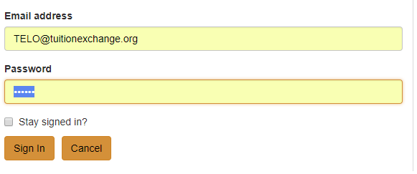
TE Guidelines
www.tuitionexchange.org
Select the TELO ONLY Resource section
All use the SAME email and password to access this portal
Telo@tuitionexchange.org
TELO14
Communication folder – look for TE Guidelines template
A skeleton template is available inside the
Prospective Membership tab

Slide 16
Balance Sheet
Your school
An example
Use the cheat sheet

Slide 17
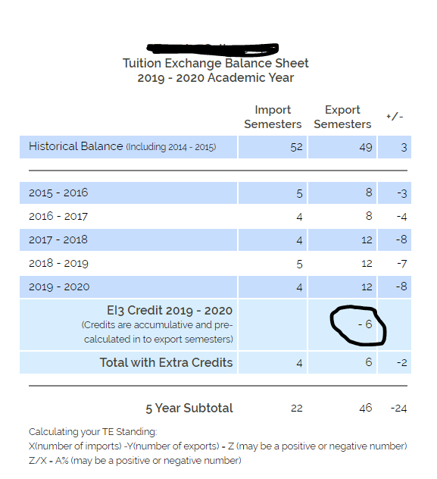
Scenario One as an E/I 3 school
22 imports
-46 exports (E/I 3)
-24
(-24/22) x 100 = (109)%
Still on Restriction but…
E/I trumps all

Slide 18
Let’s do the math remember it is the order of operation
Print out your Balance Sheet
Five-year total
number of Imports _______________
minus
Five-year total
number of Exports _______________
this box
is your X
(X divided by # 5 year of imports) = ___ ?
? X 100 =____ %
Status
Any positive % to -59% is good standing
-60 to -99 is Alert
-100 and beyond is Restriction
Remember an E/I 3 school can always export three NEW students every year!

Slide 19
Issues of Employee Eligibility
Full time employees
Less than full time employees
Adjunct employees
Furloughed employees
Reduction in Force employees
Laid-off employees
Early Retirement

Slide 20
Issues of Employee Eligibility
Full time – no change but please be sure your TE guidelines outline how long the employee must be employed before she is eligible
Less than full time – if always eligible in this status – refer to your guidelines again make sure your TE guidelines outline how long the employee must be employed before she is eligible

Slide 21
Issues in Employee Eligibility
Adjunct - if always eligible in this status – refer to your guidelines again make sure your TE guidelines outline how long the employee must be employed before she is eligible
Contract employees - if always eligible in this status – refer to your guidelines again make sure your TE guidelines outline how long the employee must be employed before she is eligible

Slide 22
COVID – 19 challenges
Furlough – what does this mean at your school?
Person will be rehired for the same job and the same wage.
If yes, TE Central suggests continuing the student’s eligibility.
Stay in touch with HR confirming the employee returns once furlough is lifted

Slide 23
Reduction in Force - RIF
RIF – what does this mean at your school? Is this any different than Furlough?
Person will be rehired for the same job and the same wage
If yes, TE Central suggests continuing the student’s eligibility
Stay in touch with HR confirming the employee returns once RIF is lifted

Slide 24
Laid-off
Person is no longer employed, and her job is no longer available to the individual
The former employee can apply for other open jobs on campus and will considered as a new employee for purposes of benefits, include Tuition Exchange and Tuition Remission

Slide 25
Early Retirement
This individual accepts an early retirement option from the institution and is no longer considered a full-time employee

Slide 26
Consider the following
Furlough, Reduction in Force, Early Retirement maintain eligibility for Tuition Exchange scholarship new and renewal
In your exit letter consider including the following caveats
Do not request any special condition consideration at the Import school
Student must remain at the Import school - no transfer options
If the parent obtains employment at another TE school, eligibility is transferred at the end of semester
Student is eligible for a maximum of eight semesters or graduation whichever comes first
No gap year option
The award is not transferable
Laid-off employee loose eligibility immediately. If the individual is laid-off mid-semester update the expiration date to the end of that semester

Slide 27
TE Central updates and reminders
2020--21 Set Rate will be 38,000
2021—22 Set Rate will be 39,000
As a reminder if your tuition is less than the set-rate you are obligated to provide tuition. If your tuition is at or greater than the current year’s set-rate you are obligated to provide at least set-rate
Offering Room credit? Be sure to double the number on your Enrollment Report
Print a final copy of your Enrollment Report and Balance Sheet no later than June 15
Make sure all your eligible student EXPORTS are recertified
We will have mandatory training beginning in July

Slide 28
Thank you for your dedication and flexibility- you are the best of the best!

Slide 29
Enjoy a little music My good friends, Mike and Karen Morris deliver an hour of great music. https://www.facebook.com/1402625299/videos/10217656429548184/

Slide 30
One more for the road! https://www.facebook.com/trippandtyler/videos/2635428640080308/
Please take care and stay well! See you in July

