Slide 1
TE Spring Review
Janet Hanson and Bob Shorb
March 10, 2020

Slide 2
Today’s Focus
Tuition Exchange lends a hand to employees at recently closed schools
Tuition Exchange Grant Opportunity update
Spring Tuition Exchange File Review
Financial Aid Office scholarship review
Continuing student Recertification
Continuing Student Funding
New Student Import Review
This Photo by Unknown Author is licensed under CC BY-NC-ND

Slide 3
Tuition Exchange lends a hand

Slide 4
Students currently in the system
Are contacted and can retain the scholarship if
The family pays the administrative fees timely AND
The student maintains her academic eligibility
The student is unable to transfer schools or stop out in this program
Funds are non-refundable

Slide 5
Fall, 2020 student imports
Are offered the opportunity to purchase eligibility for up to four years/eight semesters
Must enroll in Fall 2020 and remain enrolled at the same school for entire length of program
Must meet academic requirements of the Import school to retain the scholarship
Janet at Tuition Exchange serves as the school’s TELO

Slide 6
Tuition Exchange Grant Opportunity update (TEGO)
This Photo by Unknown Author is licensed under CC BY

Slide 7
TEGo
Received 62 nominations
59 completed the preliminary paperwork, one has since withdrawn their application
Completed applications are reviewed by four TE Board Members
Decisions will be announced mid-April
Checks are mailed to the Import schools in August

Slide 8
Spring Tuition Exchange File Review
Review your Enrollment Report
Did all return? If no, update the non-returners expiration date
Did you add new scholars for the Spring 20?, If yes, be sure to click the enrolled button and email Janet
Review your Balance Sheet making sure it matches your Enrollment Report
Have you recertified all eligible EXPORTS/ See handout or video clip
Be sure to submit the Enrollment Report and Balance Sheet printing and saving a copy of each
Is your 2020 Tuition listed correctly? Check inside the Institutional Account information section
Set-Rate for 2020-21 is $38,000. As a reminder all member schools are obligated to provide full tuition OR Set-Rate, whichever is less to all TE scholars.

Slide 9
Financial aid office review now available
This Photo by Unknown Author is licensed under CC BY-SA

Slide 10
This Photo by Unknown Author is licensed under CC BY-NC

Slide 11
Import confirmation report
The instructions are up-to-date and walk the FA through the process. See handout TE 19-20 Enrollment Confirmation instructions handout
Please review your Institutional Account to confirm the Financial Aid Director is listed correctly
If wrong, notify Janet with the new name and new email address so that corrections can be made and the new Financial Aid Director can be emailed login details

Slide 12
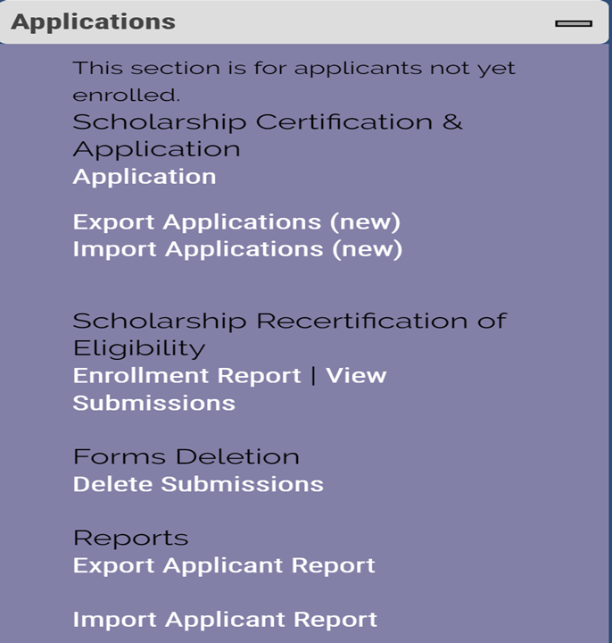
Continuing student recertification
Recertifying Eligible 2020-21 continuing student
TE scholars – EXPORT school only
Open your Enrollment Report

Slide 13
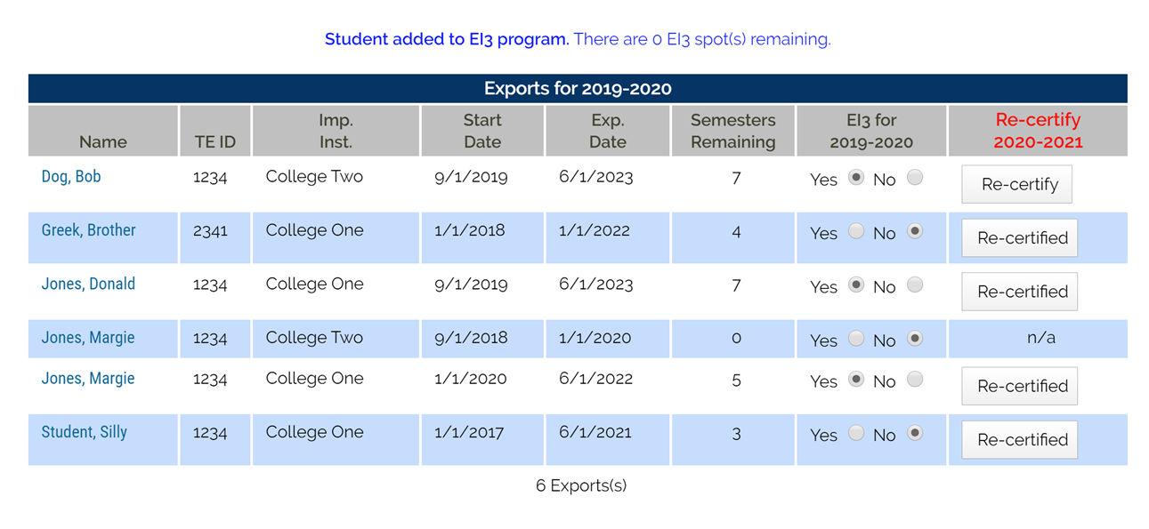
Export recertification
Scroll to the EXPORTS for 2019-20 and review the section titled Re-certify 2020-21
If the box reads Re-certified your work is complete.
If the box reads Re-certify you need to click the Re-certify box, following the prompts to update the record.
If the box reads N/A double check the Exp. Date. If the date is WRONG, contact Janet to update the date. Email is best, include the student’s name, TEID, and the NEW expiration date.
DO NOT create a new application for continuing students returning to the same school.

Slide 14
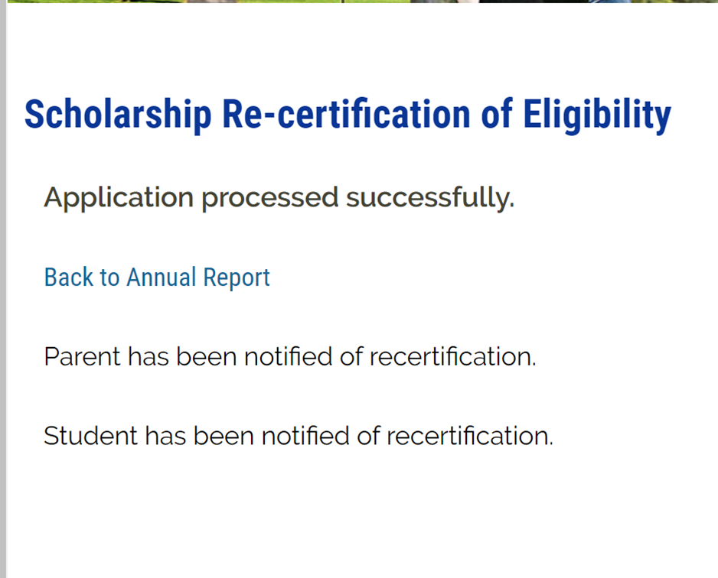
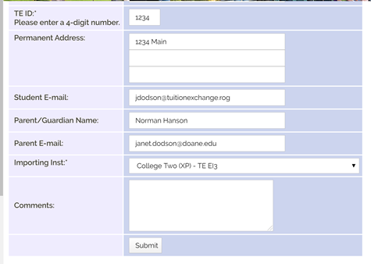
Recertifying

Slide 15
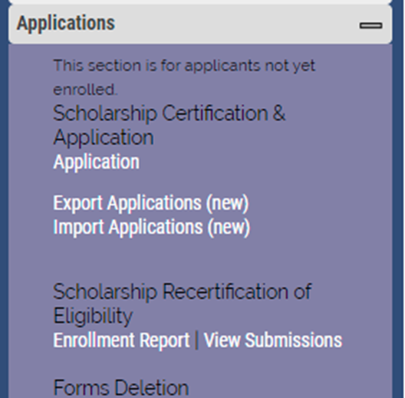
Funding eligible Continuing import students

Slide 16
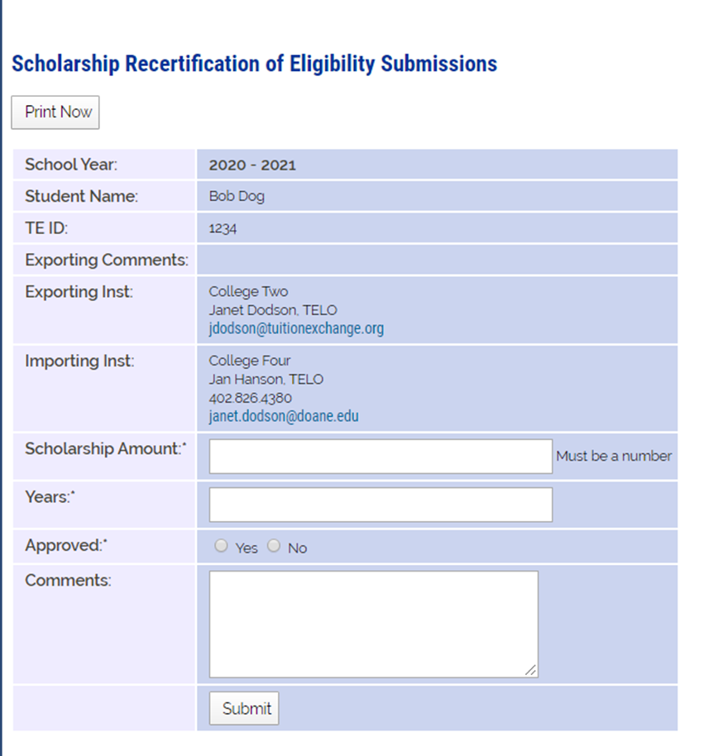
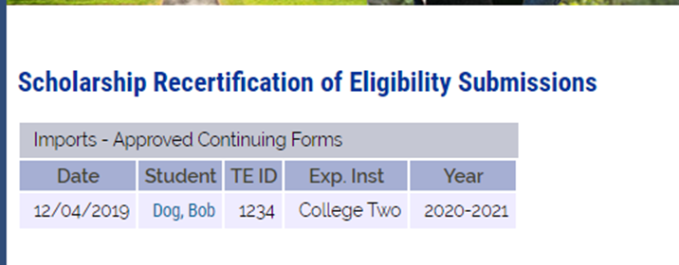
Funding eligible continuing students
Import school funds eligible continuing students
Scholarship Amount is tuition or set-rate
Years always 4
Approved Yes if eligible
No if not eligible
Comments – your choice
Submit

Slide 17
IMPORT Reminders - before July 1
Confirm with Financial Aid student is eligible to receive funding for the upcoming academic year
Confirm with the Registrar the student is enrolled for the upcoming semester/term
If yes to both issues above – approve see slide 15
Update Financial Aid regarding next year’s TE scholarship amount

Slide 18
EXPORT Reminders – do before May 30
Confirm with Human Resources parent is eligible to receive scholarship approval for the upcoming academic year
Confirm with the current year TE Enrollment Report the student continued throughout the current academic year
If yes to both issues above – recertify see slide 12
See Recertification 20-21 PowerPoint for quick instructions

Slide 19
New Student Import Review

Slide 20
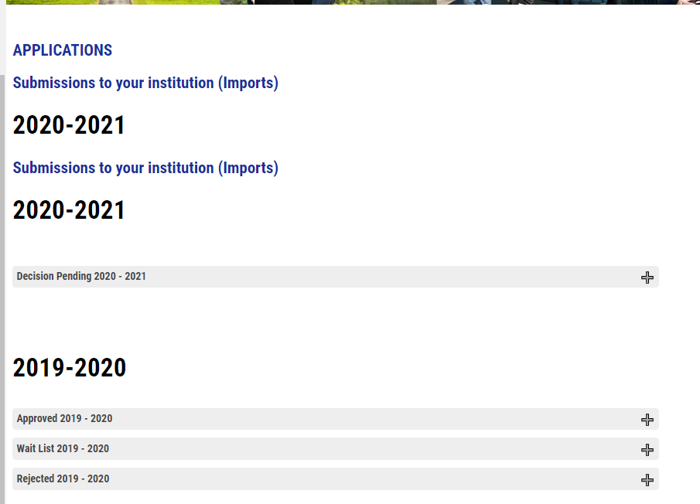
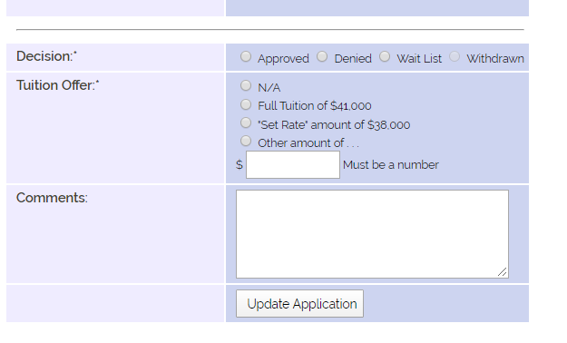
Import review reminders
Decision Pending means action is needed
Open the record and
Approve
Waitlist
Reject
Be sure to click the correct radio button
Inside the Tuition Offer
Add comments – keep them simple
Click Update Application

Slide 21
New Student Export Review

Slide 22
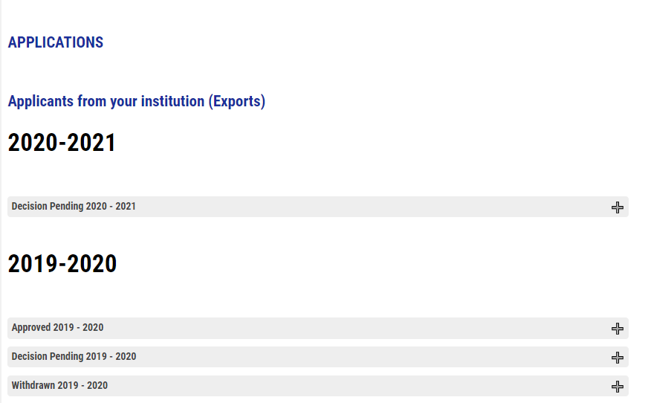
Export Review Reminders

Slide 23
Reports

Slide 24
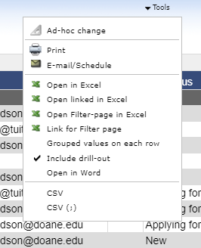
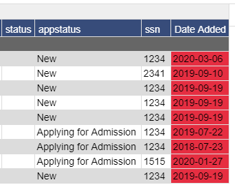
The Report

Slide 25
Some other things
Coronavirus
Institution Information
Participation Fees all paid???
Question 5 on Mandatory Institutional Profile now asks online programs available with potential TE scholarship Please confirm your answer!
Invoice Contact inside Account Information
Need an updated w-9? You can find it online
A new face for our website
New marketing and parental materials coming soon

Slide 26
We all need a break
Don’t be this Missy Cat
Be this Missy Cat and snuggle with warm towels

Slide 27
What’s next
March 24th at 1:00 central daylight time
FERPA and NACAC update
Thanks for joining us today and aren’t you glad we met via a webcast
This Photo by Unknown Author is licensed under CC BY-SA

