Slide 1
Tuition Exchange Monthly webinar November 2019
Janet Dodson
Director of Communications

Slide 2
Today’s focus
Tuition Exchange Bloopers and Blunders
Keeping 2020-21 applications up to date
Confirmation and clean-up of 2019-20 application

Slide 3
Blunders and Bloopers
TE Central appreciates all questions asked by schools and families;
This section is developed to help better understand how misconceptions occur; and
Thank you for all that you do to promote higher education.
So hypothetically speaking, lets tackle the Blunders and Bloopers…

Slide 4
Blunders and Bloopers
Parent conversations
I work at The School of Janet and my wife will be using my TE benefit – how does this work?
My dependent is enrolled at The School of Janet – where is the rest of my $37,000 benefit payment?
My TELO is new – I don’t trust her information. What are the guidelines, so I know how to get the best bang for my TE benefit?
I completed the EZ app, but I don’t remember the names of the schools selected. Please send me the application so I can make sure I did it right.
How come I won’t know about my dependent’s award until April? I applied in August.
Why isn’t my dependent’s TE award the full tuition amount? I was told by my TELO, and I trust her, that I would get full tuition.

Slide 5
Blunders and Bloopers
Parent conversations continued
I work at the School of Janet and my spouse works at the School of Bob. We will complete applications at each school so that my dependent’s application is twice as likely to be selected.
What is this balance thing. TE is a benefit – I don’t care if my school is out of balance. That is not my problem!
I completed the EZ app but my school can’t find it. Where is it?
My student’s app status doesn’t show. Why doesn’t your system tell me what I need to know?
My dependent only received denial notices. What happened to the promise of TE? My export school told me I was eligible.

Slide 6
Blunders and Bloopers
School questions and emails
I don’t see Janet’s application. Her mother told me she submitted it last night.
Janet’s mother calls me every day asking when the TE IMPORT applications will be approved. What is the timeline?
Janet’s mother received an email informing her the EZ app was denied. What gives, I didn’t even approve it.
I am the EXPORT TELO and somebody else on my campus is approving application without my knowledge. How is this happening?
Janet’s mom entered her birthdate and email address on the EZ app. But she doesn’t remember which email she entered. Can you tell me what email was entered?
I don’t want to use the EZ app. How do I turn the EZ app function off for my school?

Slide 7
Blunders and Bloopers
School questions and emails continued
Help! I have Import students on my Enrollment Report as Exports.
Why don’t my new students show up on my Enrollment Report?
Hey, where are continuing students Kristine and Mary? They are not appearing on my Enrollment Report. We are funding them this year.
What exactly is E/I 3?
I don’t understand DC 3?
How do I delete a record?
I don’t want all these extra records on my View Applicant area anymore. Can I delete them all now.
The application report won’t print. What’s wrong?
I want to add more TELO access. How do I do that?
Why can’t we have just one TELO access instead of individual access?

Slide 8
Blunders and Bloopers
School questions and emails continued
How do you get into the TELO Only Resource Section?
I am the president’s secretary and I need access to the system.
What is the Set-Rate?
We approve all employees seeking EXPORT as applications are received. Once we hit our limit, we will cancel those with less seniority and replace them with applications of employees with more seniority.
I want to modify your emails sent to parents. How do I do that?
The TELO left 2 months ago and now it is my job. What do I do?
We charge employees the Participation fee. The individual employees will be sending you a check. What is the best address?
I need to pay by credit card.

Slide 9
Keeping 2020-21 applications up to date
EZ app school
TELO entering applications on TELO portal

Slide 10
Keeping 2020-21 applications up to date
Using the EZ app
Congratulations you just freed up time and data entry energy
Emails keep you in the know
Families can monitor the status of their EZ applications
Families can monitor the status of a paper application too
The Export TELO controls the certification process

Slide 11
Keeping 2020-21 applications up to date
Once the family clicks submit, the message is immediately displayed. The EZ application is recorded at the Employer school. Please remind employees TE is not possible at the home school.

Slide 12
Keeping 2020-21 applications up to date
Tuition Exchange (The) has submitted an application to your institution for test tester. Please review the application online at: http://telo.tuitionexchange.org/liaison/ If you have a problem accessing this application, please forward this e-mail to mailto:jdodson@tuitionexchange.org (Application ID: 291445)
Check out the body of the email. You know the name of the student.
Do not share this email with the family. The link does not take them anywhere and causes confusion for all
The email is sent from a NOREPLY address. Please add the email address to your safe list.

Slide 13
Keeping 2020-21 applications up to date
Initial email sent to the EMPLOYEE informing the employee of next steps. The email launches immediately after the app is submitted

Slide 14
Keeping 2020-21 applications up to date
This email is sent to the EMPLOYEE informing the family the EZ application is approved for Export.

Slide 15
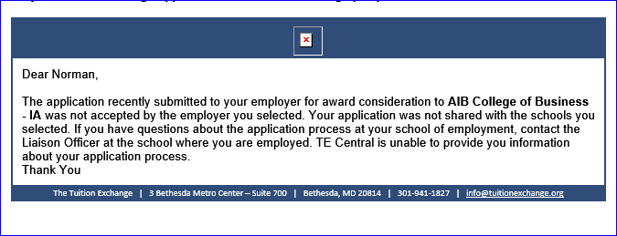
Keeping 2020-21 applications up to date
Families don’t always read directions or utilize the self-help tools provided.
This email tells the EMPLOYEE the application was denied by the employer selected.
The email directs the family to contact their TELO. As a reminder, the family may have selected the wrong school as their employer or the wrong academic year.

Slide 16
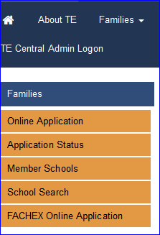
Keeping 2020-21 applications up to date
Families can monitor their dependent’s application status – again freeing up your time and energy

Slide 17
Keeping 2020-21 applications up to date
The information entered here is applicant information. Encourage families to review the power point provided or better yet listen to the
9-minute webcast.
The information must match perfectly. It is amazing how families don’t enter the details correctly. TE Central receives roughly 10 calls weekly asking for a copy of their application. Since Personal Identifiable Information (PII) is involved – TE Central WILL NOT assist. We encourage them to contact their EXPORT TELO.

Slide 18
Keeping 2020-21 applications up to date
Each EZ application has a status. It is important for you to communicate the approval timeline with your employees.

Slide 19
Keeping 2020-21 continuing students up to date
Mom’s are nervous – no action on their continuing student.
Remind parent’s it is now the student’s responsibility to maintain eligibility.
The status of NEW for continuing students means the EXPORT school recertified the student on the Enrollment Report.

Slide 20
Keeping 2020-21 applications up to date
The EXPORT TELO’s control the process because only you can APPROVE or DENY the EZ app!
The student application above requires EXPORT TELO attention. To open the record, click on the student’s name. Now either Approve or Deny the application for Export!
Should the family want a copy of the application click print now

Slide 21
Keeping 2020-21 applications up to date
When the EZ app is approved for Export the record looks like this
When the EZ app is denied for Export the record looks like this

Slide 22
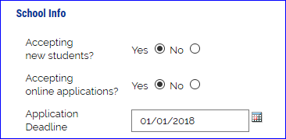
Keeping 2020-21 applications up to date
As you receive notification of new EZ apps please take action
Approve means the employee meets your EXPORT eligibility guidelines
Deny means the employee does not meet your EXPORT eligibility guidelines
If your school has an application deadline share it!
Institution Account – then Institutional Information
Don’t have an application deadline list the first day of school next fall
The date is shown on the EZ app for employees to see
A date in the past does not stop the EZ app but may help the family realize their EZ app is late

Slide 23
Confirmation and clean-up of 2019-20 applications
The Enrollment Report is your TE scholarship export and import confirmation
The report was due September 30
The Enrollment Report instructions are up to date and provide answers to many questions asked daily
Once the Enrollment Report is submitted, your Participation Fee invoice displays
Your Participation Fee invoice payment is due upon receipt
You can submit your Enrollment Report as many times as you feel the need

Slide 24
Confirmation and clean-up of 2019-20 applications
Review your Enrollment Report – who is missing?
Most likely NEW Imports and Exports
Mandatory training walks you through the process
The webinar remains available all year long.
Imports click the Enrolled Box
By clicking the Enrolled box an email is launched to the EXPORT school
ONLY the Export school can ADD STUDENT

Slide 25
Confirmation and clean-up of 2019-20 applications
This email tells the EXPORT TELO to ADD STUDENT. Until the EXPORT School adds the student, the student does not show up on your 2020-21 Enrollment Report. PLEASE be prompt!

Slide 26
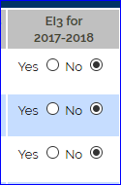
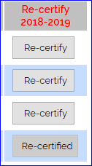
Confirmation and clean-up of 2019-20 applications
E/I 3 schools – not sure if you signed up for E/I 3?
Be sure to select three NEW exports annually
EXPORT Schools click the Re-certify 2019-20 button
Can only click once and the word Re-Certify changes to
Re-CERTIFIED once clicked
Clicking the Re-Certify button moves the student details
forward to the 2020-21 database
Double-check ALL expiration dates
If the date needs to be expanded, email
Janet with the details EXPIRATE date
trumps everything else.

Slide 27
Confirmation and clean-up of 2019-20 applications
Be sure to provide the exact tuition charged all students or weighted average if tuition charges vary by student or program. Your Financial Aid Office can provide this information.
The value of your TE scholarship may be different than your basic tuition charge. Again, your Financial Aid Office can help if you are uncertain.
Extra credit for room is now one (1) credit per semester!
Be sure to click SUBMIT

Slide 28
Confirmation and clean-up of 2019-20 applications
If your school submits payment via ACH please email Kristine Lev when your ACH payment is launched.
ACH details provided by your financial institution is not always clear about the name of your college

Slide 29
Confirmation and clean-up of 2019-20 applications
Once you submit your Enrollment Report, the Balance sheet becomes available. Be sure to review the Balance sheet carefully and read the messages

Slide 30
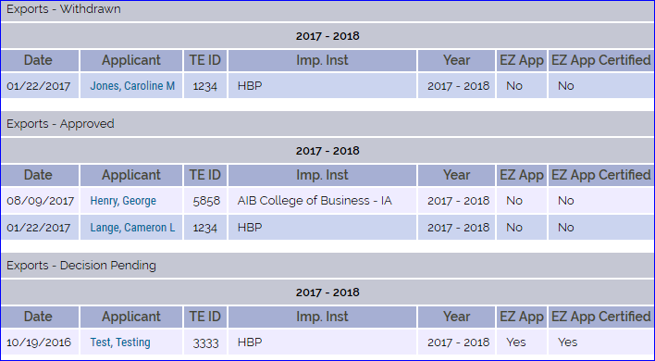
Confirmation and clean-up of 2019-20 applications
Application clean-up is an important task
Once your Enrollment Report is complete
Make sure all your Exports Decision Pending for 2019-20 are withdrawn
Make sure all your Import Decision Pending for 2019-20 are denied
If an approved IMPORT does not enroll – update the status to DENY
DENY is a multi-use word In this case the student denied your school their enrollment

Slide 31
Confirmation and clean-up of 2019-20 applications
Be sure to print and save every time you submit your Enrollment Report and Balance Sheet
TE Central captures at the end of year only the final Enrollment Report and Balance Sheet
The Enrollment Report and Balance Sheet are organic
it is difficult to track what changed without a copy of the documents submitted previously
Mark your calendar today to remind you to review your Enrollment Report at the end of first term, start of the second term, and finally after the end of your Spring term.
Keep a copy of each report you review
TE Central is unable to reproduce any previous current year Enrollment Report

Slide 32
Let’s Recap
Keeping 2020-21 applications up to date
Confirmation and clean-up of 2019-20 applications
Tuition Exchange Bloopers and Blunders

Slide 33
Thanks and see you soon!
Be sure to take a walk and enjoy all the beauty of this Fall season!

Slide 34
Thank you for all you do to promote higher education
Questions – please contact Janet at 402.418.1081 or by email at jdodson@Tuitionexchange.org

