Slide 1
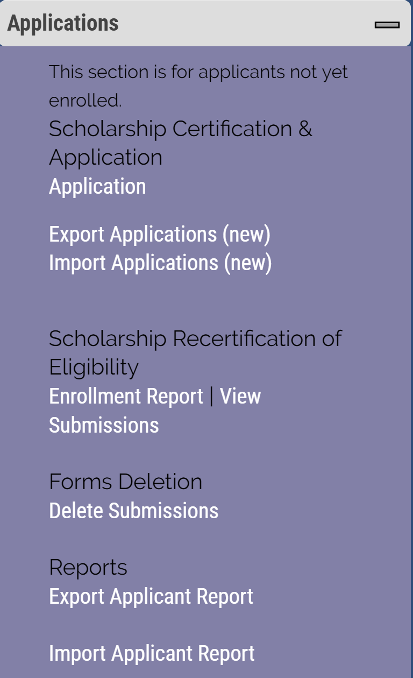
Recertifying Eligible 2020-21 continuing student
TE scholars – EXPORT school only
Open your Enrollment Report

Slide 2
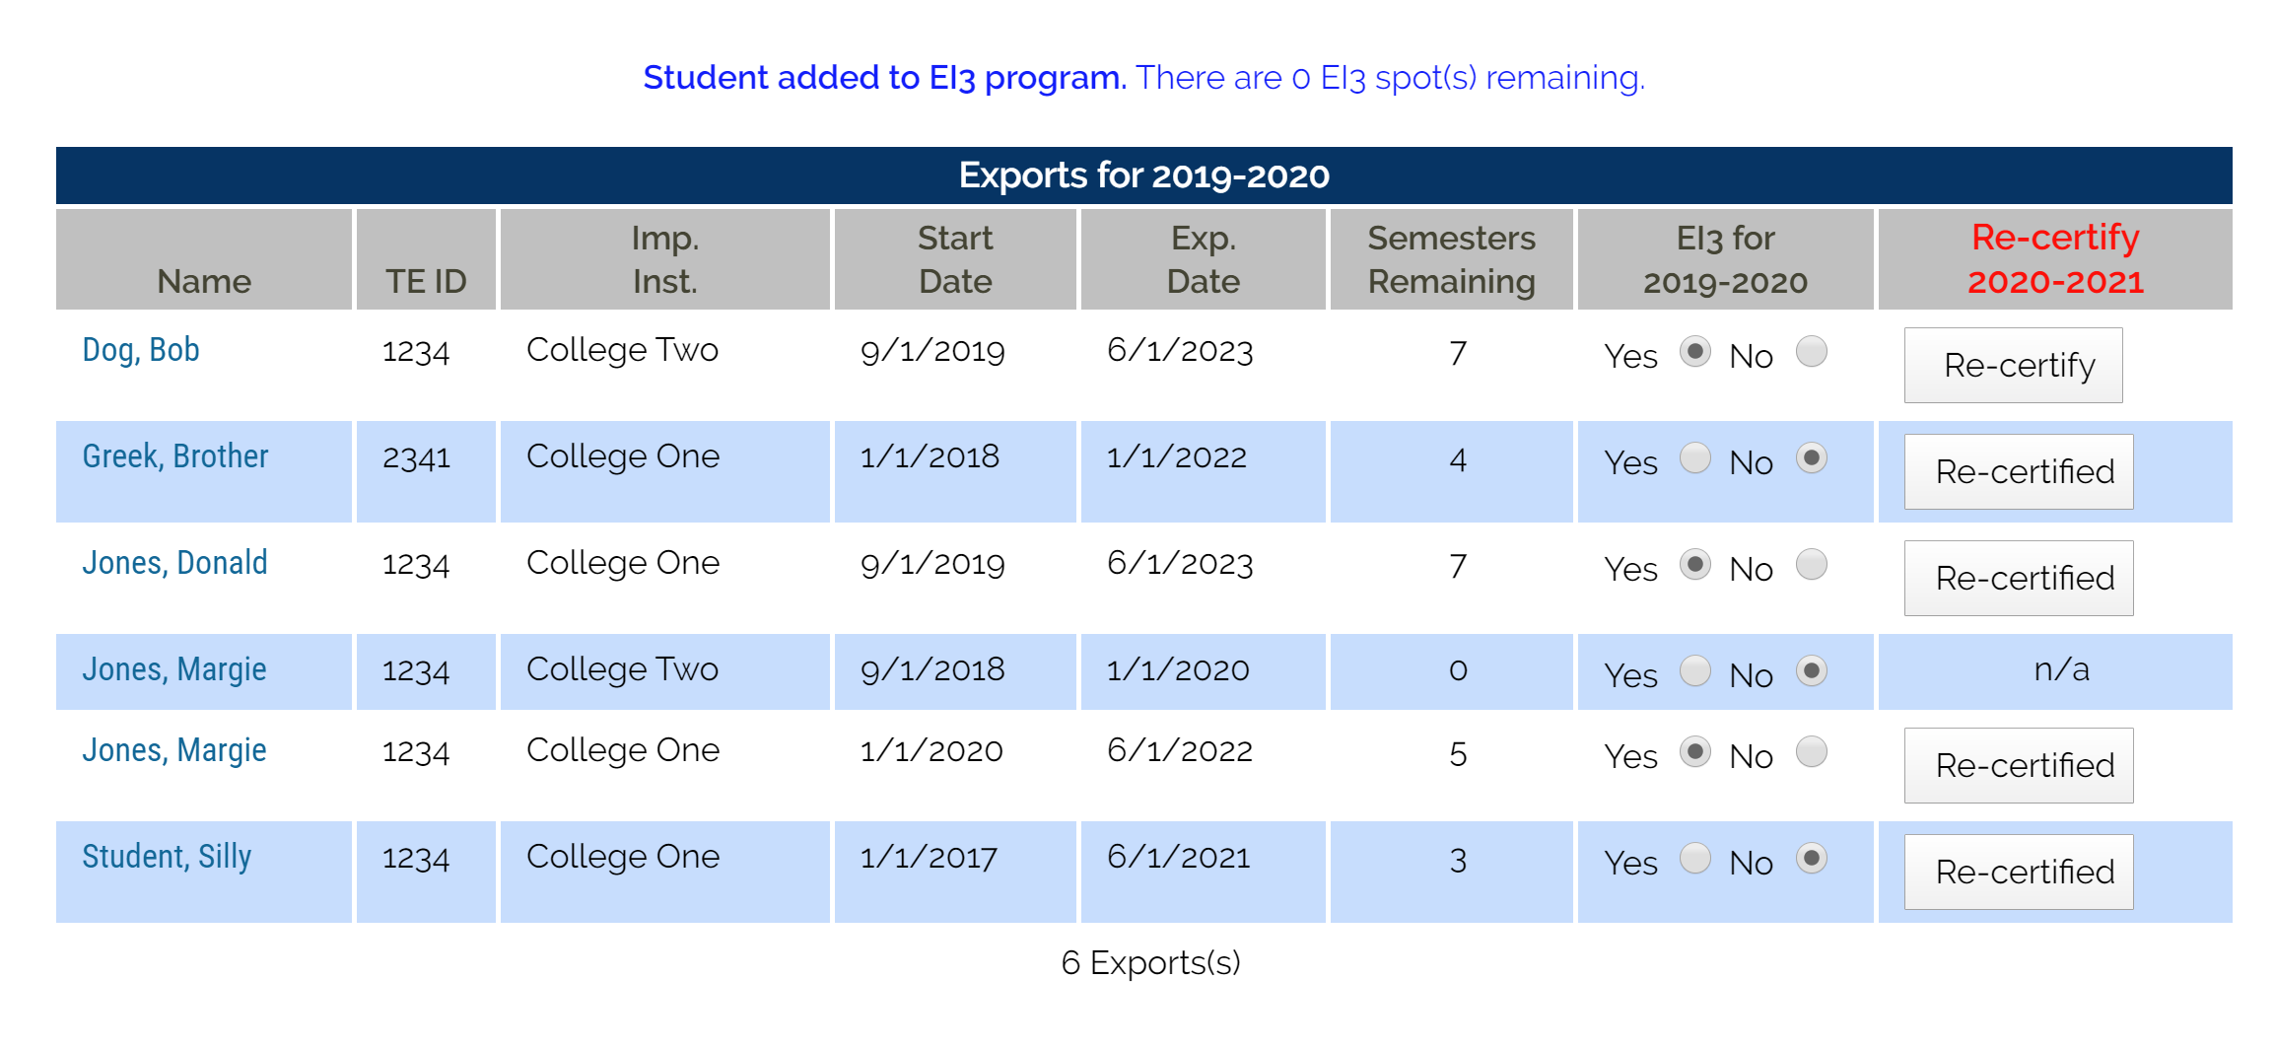
Scroll to the EXPORTS for 2019-20 and review the section titled Re-certify 2020-21
If the box reads Re-certified your work is complete.
If the box reads Re-certify you need to click the Re-certify box, following the prompts to update the record.
If the box reads N/A double check the Exp. Date. If the date is WRONG, contact Janet to update the date. Email is best, include the student’s name, TEID, and the NEW expiration date.
DO NOT create a new application for continuing students.

Slide 3
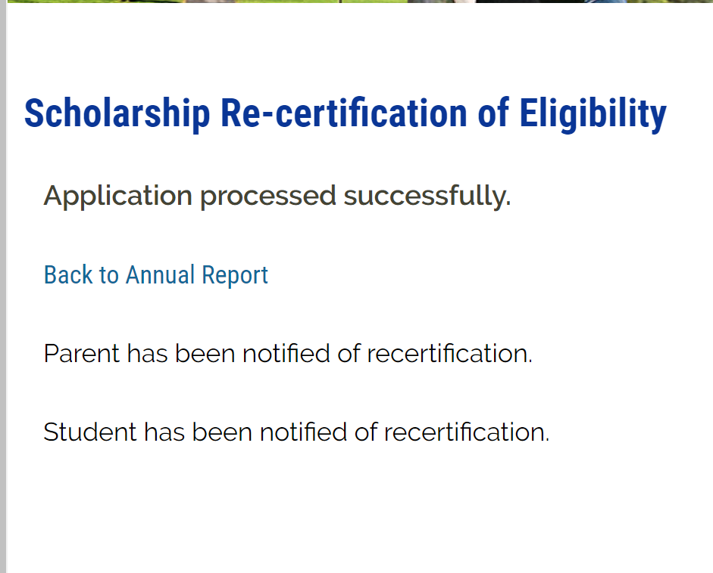
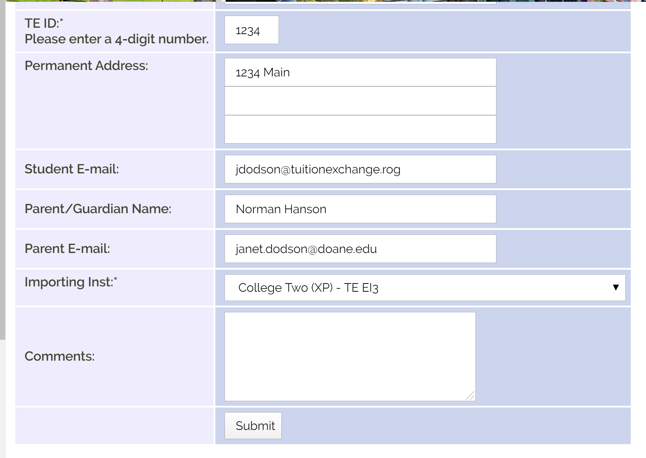

Slide 4
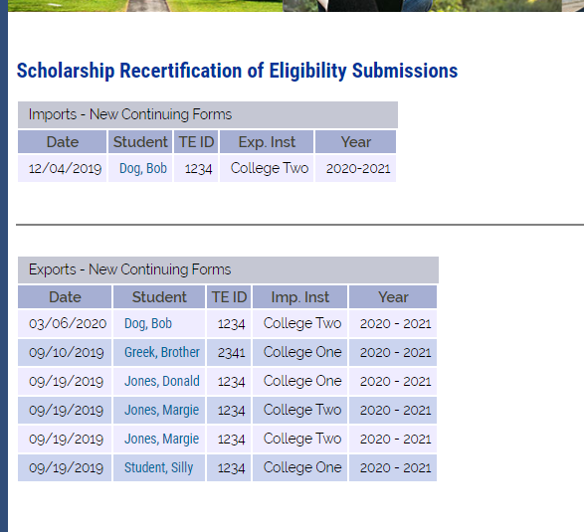
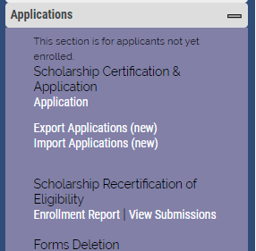

Slide 5
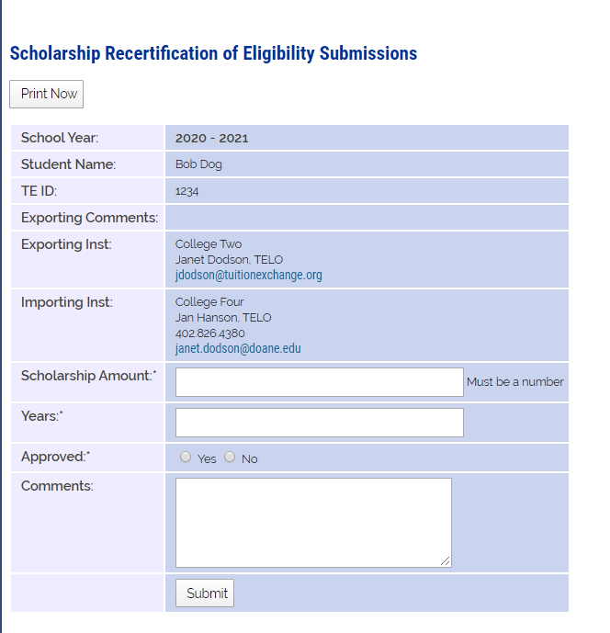
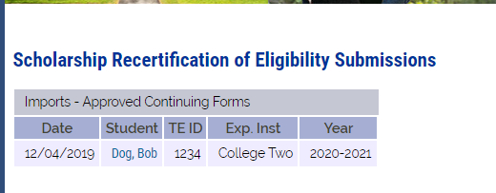
Import school funds eligible continuing students
Scholarship Amount is tuition or set-rate
Years always 4
Approved Yes if eligible
No if not eligible
Comments – your choice
Submit

Slide 6
Reminders

Slide 7
IMPORT Reminders - before July 1
Confirm with Financial Aid student is eligible to receive funding for the upcoming academic year
Confirm with the Registrar the student is enrolled for the upcoming semester/term
If yes to both issues above – approve see slide 5
Update Financial Aid regarding next year’s TE scholarship amount

Slide 8
EXPORT Reminders – do before May 30
Confirm with Human Resources parent is eligible to receive scholarship approval for the upcoming academic year
Confirm with the current year TE Enrollment Report the student continued throughout the current academic year
If yes to both issues above – recertify see slide 3

