Slide 1
Enrollment Report 2019
Janet Dodson
Director of Communications

Slide 2
Learning Objectives
Training Update
Enrollment Report
Reminders, Warnings and Cautions
Participation Fees
Reminders, Warnings and Cautions
Updating Your Mandatory Profile and Overview Information
Reminders from TE Central

Slide 3
Why Mandatory?
System understanding is important
Keeps schools in compliance making sure every enrolled Exchange scholar is listed
Opens up your Enrollment Report
This training is the Only required TE training activity
We continue to discovered students not listed on 2018-19 Enrollment Report

Slide 4
Mandatory training registration
At least one person accessing the TE web portal must participate
Once successful webinar participation occurs, all registered individuals gain access to the 2019-20 Enrollment Report
TE Central will remind weekly beginning in mid-September of potential training dates

Slide 5
Enrollment Report
Initial due date is September 30
Participation fees (P-fees) invoice
Generates every time the Enrollment Report is submitted
Confirm Continuing Imports and Export students &
Add first time new Imports
Requires Export and Import school involvement

Slide 6
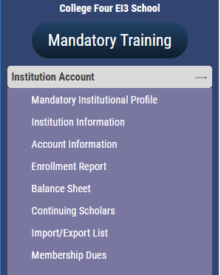
Reviewing Continuing 2019-20 scholarship recipients
Open your Enrollment Report
Review EVERY current IMPORT student for:
Accurate EXPIRATION date
Fall, 2019 registration in place
Notify Financial Aid Office of the scholarship amount
Review EVERY current EXPORT student for:
continued employee eligibility for Exchange scholarship consideration

Slide 7
If you attended Mandatory Training but…
Receive the message below – contact Janet D for assistance.

Slide 8
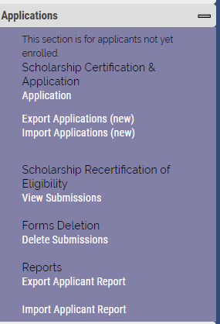
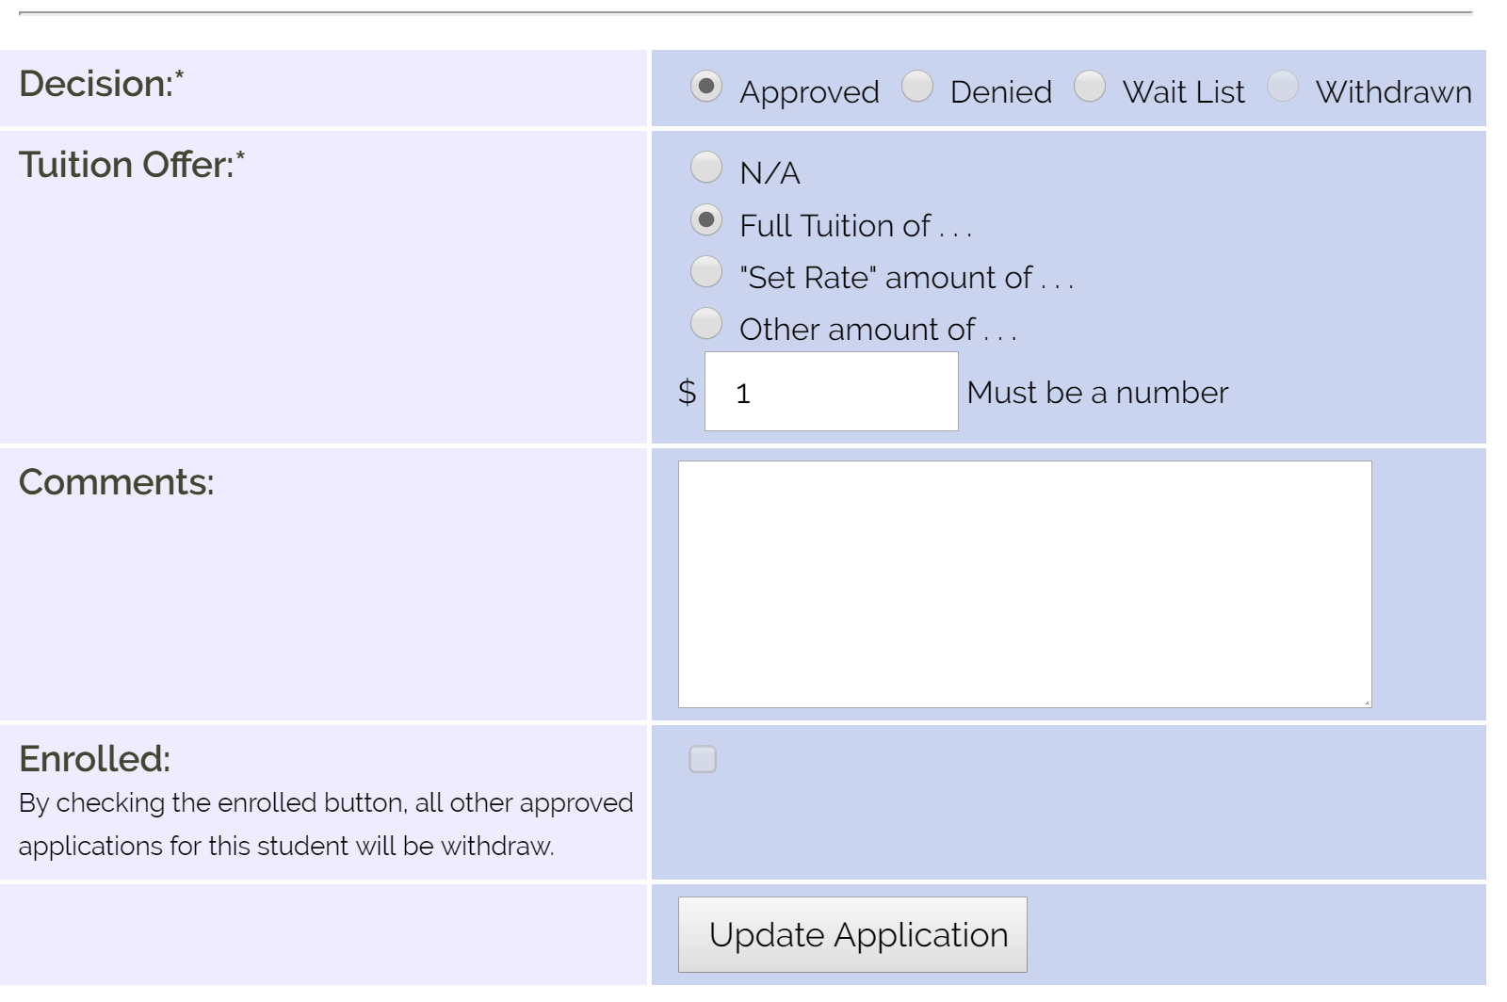
Adding first time 2019-20 scholarship recipients
IMPORT student records use active confirmation:
with your Registrar confirming all awarded new IMPORTS are admitted and scheduled to enroll
with the Financial Aid Office confirming all new IMPORTS are awarded the Exchange scholarship
If the student is enrolled and funded
check the Enrolled Box and Update Application
Check the scholarship amount entered for accuracy. Update if necessary
EXPORT school receives email notification

Slide 9
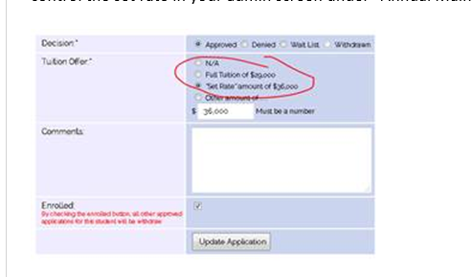
Something new since last year
If your TE scholarship is correct in the system or your school is a Set-Rate school
and click Tuition or Set-Rate the amount field populates automagically!

Slide 10
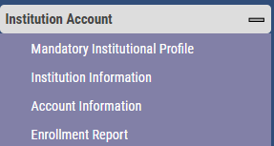
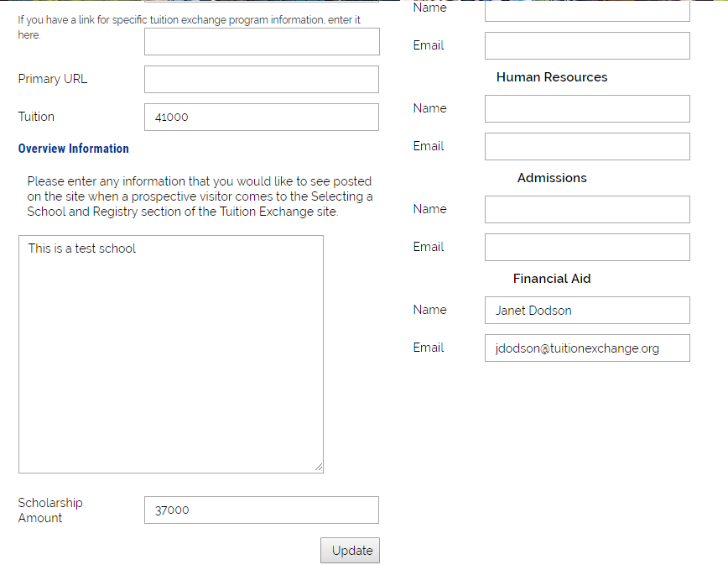
Where to update your Tuition and TE scholarship amounts
Institution Account
Institution Information
Set Rate for 19-20 is $37,000
Please be sure to share your actual tuition
While you are updating these important categories, please
confirm your overview and the names and email address for
your TE Back-up, president, Human Resources, Admissions, and
Financial Aid are current.

Slide 11
Adding first time 2019-20 scholarship recipients
EXPORT schools use active confirmation based on email confirmation:
With Human Resources confirming the employee remains eligible for Exchange scholarship consideration
If employee remains eligible, click the Add Student button
Should the employee be no longer eligible, click the Withdraw Application option
Emails launch informing the Import school of action taken by the Export school

Slide 12
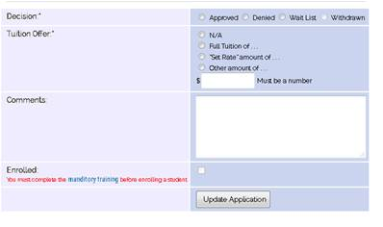
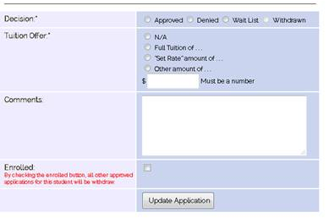
I want to check the enrollment box, said the anxious Import school…
In order to check the enrollment box the IMPORT school must attend Mandatory Training
If you have NOT attended Mandatory Training you will see this message.
If you attended Mandatory Training, you will see this reminder

Slide 13
This Photo by Unknown Author is licensed under CC BY-SA

Slide 14
Reminders, warnings, and cautions
IMPORT schools
Check the ENROLLMENT box only after the student enrolls for classes
See Slide 8
The timing depends on your school’s academic calendar but no later than September 30 of the initial Enrollment Report confirmation
Clicking the ENROLLMENT box automatically withdraws the student’s Exchange applications approved at all other schools

Slide 15
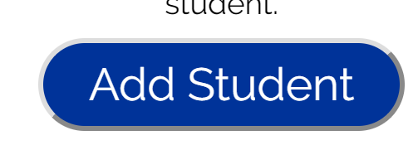
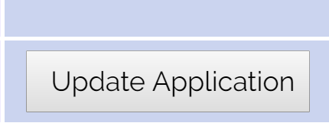
Reminders, warnings, and cautions
The EXPORT school must click Add Student in order to finalize the addition of the student to all Enrollment Reports
See slide 11
IMPORT schools denied applications
The student denied your offer by not enrolling OR the student does not meet your criteria for scholarship
EXPORT schools withdraw applications
The employee is no longer eligible OR the family notifies you regarding the student’s decision to not attend a particular TE school

Slide 16
Typical TELO Questions
2019 – 20 new Imports are missing
Did the IMPORT mark the student as enrolled?
Did the EXPORT school ADD the student?
My school is not listed on the Dropdown Box? Why not?
Only EXPORT schools can ADD a new student.
If the student is NEW, did the IMPORT school mark the student as enrolled?
Did the EXPORT school ADD the student?
If this is a continuing student, contact TE Central for assistance

Slide 17
Typical TELO Questions
What is the process to update a bad expiration date?
See slide 19 for visual instructions for updating Expiration dates.
If the expiration date is outside last term or the current term, contact TE Central
There is a student on my Enrollment Report who is not enrolled.
If the student did not return or enroll for the current term, see slide 19 for visual instructions of updating Expiration dates.
If the student NEVER attended, contact TE Central

Slide 18
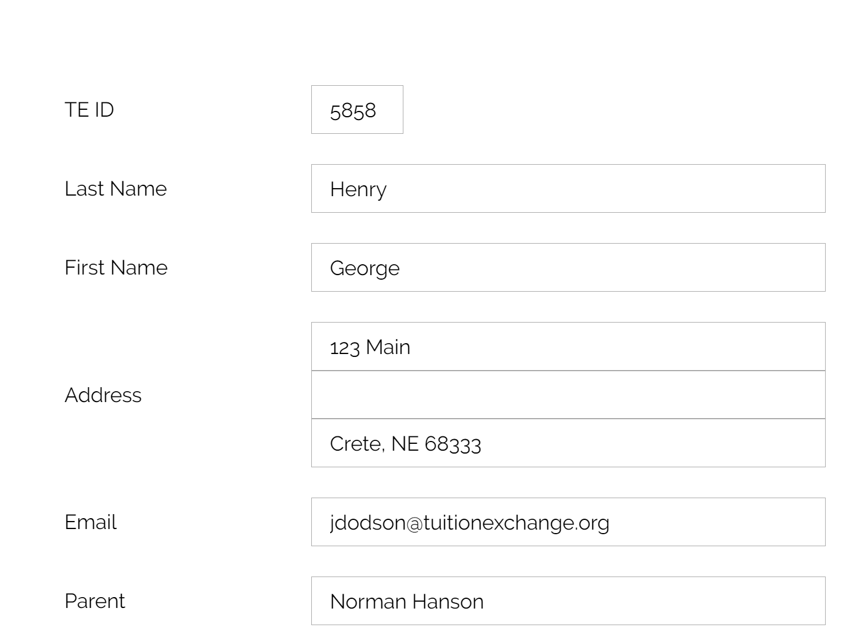
Typical TELO Questions
The student’s biographical information is wrong or missing
Contact the EXPORT school. Export schools can update information found in the white sections of the student’s application
Or contact TE Central
The student is transferring to a new Exchange school next semester
This action requires a NEW EXPORT application listing the new IMPORT school
The employee is moving to a new school
This action requires a NEW EXPORT application from the new employer

Slide 19
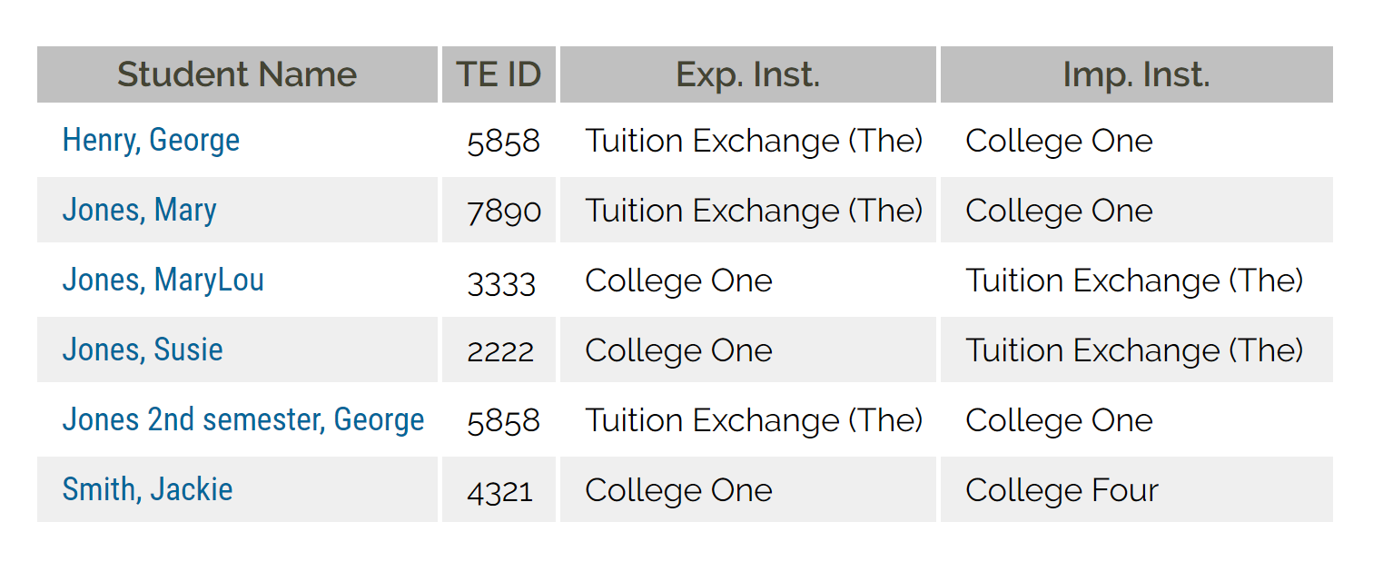
Updating an expiration date
Enrollment Report
Click on the student’s name
Then again
Scroll to the bottom of the student’s open record and select the correct drop option
Drop student at the END of this semester
Is NOW
Drop student at the End of LAST semester
Is the most recently concluded enrollment period
If neither option is correct, contact TE
Central

Slide 20
Enrollment Report Calendar
Initial Review date
September 30
End of Fall term Review
Spring term confirmation Review
End of Spring term final Review
Please be timely!!!
R
R
R
R
R

Slide 21
Confirming the enrollment report is accurate
Export responsibilities
Confirm all funded returning students and new 19-20 applications
Import responsibilities
Accept or Deny all applications
Keeping the Enrollment Report up-to-date
Export schools must click Add Student to add the applicant to the Enrollment Report once the IMPORT school enrolls the student
Withdraw any no longer eligible students/applicants
Click the Enrolled button for all NEW attending Imports
Remember – Imports and Exports share the student record
Confirm scholarship for all students is correct
Deny applicants that do not enroll or are still pending
Withdraw any no longer eligible students/applicants
Emails keep you up to date!
Click ADD STUDENT for each new enrolled IMPORT

Slide 22
Stop and LOOK
Let’s see a real case of enrolling and adding a new student to the Enrollment Report
Sissy Student
TEID 1234
Home school is College Four
Approved at College One and College Three
Waitlisted at College Two

Slide 23
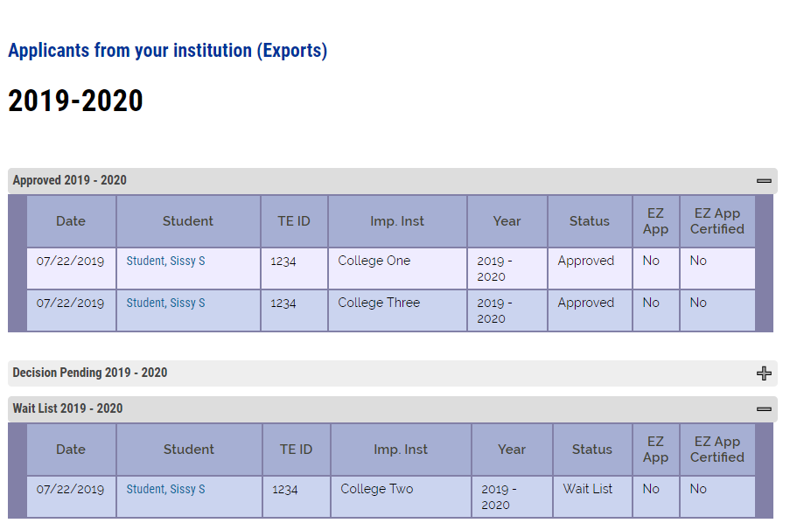
Sissy Student’s applications
Sissy Student has three active applications.
She can only attend one school at a time.
Sissy has decided to attend College One
Watch what happens next

Slide 24
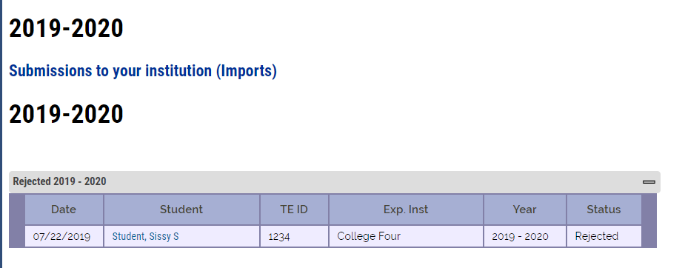
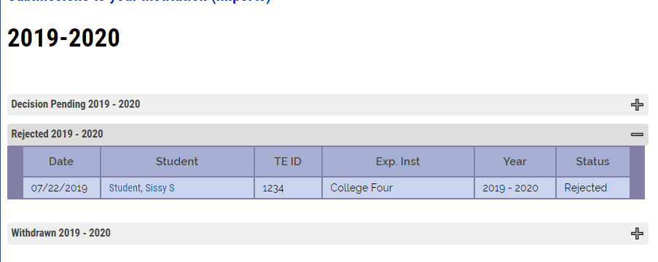
When the attending school clicks the ENROLLED BOX, all other approved or waitlisted applications reject.

Slide 25
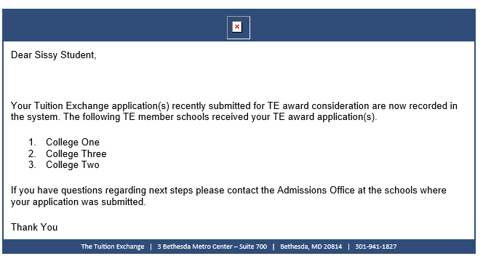
Emails launch
This email is sent to the student and parent, if valid email addresses are provided.

Slide 26
Emails launch

Slide 27
Emails launch
Every time a status change is made, the Import and Export school TELO is notified. We ask that you do not forward or share these emails because the student and parent, provided valid emails are in place, get a notice too.
The TELO notice is blunt. The family notices are a bit less blunt and looks more official. Thank you!!!

Slide 29
Tuition Exchange Participation Fees – (P-Fees)
Two types of P-fees
Export fee at $40 per EXPORT student
Import fee at $40 per Double Credit 3 (DC3) IMPORT student
P-fees are not prorated
If a student transfers mid-year there is a new $40 P-fee
P-fees may be passed on to the family
TE member schools are responsible for payment to TE Central upon completion and any updates to your Enrollment Report

Slide 30
P-fee statement
Each time the Enrollment Report is submitted, a new Participation Fee statement generates
Please review the statement as it may not be a new bill
Payment is due upon receipt of your Participation Fee statement
Tuition Exchanges accepts checks or ACH payments
Students transferring mid-year to another TE school are assessed a new $40 Participation Fee
Interested in ACH payment options? Contact Kristine Lev at klev@tuitionexchange.org

Slide 31
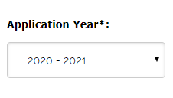
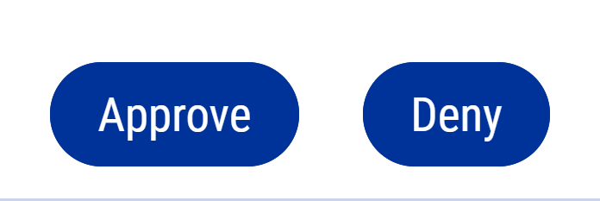
Remember – every school is an export and an import school!
May begin the process of entering new exports after completion of this webinar
Be mindful when entering new TE applications there are TWO application years now open
The EZ app makes the application process simple for your school. Turn the option on and allow families the ability to apply online
Remember Export schools always CONTROL the Export application approval process

Slide 32
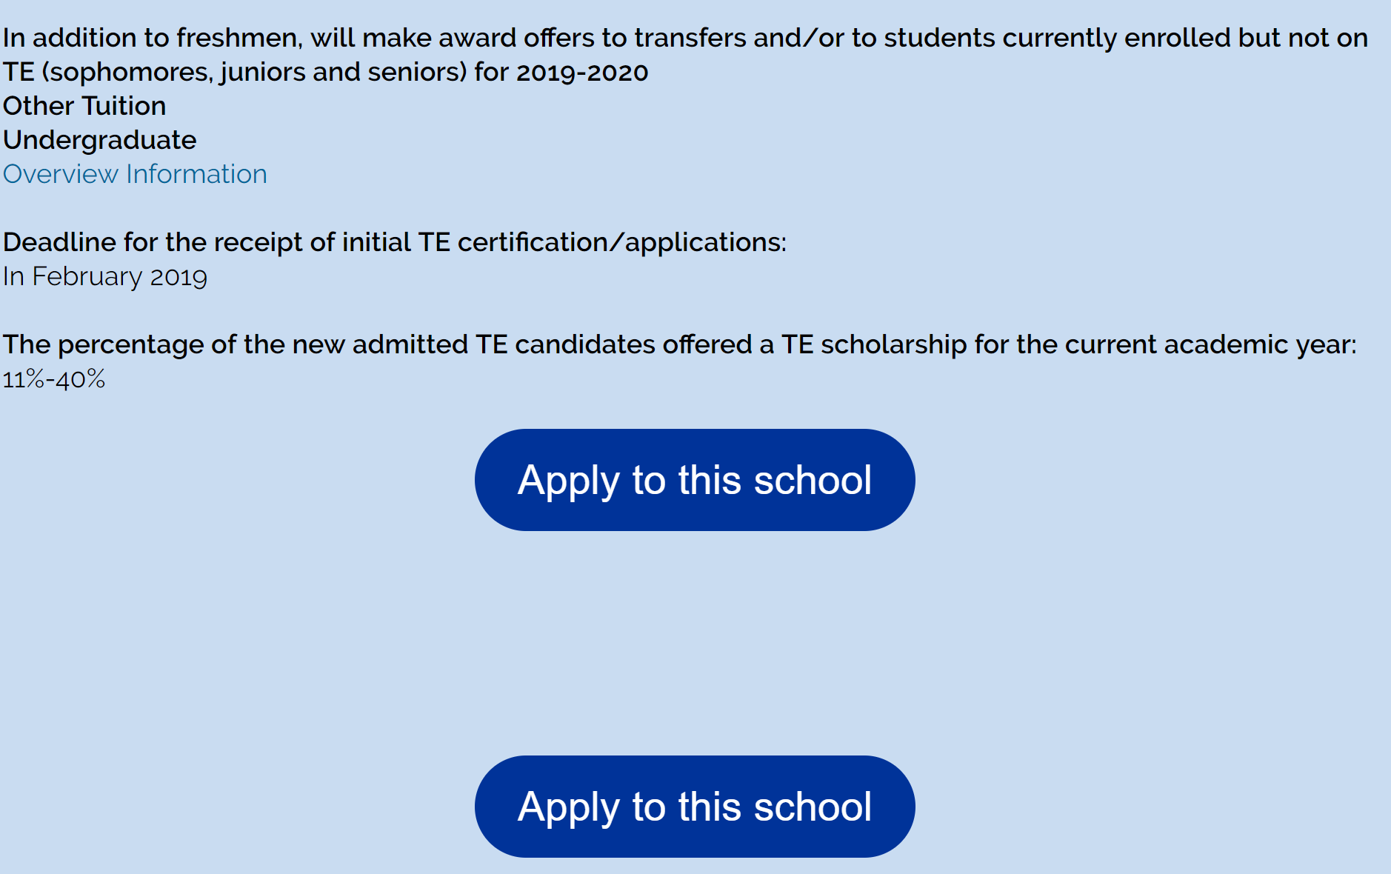
Updating your Mandatory Profile
Provides families with information
Tells your datelines
Gives families a taste of your school
PLEASE complete your overview
Be more like school one than school two!
1
2

Slide 33
Updating your Overview Information
The percentage of the new admitted TE candidates offered…
130 applications for Tuition Exchange
100 of the 130 apply for Admission and Tuition Exchange
55 of the 100 admitted students offered Tuition Exchange
55/130 = 42%
The Overview details 41% to 60%
You are welcome to provide a comment on your Institutional Overview if you anticipate your Approval Rate will be different in the 2020-21 award year.

Slide 34
Updating your Overview Information
Confirm your TELO details are correct
What about your application date?
Read your message – is it friendly
Please add the following information – name and email
President
Human Resources
Director of Admission
Director of Financial Aid
We are building our data base and need your help

Slide 35
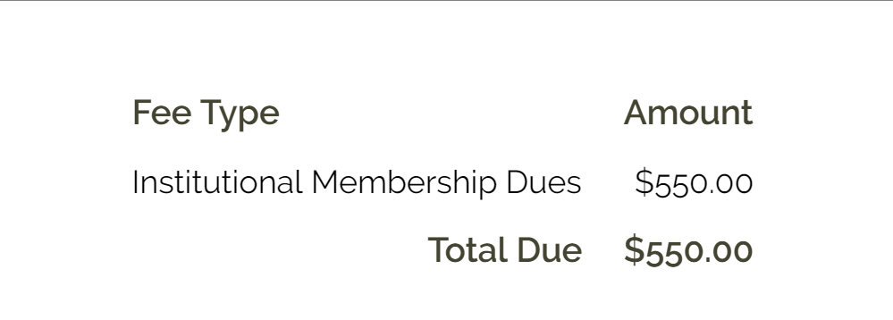
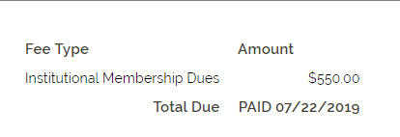
Reminders from TE Central
TELO ONLY RESOURCE SECTION review
TE Membership Dues are now late.
Please double check your Membership Dues statement
This Photo by Unknown Author is licensed under CC BY
This member has NOT paid their dues
This member paid their dues

Slide 36
Learning Objectives
Training Update
Enrollment Report
Reminders, Warnings and Cautions
Participation Fees
Reminders, Warnings and Cautions
Updating Your Mandatory Profile and Overview Information
Reminders from TE Central

Slide 37
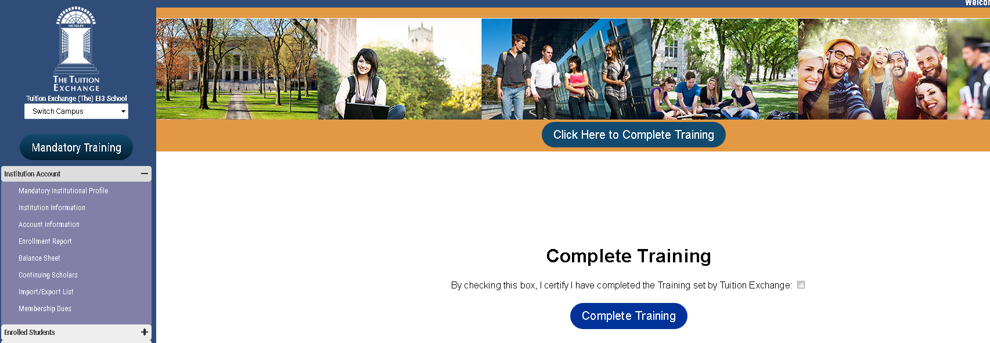
One final step

Slide 38
TE Central contact information
www.tuitionexchange.org info@tuitionexchange.org
Robert “Bob” Shorb Member Recruitment Executive Director/CEO
rshorb@tuitionexchange.org 518.859.7301
Janet Dodson Membership Services
Director of Communications
jdodson@tuitionexchange.org 402.418.1081
Kristine Lev All things financial
Director of Administration
klev@tuitionexchange.org 301.941.1827

Slide 39
This Photo by Unknown Author is licensed under CC BY-ND

