Slide 1
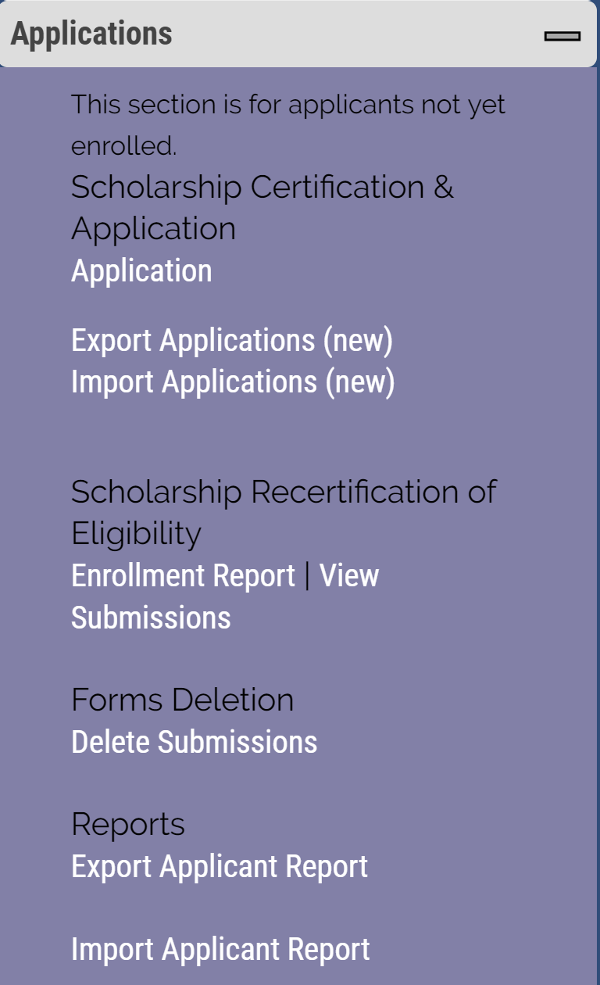
Recertifying Eligible 2019-20 continuing student
TE scholars – EXPORT school only
Open your Enrollment Report

Slide 2
Scroll to the EXPORTS for 2018-19 and review the section titled Re-certify 2019-20
If the box reads Re-certified your work is complete.
If the box reads Re-certify you need to click the Re-certify box, following the prompts to update the record.
If the box reads N/A double check the Exp. Date. If the date is WRONG, contact Janet to update the date. Email is best, include the student’s name, TEID, and the NEW expiration date.
DO NOT create a new application for continuing students.

