Slide 1
TE 104 (s) Import Verification Reporting
2018-19
Janet Dodson
Associate Director of Communications
March, 2019

Slide 2
Learning Objectives
Training Update
Enrollment Report
Reminders, Warnings and Cautions
Participation Fees
Reminders, Warnings and Cautions
Updating Your Mandatory Profile and Overview Information
Reminders from TE Central

Slide 3
Why a spring import verification review?
System understanding is important
Keeps schools in compliance making sure every enrolled Exchange scholar is listed
Last academic year, discovered more than 100 students were not listed on 2017-18 Enrollment Report
Improves institutional understanding of the TE scholarship program

Slide 4
Import Verification Report
Reviews need to be completed before April 19, 2019
Confirm your 2018-19 Participation fees (P-fees) are paid in full
Confirm all Imports are listed on your Enrollment Report
Students missing? Contact your TE Liaison Officer

Slide 5
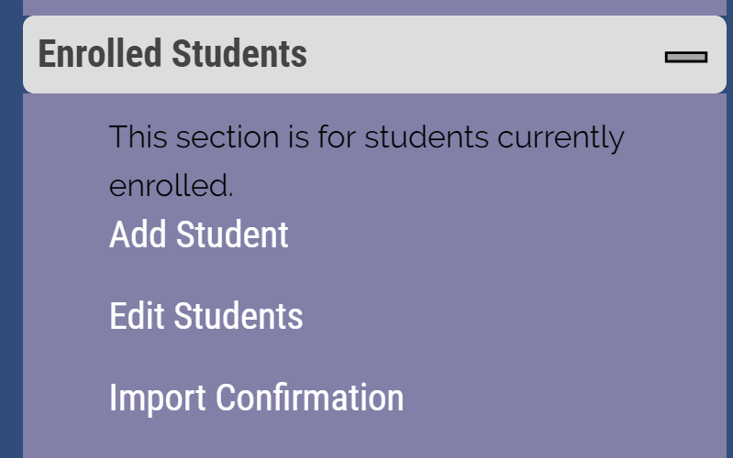
This slide details the how to log into the system
TE Liaison Portal
  Select Enrolled Students
    Import Confirmation

Slide 6
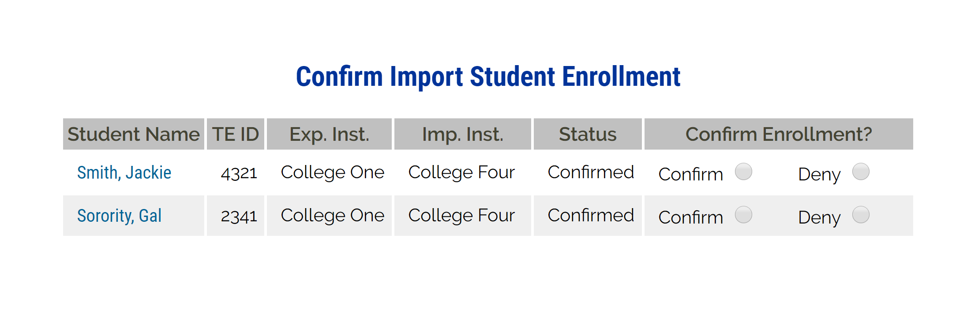
Confirming enrolled students for 2018-19
The Financial Aid Office needs to confirm or deny each student.
Confirm means enrolled and funded with a TE scholarship during some part of the 2018-19 academic year
Deny means NEVER funded a TE scholarship at any time during the 2018-19 academic year
The confirm/deny buttons do not hold the
Click today. IT is working on modifying the hold.

Slide 7
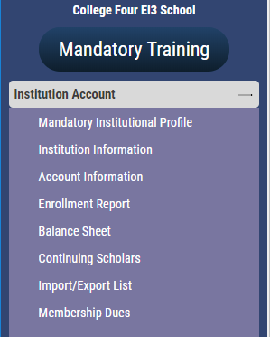
Confirming 2018-19 IMPORT TE scholarship recipients
Open your Enrollment Report
Review EVERY current IMPORT student for:
  Accurate EXPIRATION date

Slide 8
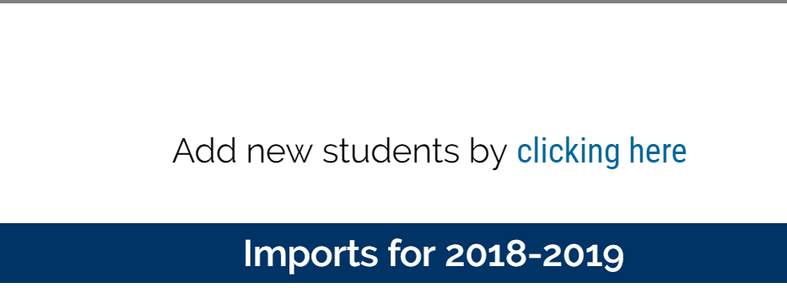
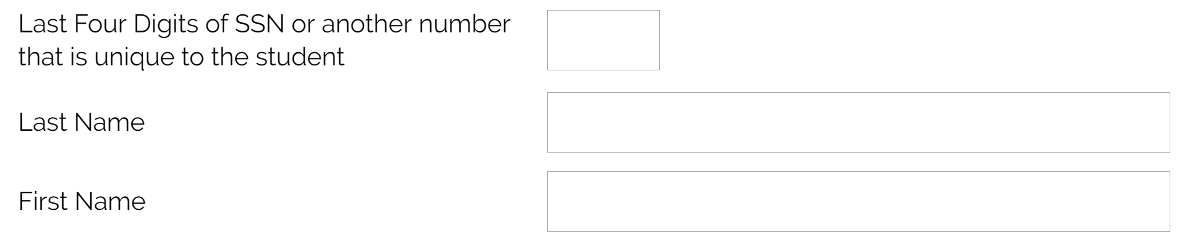
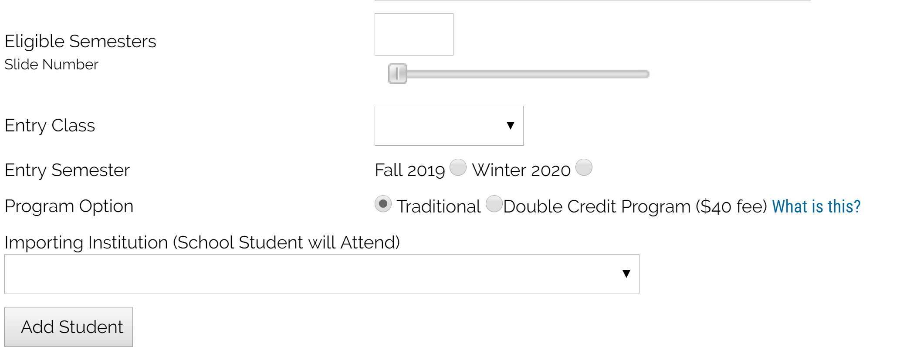
Adding missing 2018-19 TE scholarship recipients
Missing IMPORT records
Contact the EXPORT school
  Ask the TE Liaison Officer to add the student
  Required data is:
    TE ID
    Full name
    Semesters
    Entry class
    Start term
    Import school
  Be sure to click ADD STUDENT
If EXPORT school needs assistance – contact Janet

Slide 9
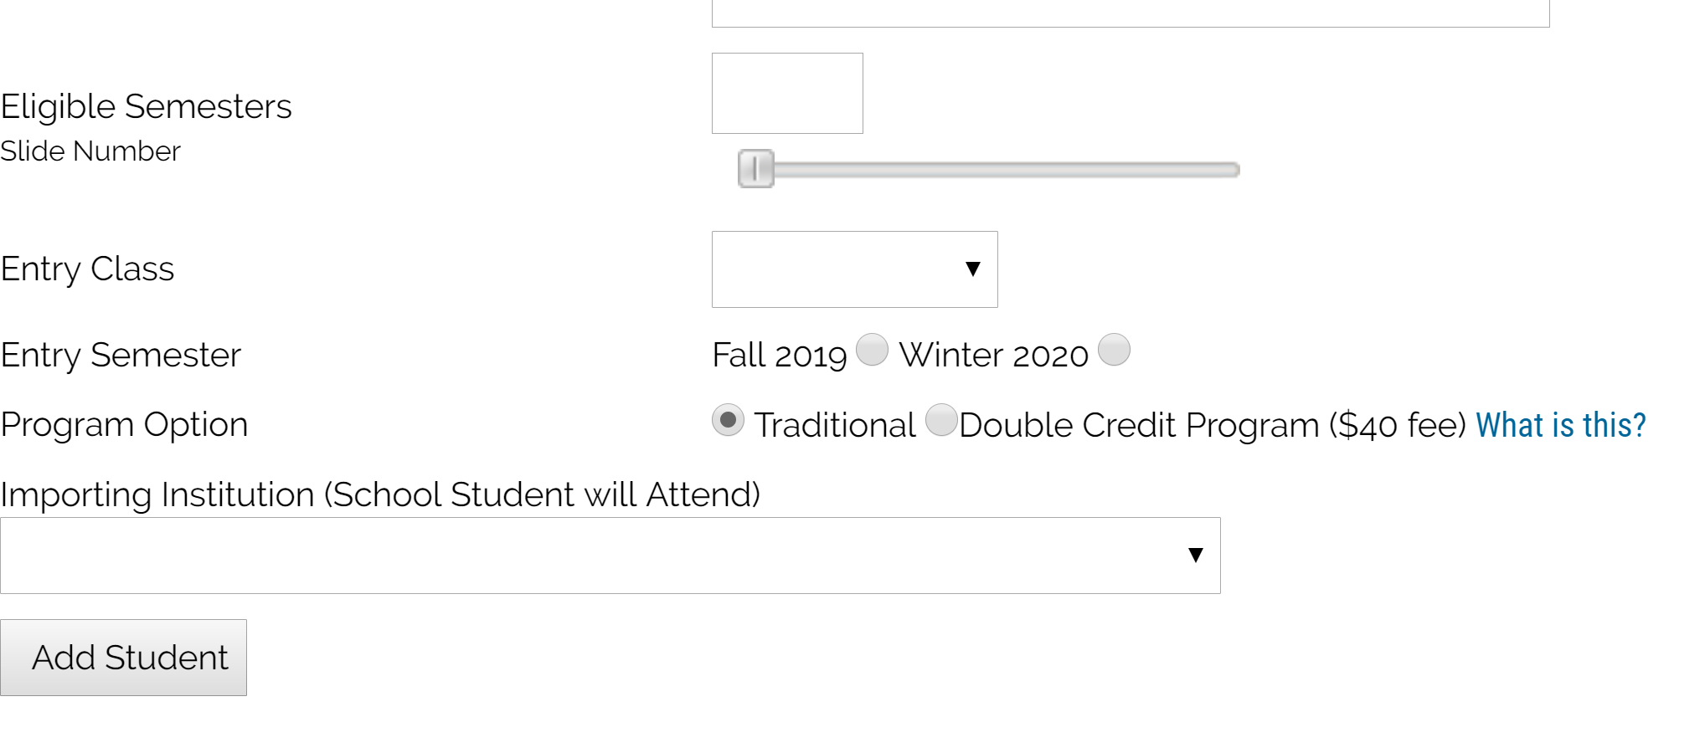
Students NOT appearing the Confirm Import Student Enrollment Report
The EXPORT TE Liaison is the only individual who can ADD new students.
  Adding a missing 18-19 student is completed on the Enrollment Report
    The TE liaison must add the student’s TE ID, their complete name, and the information to the right.
NOTE once the student is added, email Janet with her TEID so that I can modify the entry semester.

Slide 10
What happens next?
The Import Verification Report is a required activity.
TE Central expects the Financial Aid Office to complete this task
Each financial aid director (name provided on your Institutional overview) will receive a 30 day password for this project.
The Verification Report is due no later than April 19.
Reminders will be send to the TE liaison officer and the Financial Aid email on file.

Slide 11



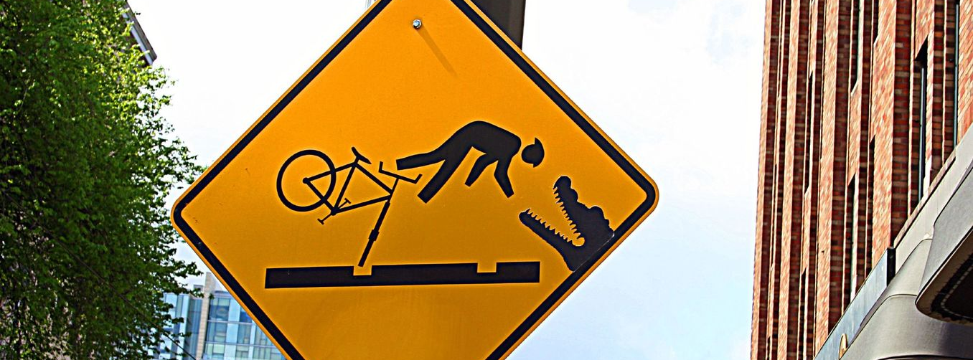
This Photo by Unknown Author is licensed under CC BY-ND
This Photo by Unknown Author is licensed under CC BY-SA
This Photo by Unknown Author is licensed under CC BY-SA
This Photo by Unknown Author is licensed under CC BY-NC-ND

Slide 12

Reminders, warnings, and cautions
IMPORT schools
  If a student is missing from the Import section – contact the EXPORT school
    Export can ADD the student
      See Slide 8
    If all else fails, contact Janet

Slide 13
Typical TELO Questions
Reasons why the 2018 – 19 new Imports are missing
Did the IMPORT mark the student as enrolled?
Did the EXPORT school ADD the student?
My school is not listed on the Dropdown Box? Why not?
Only EXPORT schools can ADD a new student.
If the student is NEW, did the IMPORT school mark the student as enrolled?
Did the EXPORT school ADD the student?
If this is a continuing student, contact TE Central for assistance

Slide 14
Typical TELO Questions
What is the process to update a bad expiration date?
See slide 14 for visual instructions for updating Expiration dates.
If the expiration date is outside last term or the current term, contact TE Central
There is a student on my Enrollment Report who is not enrolled.
If the student did not return or enroll for the current term, see slide 14 for visual instructions of updating Expiration dates.
If the student NEVER attended, contact TE Central

Slide 15
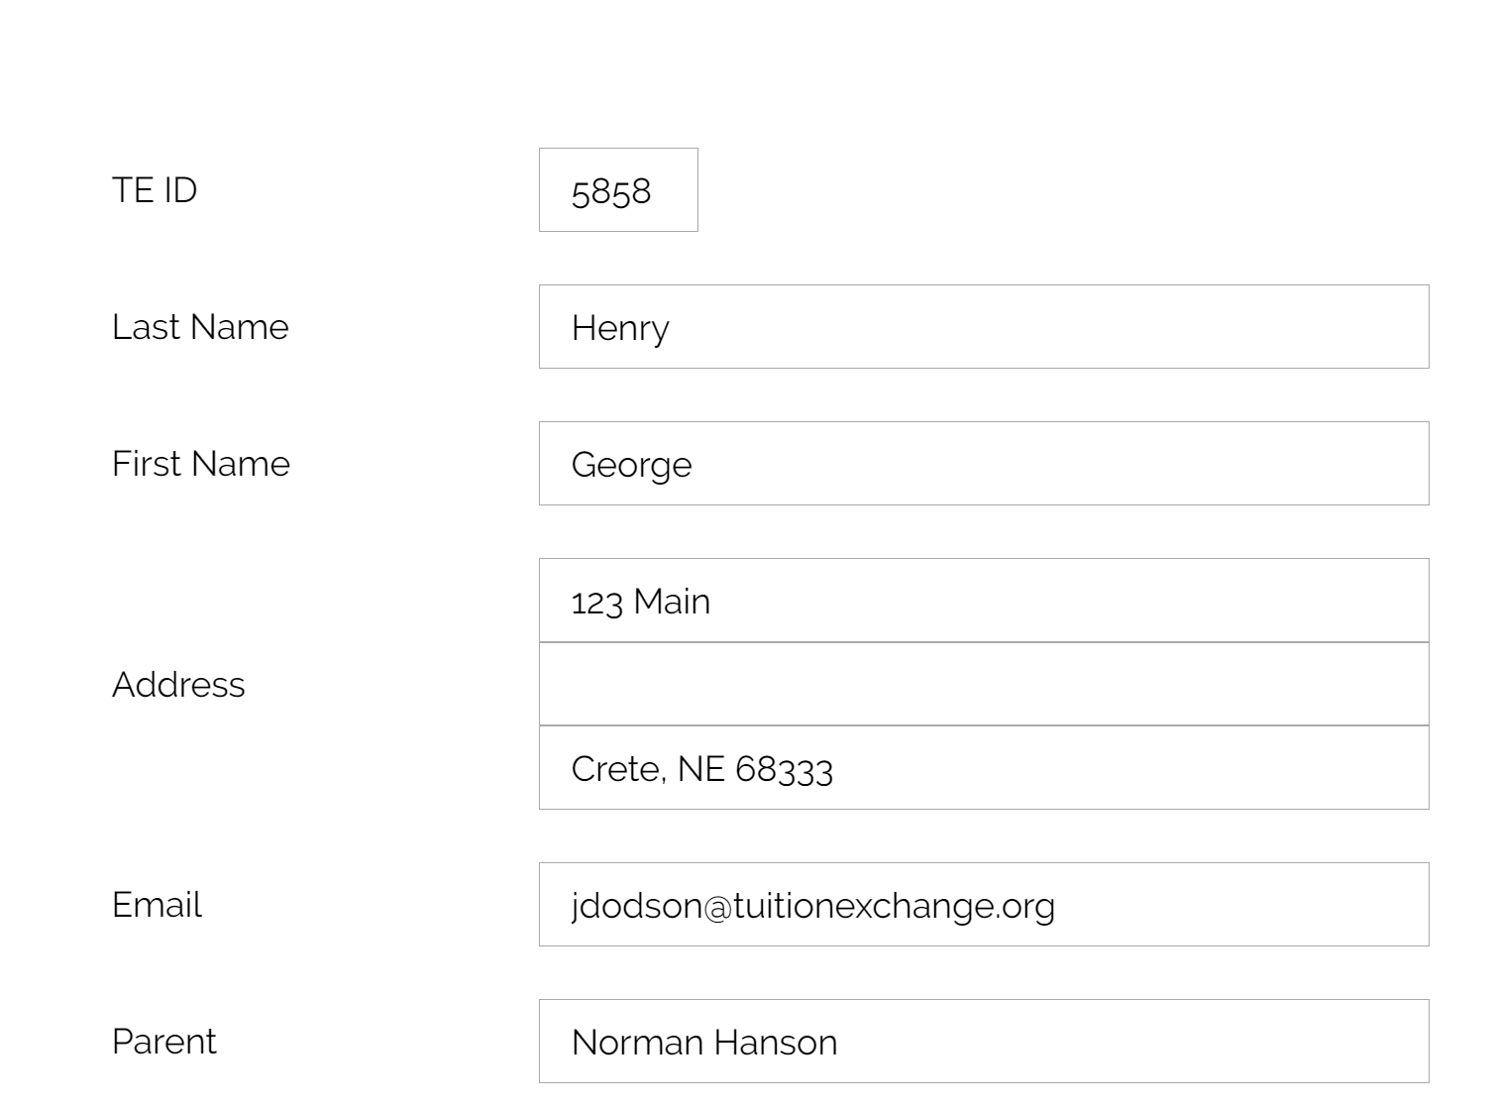
Typical TELO Questions
The student’s biographical information is wrong or missing
  Contact the EXPORT school. Export schools can update information found in the white sections of the student’s application
  Or contact TE Central
The student is transferring to a new Exchange school next semester
  This action requires a NEW EXPORT application listing the new IMPORT school
The employee is moving to a new school
  This action requires a NEW EXPORT application from the new employer

Slide 16
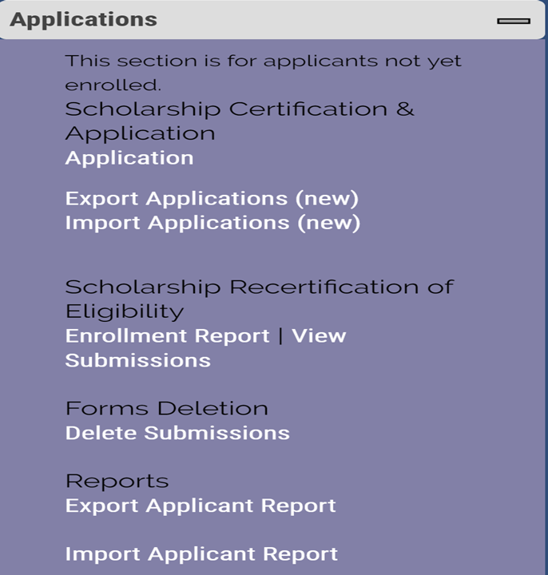
Recertifying 201-20 applications
Export responsibility
Completed inside the Enrollment Report

Slide 17

Email reminders send until ALL continuing eligible students are recertified or their expiration date is updated
In reviewing your Enrollment Report, you have at least one 2018-19 Export student not yet recertified. Please take care of this important detail as soon as possible. The 2018-19 system will close the first Friday in July. If you have not recertified all eligible students by that time, those eligible continuing students will require you to complete individual new applications. Recertification is quick – entering individual new applications is not. See the TE Recertify details 19-20 for visual assistance.
Thank you for your prompt attention to this important matter. You will continue to receive this email until all continuing students are either recertified or their expiration date is updated reflecting either a 01.01.19 or 06.06.19.
As always, if you have questions, please contact me directly. JD

Slide 18
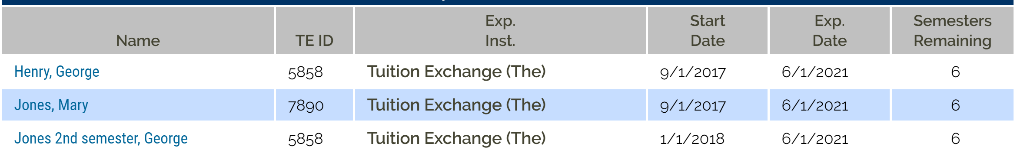
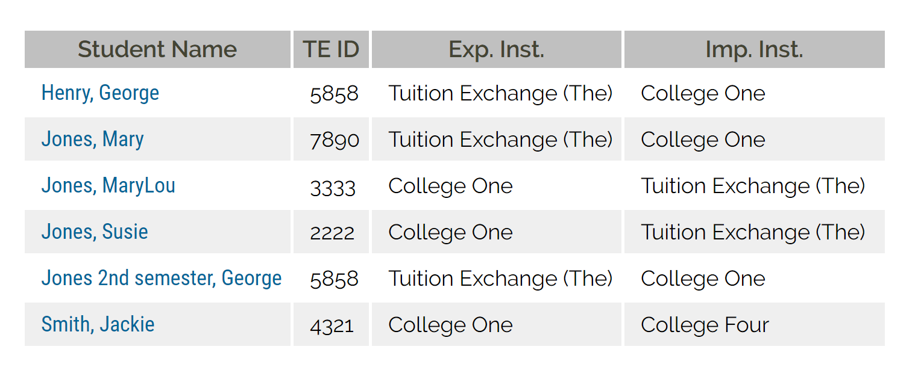
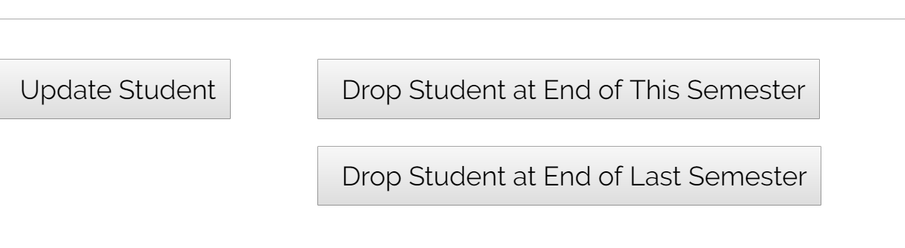
Updating an expiration date
Enrollment Report
  Click on the student’s name
  Then again
  Scroll to the bottom of the student’s open record and select the correct drop option
    Drop student at the END of this semester
      Is NOW
    Drop student at the End of LAST semester
      Is the most recently concluded enrollment period
  If neither option is correct, contact TE Central

Slide 19
Confirming the enrollment report is accurate
Export responsibilities
Confirm all funded returning students and new 18-19 applications
Import responsibilities
Accept or Deny all applications
Keeping the Enrollment Report up-to-date
Export schools must click Add Student to add the applicant to the Enrollment Report once the IMPORT school enrolls the student
Withdraw any no longer eligible students/applicants
Click the Enrolled button for all NEW attending Imports
Remember – Imports and Exports share the student record
Confirm scholarship for all students is correct
Deny applicants that do not enroll or are still pending
Withdraw any no longer eligible students/applicants
Emails keep you up to date!
Click ADD STUDENT for each new enrolled IMPORT

Slide 20

2019-20 dues
  $550
  Due 7.1.19
  Considered late 9.1.19
    Will be charged $50 late fee each month unpaid
2019-20 fees
  $40 per successful export
  Due when you submit your Enrollment Report
  Considered late 10.1.19
    Will be charged $50 late fee each month unpaid
Make sure your 2018-19 participation fees are paid in full

Slide 21

Tuition Exchange Participation Fees – (P-Fees)
Two types of P-fees
  Export fee at $40 per EXPORT student
  Import fee at $40 per Double Credit 3 (DC3) IMPORT student
  P-fees are not prorated
  If a student transfers mid-year there is a new $40 P-fee
  P-fees may be passed on to the family
  TE member schools are responsible for payment to TE Central upon completion and any updates to your Enrollment Report

Slide 22
P-fee statement
Each time the Enrollment Report is submitted, a new Participation Fee statement generates
  Please review the statement as it may not be a new bill
Payment is due upon receipt of your Participation Fee statement
Tuition Exchanges accepts checks or ACH payments
Students transferring mid-year to another TE school are accessed a new $40 Participation Fee
Interested in ACH payment options? Contact Kristine Lev at klev@tuitionexchange.org

Slide 23
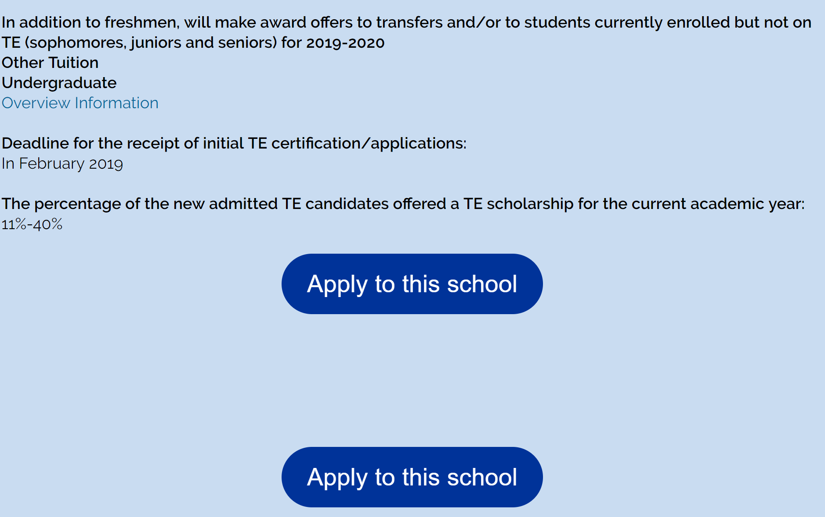
Updating your Mandatory Profile
Provides families with information
Tells your datelines
Gives families a taste of your school
  PLEASE complete your overview
  Be more like school one than school two!
1
2

Slide 24
Updating your Overview Information
The percentage of the new admitted TE candidates offered…
  130 applications for Tuition Exchange
  100 of the 130 apply for Admission and Tuition Exchange
  55 of the 100 admitted students offered Tuition Exchange
  55/130 = 42%
  The Overview details 41% to 60%
  You are welcome to provide a comment on your Institutional Overview if you anticipate your Approval Rate will be different next year.

Slide 25
Updating your Overview Information
Confirm your TELO details are correct
Read your message – is it friendly
Please add the following information – name and email
President
Human Resources
Director of Admission
Director of Financial Aid
We are building our data base and need your help

Slide 26
Learning Objectives
Training Update
Enrollment Report
Reminders, Warnings and Cautions
Participation Fees
Reminders, Warnings and Cautions
Updating Your Mandatory Profile and Overview Information
Reminders from TE Central

Slide 27
TE Central contact information
www.tuitionexchange.org
Robert “Bob” Shorb Janet Dodson Kristine Lev
  Executive Director/CEO Associate Director Assistant Director
  Member Recruitment Membership Services All things Financial
  & Training
  rshorb@tuitionexchange.org jdodson@tuitionexchange.org klev@tuitionexchange.org
  518.859.7301 402.418.1081 301.941.1827

Slide 28

This Photo by Unknown Author is licensed under CC BY-SA

