Slide 1
Tuition Exchange 101
TE Central Staff
2023-2024

Slide 2
New TE Liaison Officer (TELO) Training Series Details
Available On-Demand
An excellent resource for new and seasoned TELOs
101 – TELO Basics
102 – TELO Website details, TE-EZ Online app
103 – TELO Guidelines, TELO Expectations & Employee Eligibility Issues
104 – TELO Monthly Training, Reporting & Frequently Asked Questions by TELOs

Slide 3
Today’s Focus
TE 101
TELO Responsibilities
TELO Expectations
TE-EZ Online App
This Photo by Unknown Author is licensed under CC BY

Slide 4
Where do I find Liaison Officer responsibilities and resources?
www.tuitionexchange.org
Click on the Liaison Officers option for valuable information
Then, for additional resources, click the pull-down menu

Slide 5
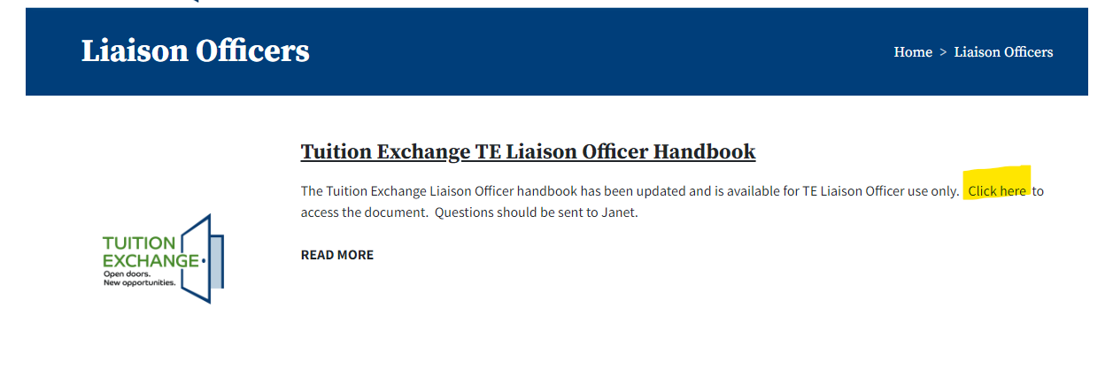
The TE Liaison Officer Handbook is the TELOs guide and summary of TELO responsibilities
This Photo by Unknown Author is licensed under CC BY-SA

Slide 6
Primary TELO Responsibilities
To maintain fiduciary compliance with TE Central
To create and share equitable and fair TE guidelines
To advise eligible employees and their families about the TE program
To certify the eligibility of faculty and staff family members who apply for TE scholarships at other institutions
To re-certify the eligibility of “exports” annually

Slide 7
The TE Handbook is your guide and summary of TELO responsibilities
To monitor the eligibility of “imports” each academic year
To monitor “export” and “import” applicant's enrollment
To maintain a reasonable balance between “exports” and “imports”
To comply with limitations and restrictions imposed by Tuition Exchange
To resolve exchange problems with TELOs at other member institutions
To complete the initial Enrollment Report no later than September 30
To review and modify as necessary the Enrollment Report throughout the academic year (December, late January/early February, and end of school year)
To keep current the TE Mandatory Profile/Overview
To maintain up-to-date TELO/school information with TE Central

Slide 8
Expectations
Document everything!
Update TE Central (info@tuitionexchange.org) when you know you are leaving your TELO position
Share the new TELO’s name, title, email address and contact number
Every school is expected to have one primary and one secondary TELO
Beginning July 2024, this expectation will become mandatory

Slide 9
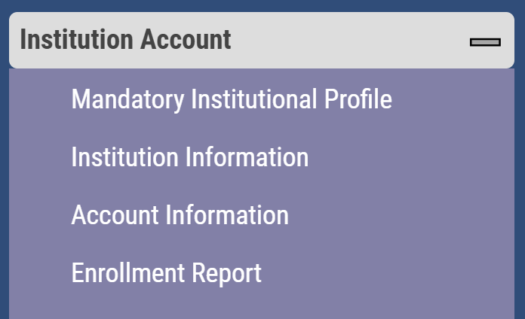
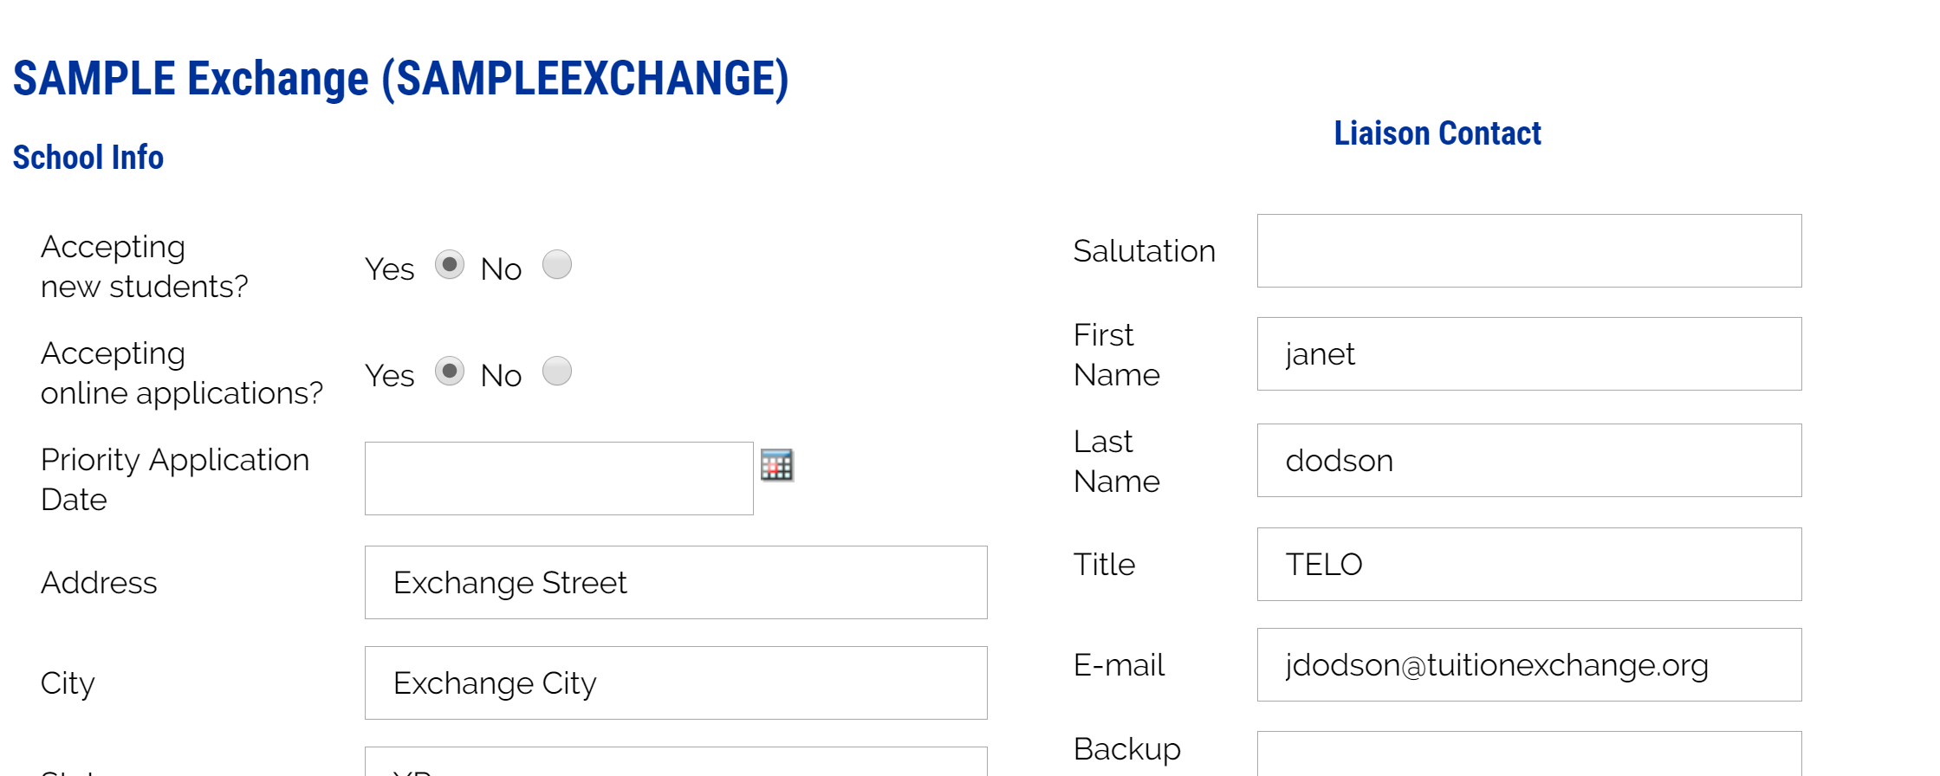
Where to review the TELO contact information

Slide 10
EXPORT Schools TE-EZ Online App
Make your office hours count
The TE-EZ Online App allows families to complete their application
The TE-EZ Online app first goes to the EXPORT school for eligibility certification and approval
The EXPORT school controls the employee eligibility approval or denial of the TE-EZ Online app
Remember, once you approve the TE-EZ Online app and hit submit, you have approved the named student for IMPORT scholarship consideration – there is NO recall option unless the parent is no longer an eligible employee

Slide 11
TE- EZ Online App process
Step 1 – Family completes the TE-EZ online app and submits
Step 2 – Export TELO receives a notification email from NOREPLY@tuitionexchange.org that the app is available for review
Step 3 – Export TELO looks inside Applications – New Exports – 2023-2024 Decision Pending
Step 4 – Approve or Deny each application for Import scholarship consideration
This only means the employee meets your eligibility guidelines for Export!
Step 5 – Emails launch to the family members with an email address listed on the application informing them of the Export decision
Now the student shifts their focus of communication to the IMPORT school
This Photo by Unknown Author is licensed under CC BY

Slide 12
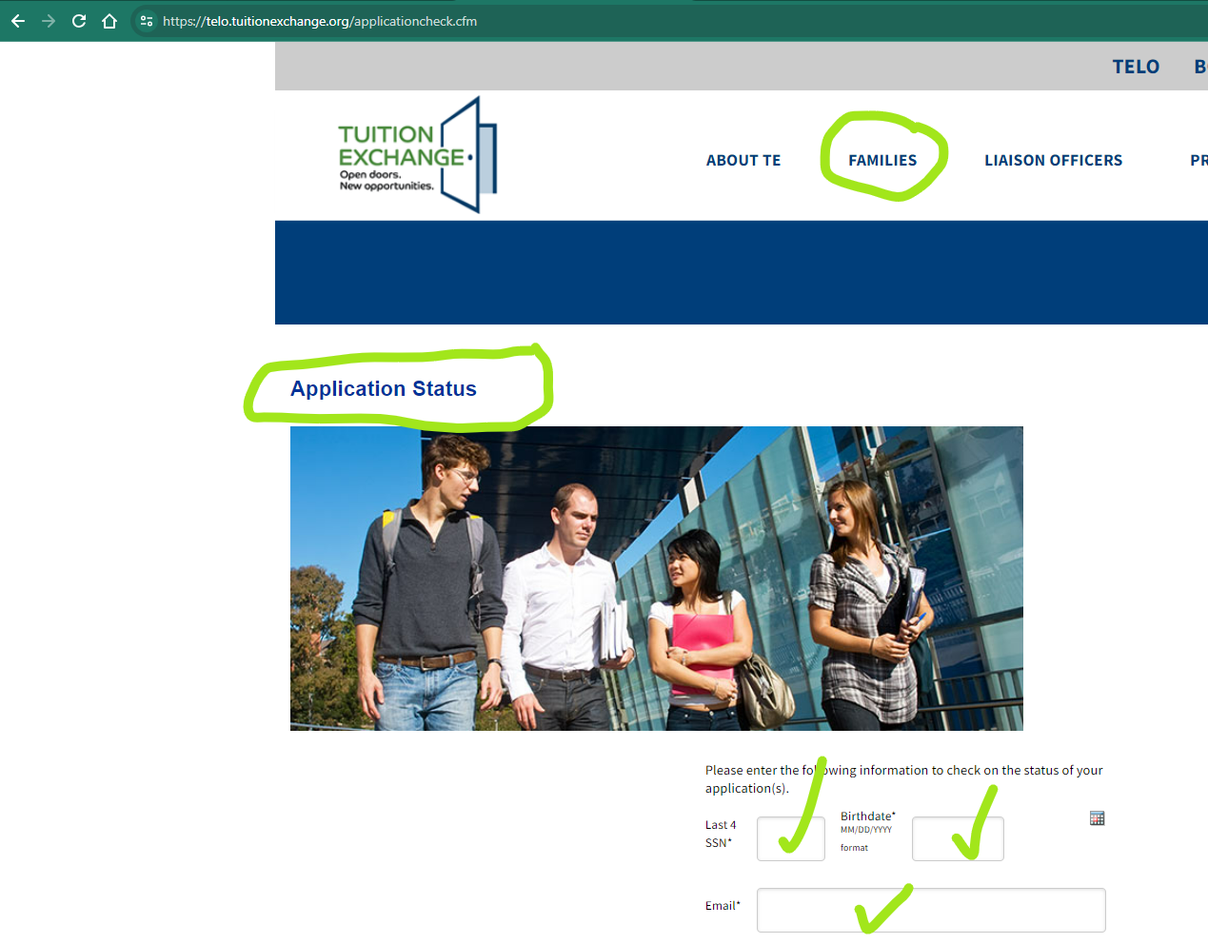
TE- EZ Online App process
The TE-EZ Online application status can be tracked
The tracking details require information to be entered exactly as it was submitted on the TE-EZ Online app
Typical error issues are student birthdate and email address
TELO can share a copy of the app with the student upon request

Slide 13
How to share a copy of a TE app with the student
TELO Portal
Applications
Export Applications (new)
Open student record
Click print
Print a PDF
Email PDF to student

Slide 14
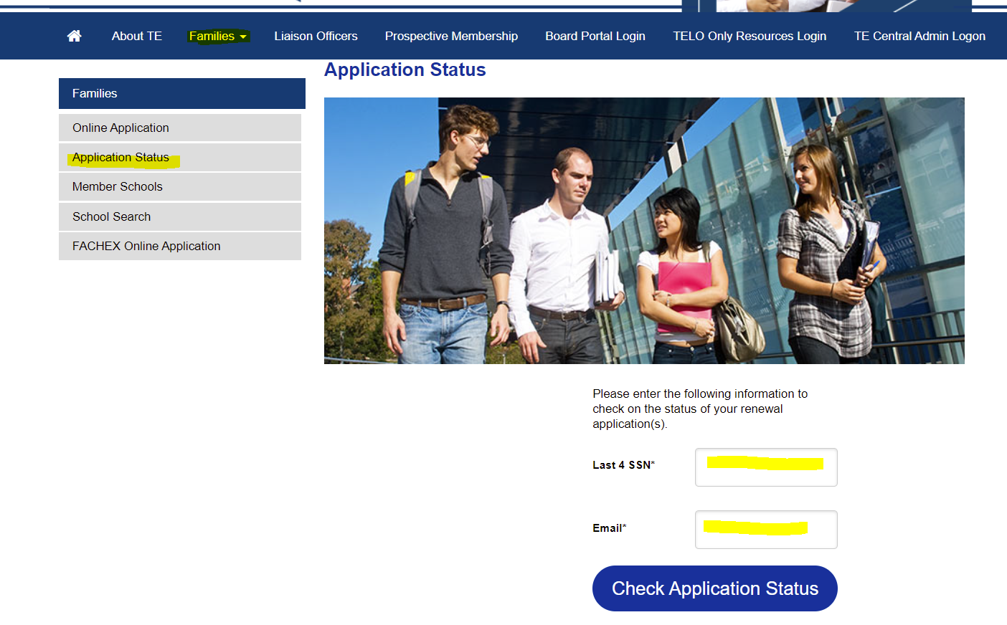
Continuing student’s application status
The information must match what is in the system
Be mindful of FERPA issues when providing information to the employee
Import schools, be sure to fund the student in the spring inside the View Submission of the TE Portal

Slide 15
TE Central Contact Information
www.tuitionexchange.org
Robert “Bob” Shorb Janet Hanson
Executive Director/CEO Director of Communications
rshorb@tuitionexchange.org jhanson@tuitionexchange.org
518.859.7301 402.418.1081
Kristine Lev Suzanne LeAnce
Director of Administration Assistant Director of Communications
klev@tuitionexchange.org sleance@tuitionexchange.org

