Slide 1
2018-19 TE recipient review 2019-20 approval and processing reminders TE reports te central updates
January, 2019 Tuition exchange Webinar
Janet Dodson, Associate Director of Communications

Slide 2
Today’s focus
2018-19 Recipient Review
2019-20 Approval and Processing
TE Reports
TE Central Updates
Recap

Slide 3
Enrollment Report Review
Open your Enrollment Report

Slide 4
2018-19 Enrollment Report Review
Confirm your 2018-19 Enrollment Report is up-to-date
Are all listed students still enrolled and eligible
If no, update the student’s expiration date
Enrollment Report – click on student’s name, then again and update the expiration date
End of this semester is 6.1.20
End of last semester is 1.1.19

Slide 5
Enrollment Report Review
Confirm each enrolled IMPORT continues enrollment at your school
Confirm each Export dependent family member employed at your school remains eligible

Slide 6
Enrollment report review - Imports
Print your Enrollment Report
Confirm with the Registrar’s Office all students successfully completed the Fall semester and are enrolled full-time for the Winter/Spring semester
If not update the student’s Expiration date (refer to slide 4 or 7)
If the student NEVER enrolled for AY 18-19 contact Janet

Slide 7
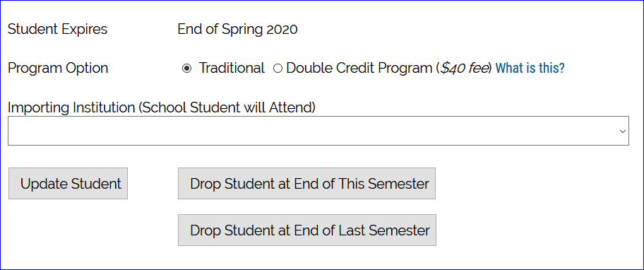
Enrollment Report Review - imports
The Registrar informs you that Jackie Smith is no longer enrolled at your school
Inside your Enrollment Report, click on Jackie’s name, then again, now, scroll to the bottom of Jackie’s record and select Drop at the END of LAST semester to update her record

Slide 8
Enrollment report review - imports
Return to your Enrollment Report and review Jackie’s record. Her expiration date is updated and her remaining semesters are 0
Emails launched updating the EXPORT TELO of the change. NOTE: All emails come from NOREPLY@tuitionexchange. org
Please make sure the email is added to your SAFE list.

Slide 9
Enrollment report review - exports
Confirm with Human Resources all employees retain their eligibility
If not update the student’s Expiration date (see slide 4) AND notify the Import school TELO immediately
Emails launch to the IMPORT TELO with information on the update. NOTE: All emails come from NOREPLY@tuitionexchange.org
Please make sure the email is added to your SAFE list.

Slide 10
Enrollment Report Review
Should your review result in a student not appearing on your Enrollment Report and your school is funding the student with a TE scholarship – contact Janet Dodson for further assistance
If the student attended any time during the current school year, you update the student’s expiration date
See Slide 4 or 7 for visual directions
Do not DELETE a student record as this eliminates the record completely
Should you discover a student NEVER enrolled – contact Janet Dodson for further options

Slide 11
Enrollment Report Review
Incorrect expiration dates continue to plague the system
The system calculates expiration dates based on the entering class
The system only understands whole numbers
The system doesn’t understand words in fields that expect numbers
For example – you select the student’s class as FRESHMAN – the system calculates the expected graduation date four years out
If your school awards TE for less than 8 semesters, be sure you are in contact with the importing school or add a comment to the record.

Slide 12
Enrollment Report Review
Once you confirm the Enrollment Report is correct for second semester SUBMIT IT
Print a copy for your records
Print your Participation Fees statement; and
Print your Balance Sheet
If the Participation Fee statement shows:
a balance due, remit immediately
Note – students transferring to a different TE school second semester are charged another $40 participation fee
This new participation fee is not waived
The Enrollment Report is fluid and changes when shared student records are modified
Be sure to print and save your Enrollment Report and Balance Sheets each time you modify the report

Slide 13
Enrollment Report Review
Second semester new students
Brand new student to TE
Contact the other school to confirm support
Export school must add the NEW second semester student to their Enrollment Report
Adding new second semester scholars means adding to the Enrollment Report, Balance Sheet and Participation Fees statement so be sure to review, confirm, pay and print all three pieces

Slide 14
Enrollment Report upcoming reminders
March 2019
Financial Aid Offices will be asked to confirm all IMPORT students funded on your current academic year Enrollment Report
This confirmation report due date is April 20
The Financial Aid Office and the TELO will need to work together to make any necessary corrections
As always, TELO’s are copied on all notices
Remember to review your Enrollment Report at the conclusion of Spring semester 2019
The 2018-19 Enrollment Report information is removed from the system 6.30.19
Please be prompt with your final review

Slide 15
2019-20 Application process
Application pertains to new students and Scholarship Recertification pertains to continuing students
The term View Applicants applies to your NEW EXPORTS and the term View Submissions applies to your NEW IMPORTS
NEVER create a new application for a student returning to the same school for next year. See Slide 16 for continuing student recertification

Slide 16
2019-20 recertification process – exports
Scholarship Recertification applies to continuing students
The recertification process is quick and easy
Open the Enrollment Report and check the Recertify box for each student
If the box reads Re-certified your work is done
If it reads RECERTIFY – click the button for all eligible students
If the box reads N/A review the expiration date for accuracy
Parents and Imports are anxiously awaiting current TE recipient recertifications – please recertify soon!

Slide 17
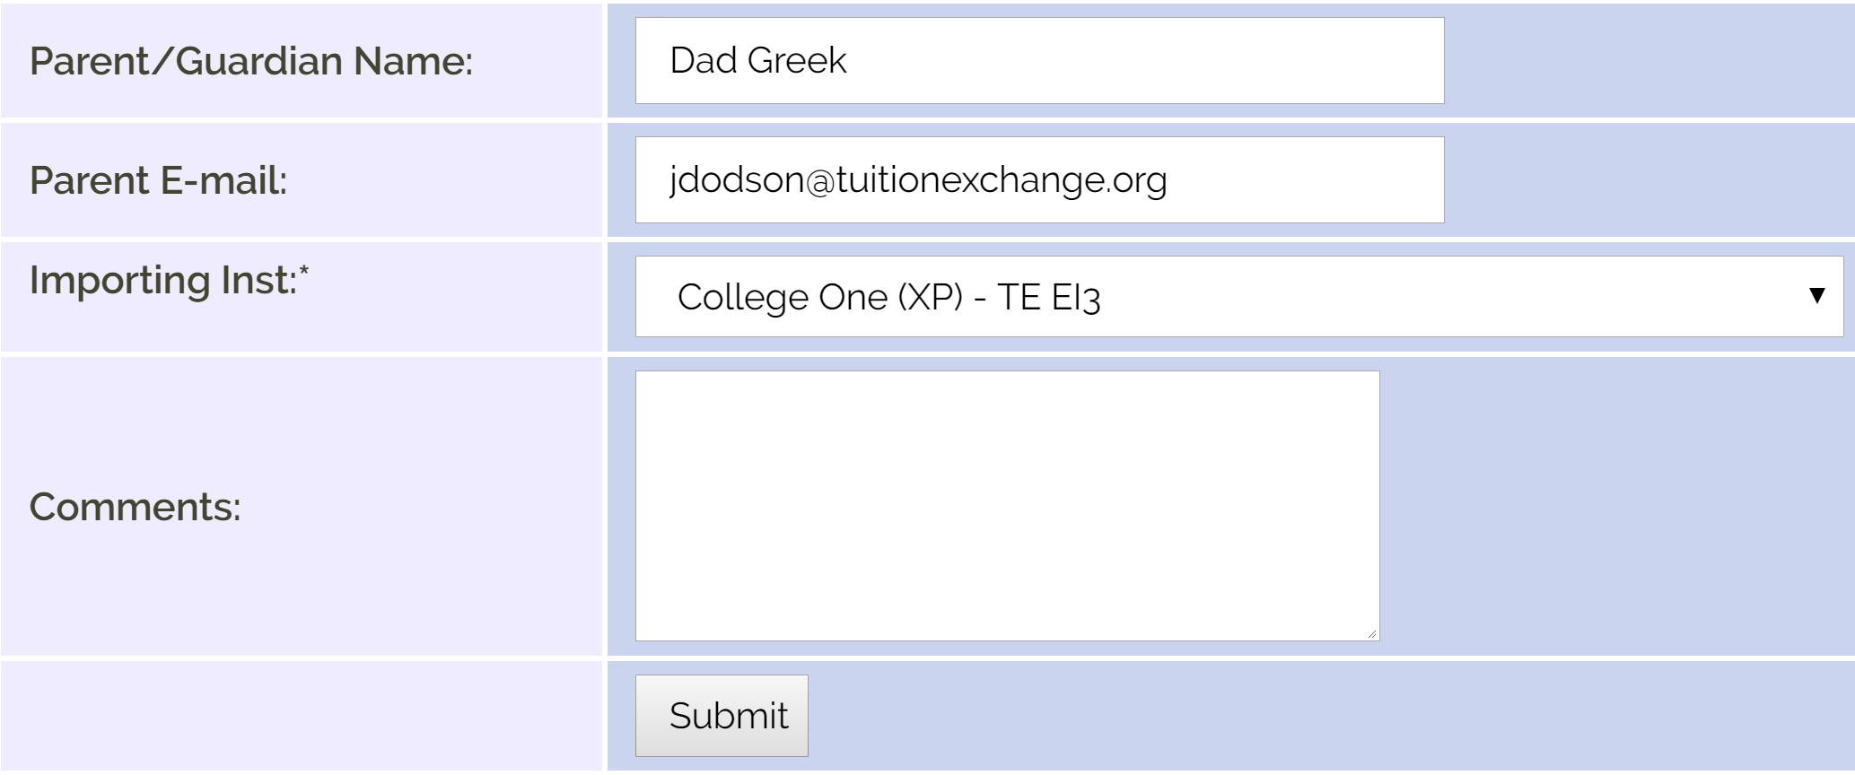
2018-19 recertification process - exports
Inside the Enrollment Report, click the Recertify button
The screen to the left opens, scroll to the bottom and click submit
The IMPORT TELO receives a notification email; and,
Provided the parent and student emails are valid emails are sent to them too

Slide 18
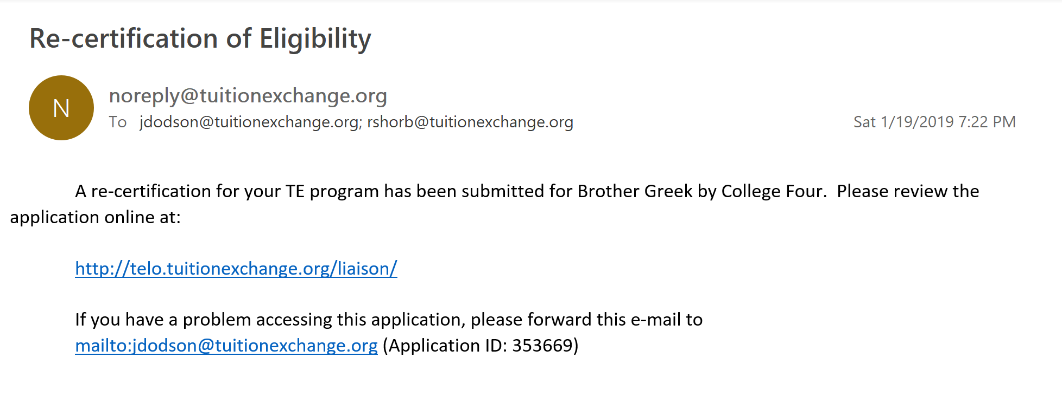
2019-20 recertification process - exports
IMPORT TELO notice
Once the submit button in clicked, this notice appears
If there is no valid emails the message alerts you that the parent/student were not provided an update
Do not forward this email to the family!

Slide 19
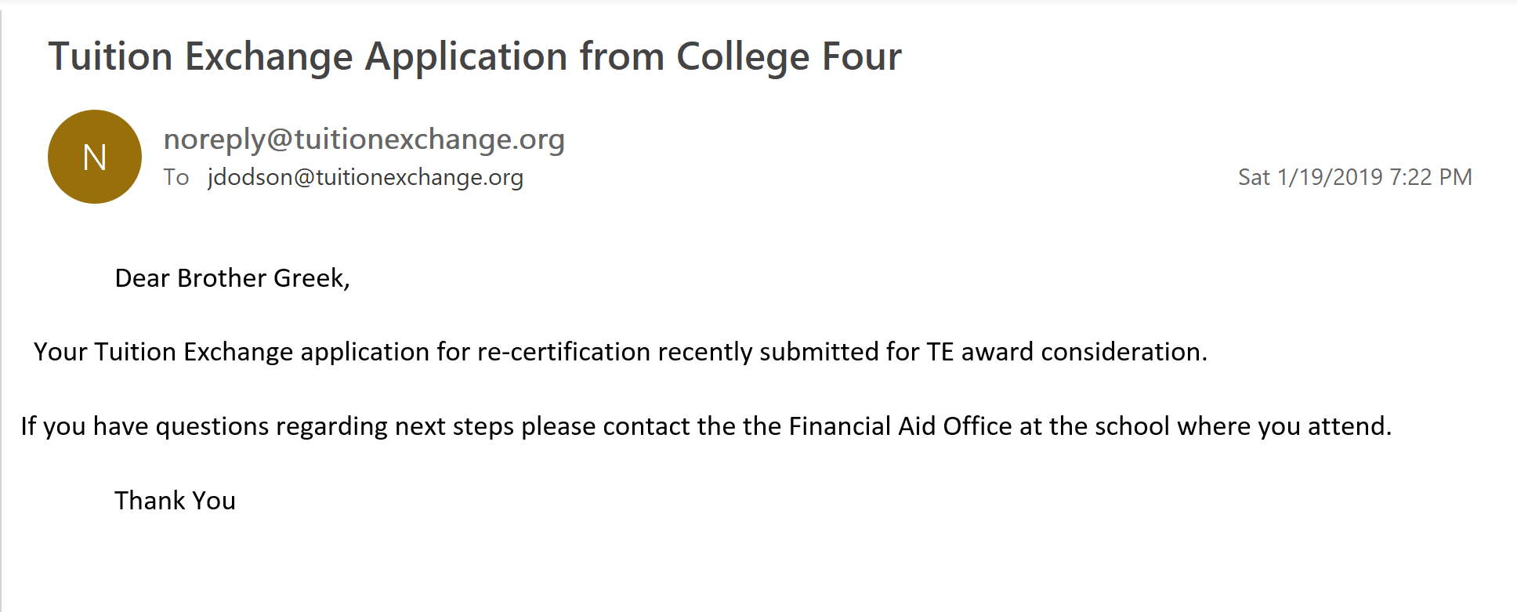
2019-20 recertification process – export email notifications
Student
Employee

Slide 20
2019-20 recertification process
If a Re-certified student is no longer eligible – update the student’s expiration date
Updating the expiration date trumps the original re-certification process
Review slide 4 or 7 for visual directions to update the student’s expiration date

Slide 21
2019-20 recertification process - imports
Imports require action too.
Review the View Submissions section for continuing student IMPORTS and EXPORTS who have been recertified in the current academic year for next year

Slide 22
2019-20 recertification process - imports
Click on the student’s name you wish to recertify for 2019-20
This opens up the student’s 2019-20 record
If you do not recertify each eligible student, the student will NOT appear on your 2019-20 Enrollment Report

Slide 23
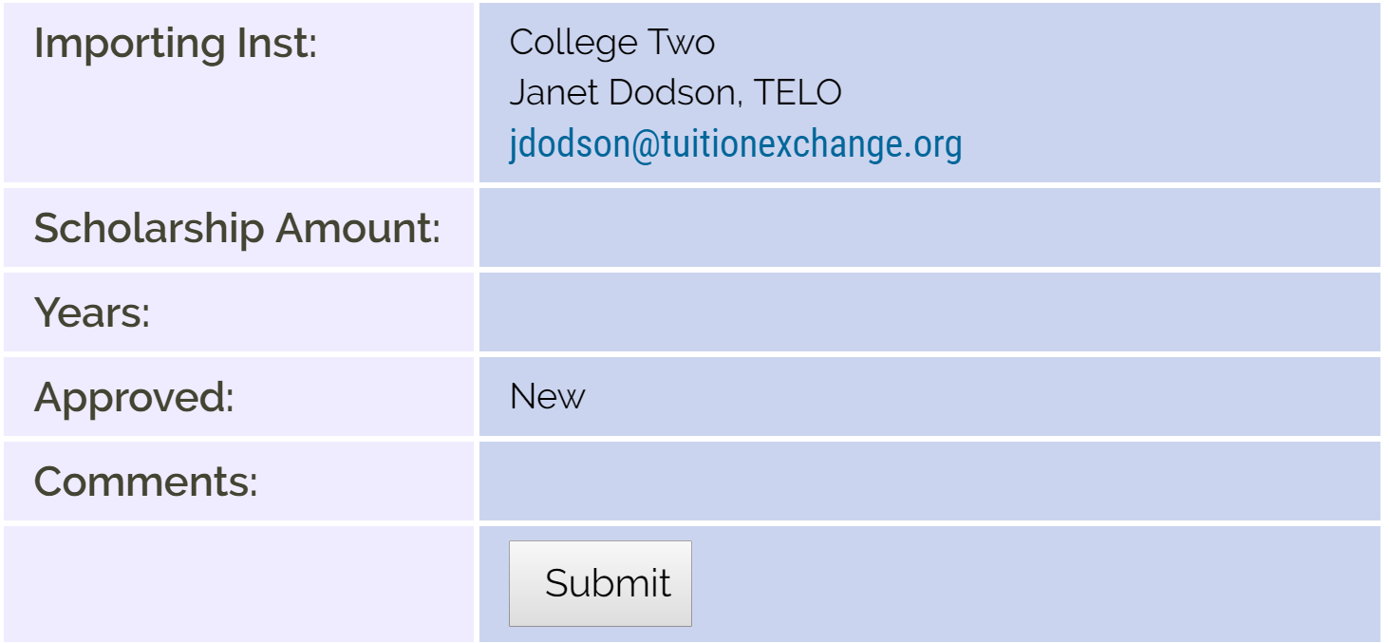
2019-20 recertification process - imports
Each IMPORT school must complete the information for EACH eligible import
The scholarship amount is the dollar amount the student will receive in TE funds for the 19-20 academic year
Whole numbers only and NO $ signs, commas, periods or cent signs
Years is the total number of years you expect to support the student
Approved click Yes
Comments are shared with the other school
Be sure to click SUBMIT

Slide 24
2019-20 Application process – new student
Engage the EZ application option
The EZ app can free up your time for other important tasks
If you engage the EZ app you still control the approval process
Complete the application via the Application option in your TELO portal
If you complete the application you are automatically approving the application when you click submit!
Remember you must click preview, close the preview screen and then click submit

Slide 25
2019-20 application process – new student
Often students want their applications sent to many schools. To accommodate their request use the following instructions
Students may ask that you submit TE applications after their original application is submitted
The TE System has school specific tables rather than student specific tables
This means that when students ask you to add more schools to their application
– you start again with a NEW APPLICATION or the student completes another EZ App
TE Central recommends using Firefox or Chrome for the best TE application and report results

Slide 26
2019-20 application process - import
The Import school needs to review the Decision Pending section often and…
APPROVE - means your school will fund the student or
DENY – is a multi-purpose word
either the school denies the student the award OR
the student declines the award by saying no OR not completing the admission application process or
WAITLIST – means you will consider the student should a spot become available

Slide 27
2019-20 application process – import
When approving an IMPORT application you click Approved, one of the three tuition options AND the tuition amount
Comments are shared with the EXPORT school
Be sure to click Update Application

Slide 28
2011-20 application process – email communication
Parent email
Student email
Above is an example of a NEW TE scholar email. These emails are mailed from a NoReply email address.
This email box is not monitored. No emails for deny, withdraw, or waitlist are sent to families.

Slide 29
Telo report options
Firefox or Chrome work best with the TE portal
Reports can be downloaded and then uploaded to your CSM system
The details presented in the report are the details entered on the application either by the family or TELO

Slide 30
Telo report imports/exports
Click Tools for download options
Click the + to expand the year
PLEASE Be mindful when downloading this file to EXCEL. All years are available. You need to review the EXCEL file and modify it to include ONLY the students you wish to notify.

Slide 31
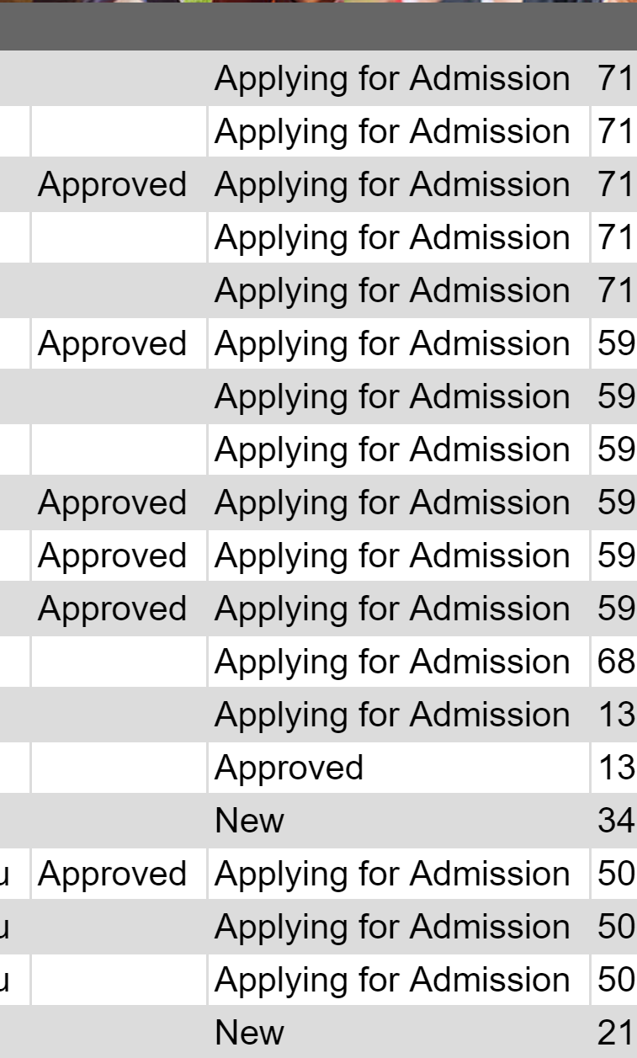
TELO Report Options
Applying for Admission represents NEW TELO applications
NEW represents continuing TELO applications for continuing students
Approved means the NEW TE application was approved at the IMPORT school and the student will receive a TE scholarship should they enroll.

Slide 32
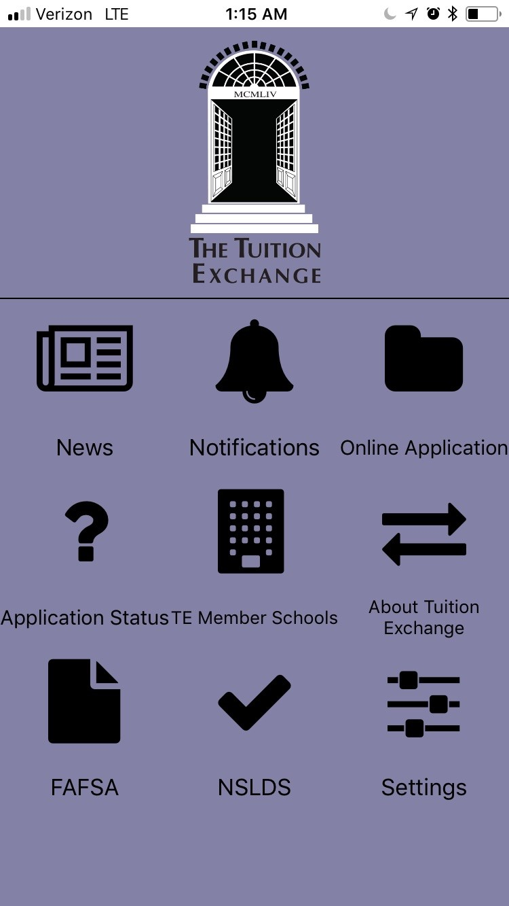
TE Central updates
Set-Rate
2019-20 is 37,000
2020-21 is 38,000
Tuition Exchange – there’s an app for that…
Apple Store – search Tuition Exchange
Google Play Store – search Tuition Exchange

Slide 33
Te Central updates
Check out the latest addition to the Families section
Each TE member school can be found on the google map
TE assumes no responsibility for your school’s Google rating

Slide 34
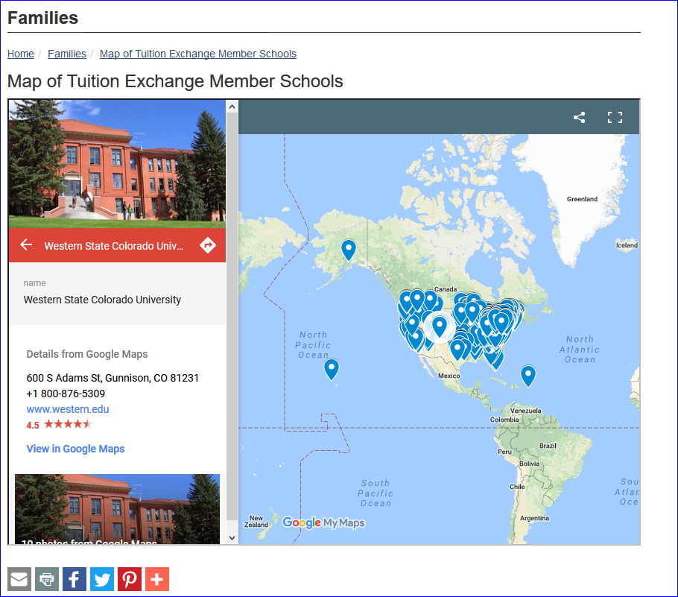
Te central updates

Slide 35
Let’s Recap
2018-19 Recipient Review
2019-20 Approval and Processing
TE Reports
TE Central Updates
Recap

