Slide 1
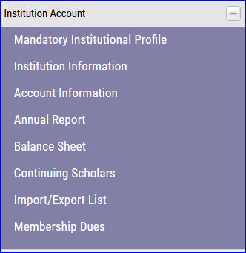
Recertifying Eligible 2017-18 continuing student
TE scholars – EXPORT school only
Open your Annual Report

Slide 2
Scroll to the EXPORTS for 2016-17 and review the section titled Re-certify 2017-18
If the box reads Re-certified your work is complete. If the box read Re-certify your
need to click the Re-certify box and update the record.
DO NOT create a new application for continuing students.

