Slide 1
Mandatory Training
Fall 2023
TE Liaison Professionals
TE Staff

Slide 2
Agenda
Why Mandatory Training?
Mandatory Institution Account Review & Update
TELO Options
Policy and Procedures
Application Review
New and Continuing Student processes
Enrollment Report
Be aware of Family changes
Exciting News

Slide 3
Why Mandatory Training?
Timely processing reminders
The constant change in TELOs
New Academic Year Checklist review
A break from your normal routine – with a national weather report ☺
Exciting News

Slide 4
Processing Reminders
Subtitle

Slide 5
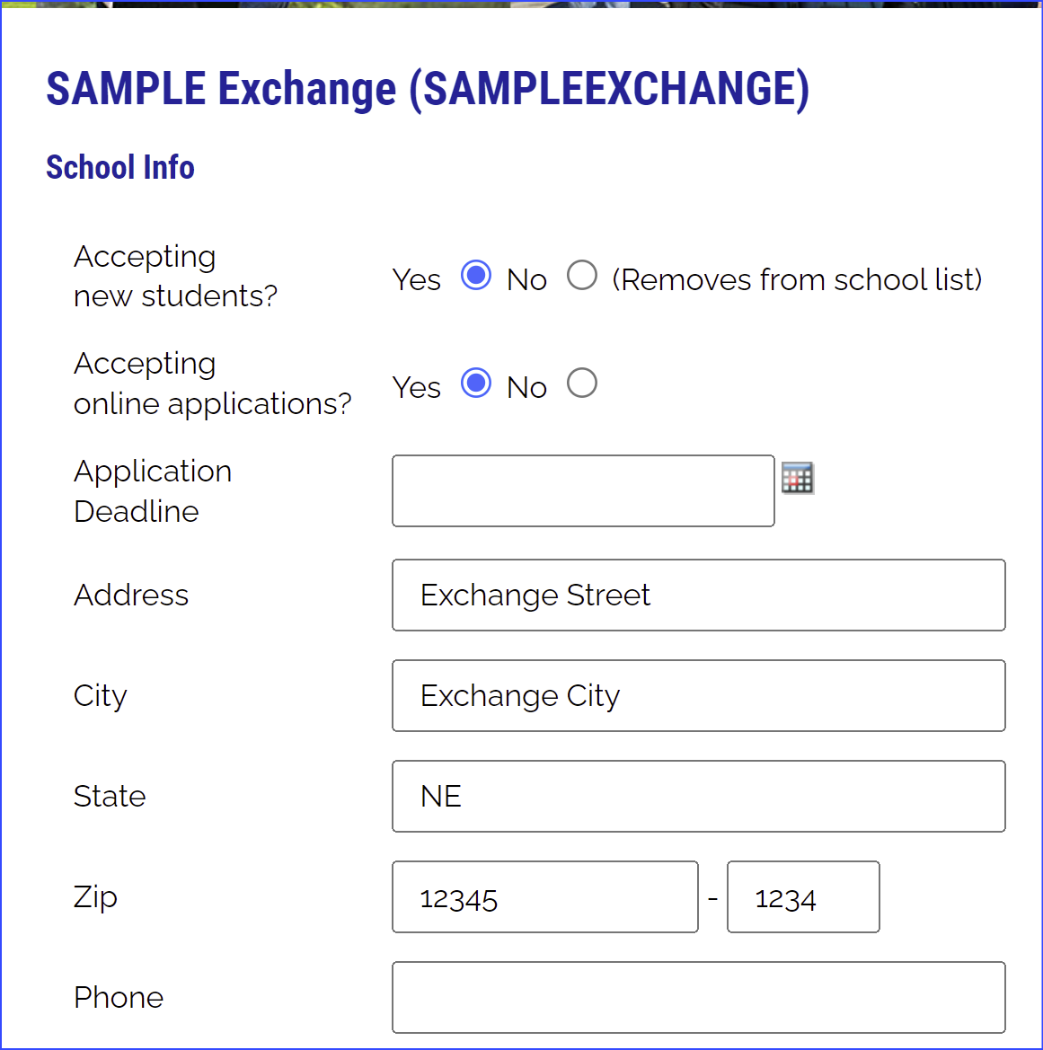
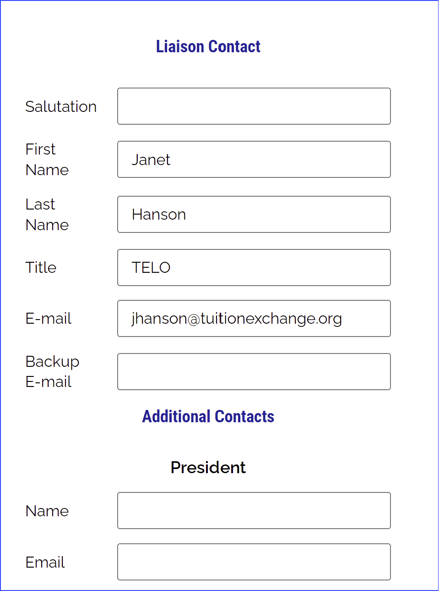
Processing Reminders
Confirm & Update
Review listed employees

Slide 6
Mandatory Updates Needed NOW!
Update 2023-2024 Tuition and Scholarship amount
Confirm the application deadline is not blank
If you do not have a deadline enter 8.15.2024
No deadline means your school does not appear on the list of participating schools
Is the listed TELO information, correct? If not, email Suzanne at sleance@tuitionexchange.org with the name, email, phone, and title
Is your school’s name and mailing address, correct?

Slide 7
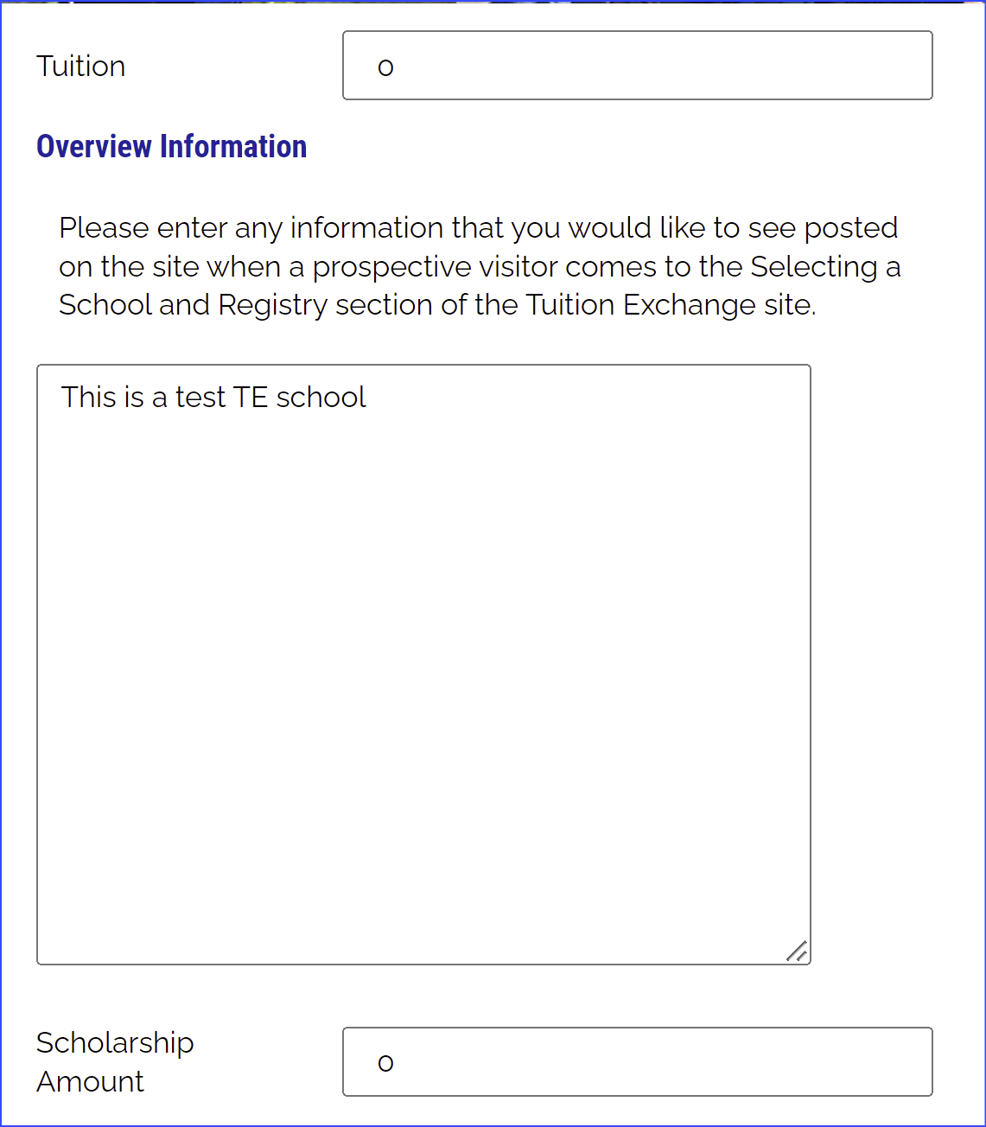
Mandatory updates
Update Tuition and Scholarship amounts
Be sure your overview is friendly and accurate

Slide 8
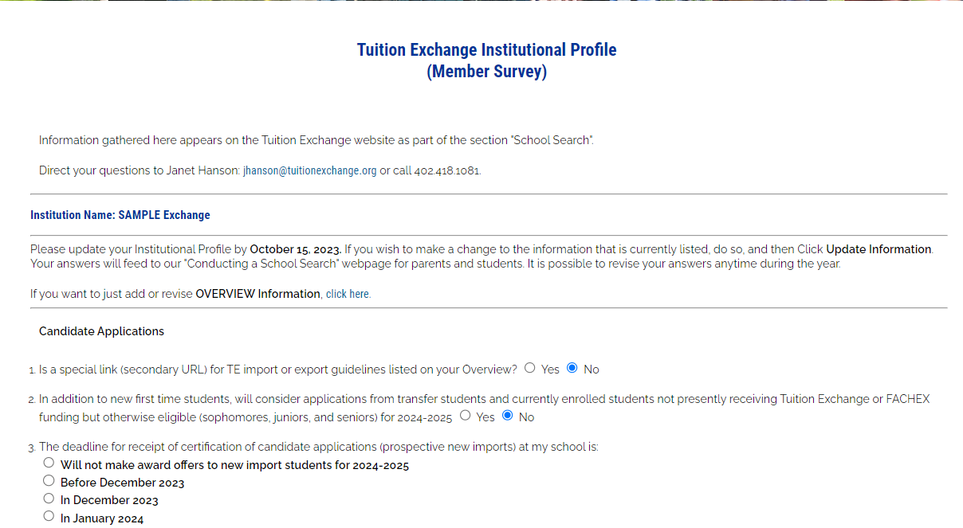
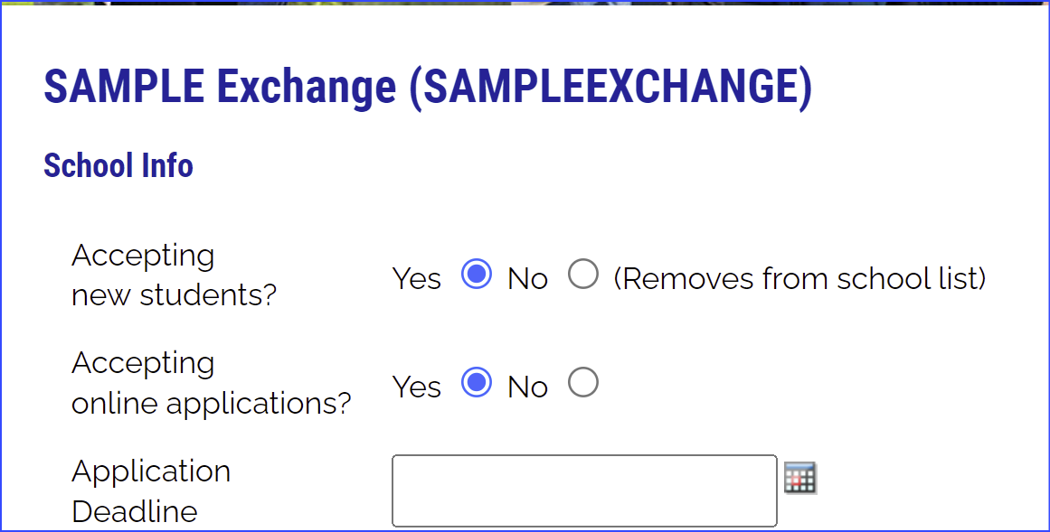
Mandatory review
Review the Institutional Profile
TE-EZ Online application

Slide 9
TELO Options
TELO–Primary and Secondary
TELO–Export and Import
Primary and secondary are responsible for the entire process but:
If the primary is in Human Resources, there are Admissions and Financial Aid issues
If the primary is in Admissions, there are Human Resources and Financial Aid issues
Consider…
Two TELOs with access to and knowledge of specific issues
Human Resources knows employees
Admissions and Financial Aid know new students and continuing students
The TE system can accommodate a split in duties

Slide 10
The TE Players at your school
Primary TELO
Backup TELO
Student
Employee

Slide 11
Where is yours? The TE TELO Handbook is updated and available online
Policies vs Procedures
This Photo by Unknown Author is licensed under CC BY

Slide 12
www.tuitionexchange.org Liaison Officers TE Liaison Officer Handbook
Tuition Exchange
TE Liaison Officer Handbook
This Photo by Unknown Author is licensed under CC BY-NC-ND

Slide 13
Policies & Procedures
Employees
Incoming & Continuing students
Time on the job
Full-time-vs-less than full-time-vs-contract labor
Retired or deceased
Definition of employee dependent
Undergraduate student – employee, spouse, or dependent
Graduate student – employee or spouse
Eight semesters max for undergraduate
Four semesters max for graduate
Applied and admitted
Enrollment status
Transfer credit review
Approved Leave of Absence (LOA)
Graduation date review
Enrolled in a degree program

Slide 14
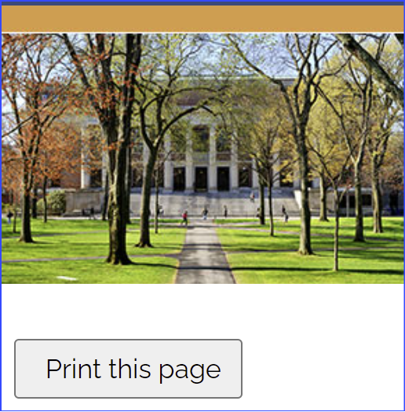
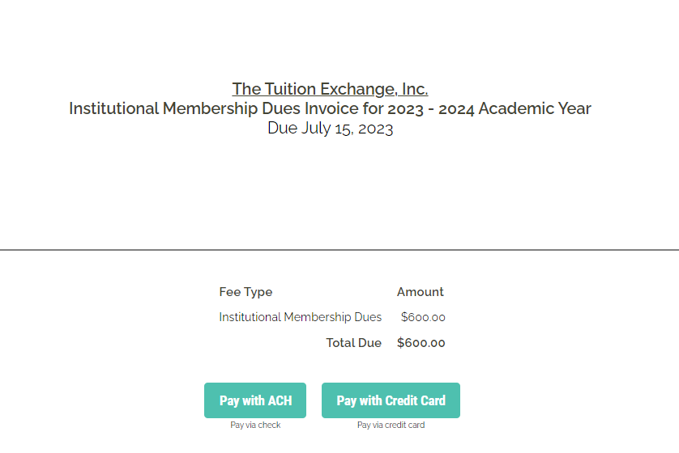
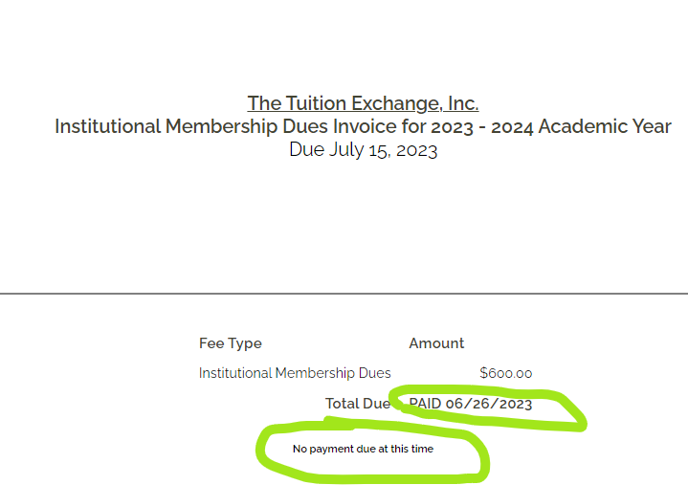
Membership Dues
Membership Dues
Payment options
Membership Dues are to be paid upon receipt and considered late if not paid by July 15.
TE Central accepts Credit Card and paper checks.
No fees are charged when using a credit card for payment.
Once payment is received, an updated statement is emailed with a No payment due at the time message.
On June 26, 2023 Invoices were emailed to the primary and backup TE liaison and Invoice contact if listed
If your invoice is paid the option is missing when you log in to the system.
You can always review your Membership Dues statement.

Slide 15
When paying by check, please allow 14 days for processing

Slide 16
Brain break

Slide 17
TE Applications - TE-EZ Online app or paper?

Slide 18
EXPORT Schools TE-EZ Online App
Make your office hours count.
The TE-EZ Online App allows families to complete their application
The TE-EZ Online app first goes to the EXPORT school for eligibility certification and approval
The EXPORT school controls the employee eligibility approval or denial of the TE-EZ Online app
Remember, once you approve the TE-EZ Online app or ENTER the paper application, and hit submit, you have approved the named student for IMPORT scholarship consideration – there is NO recall option unless the parent is no longer an eligible employee

Slide 19
TE-EZ Online App process
Step 1 – Family completes the TE-EZ Online app and submits
Step 2 – Export TELO receives a notification email from NOREPLY@tuitionexchange.org that the app is available for review
Step 3 – Export TELO looks inside Applications – New Exports – 2023-2024 Decision Pending
Step 4 – Approve or Deny each application for Import scholarship consideration
This only means the employee meets your eligibility guidelines for Export!
Step 5 – Emails launch to the family members with an email listed on the application informing them of the Export decision
Now, the student shifts their focus of communication to the IMPORT school

Slide 20
Regardless of how the initial TE-EZ Online application is entered, the application can be tracked The tracking details require information to be entered exactly as it was submitted on the TE-EZ Online app Typical error issues are the student’s birthdate and email address. TELO can share a copy of the app with the student upon request

Slide 21
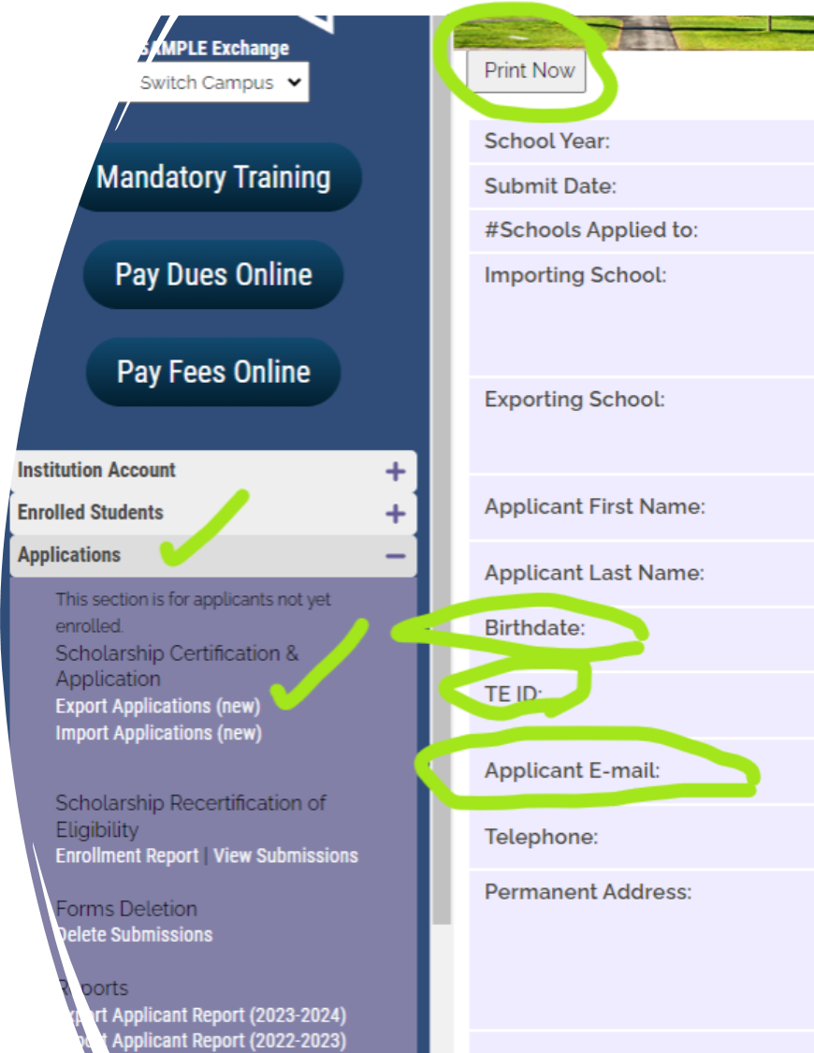
How to share a copy of a TE-EZ Online app with the student
TELO Portal
Applications
Export Applications New
Open student record
Click print
Print a PDF
Email PDF to student

Slide 22
Information Flow
Export TELO
Employees informed via lunch and learns, HR announcements & other notification avenues
Family
Families explore the TE website. The family section includes membership lists, individual school requirements, and application deadlines
Import TELO
Campus officials are reminded of your school’s participation. Keep Admissions and Financial Aid personnel in the know!
Student
Admissions & FA
Students must apply for admission and be admissible to be considered for Tuition Exchange
Import TELO needs to be diligent in sharing Import information details with Admissions and Financial Aid

Slide 23
Import Students – New & Continuing
New students - IMPORT
Continuing students - IMPORT
Confirm the new student’s admit status
If not admitted at this point in the year, deny the application
Communicate with FA that the TE scholarship is official
If admitted, confirm the student paid their enrollment deposit and plans to attend your school in the fall
Once school begins in the fall, the Import school clicks the Enrollment Box provided the student “shows up”
Confirm the student is enrolled for the upcoming semester/term
If not enrolled, update the expiration date – Drop at the END of LAST semester
Confirm academic progress (Check with FA or the Registrar)
Communicate with FA that the TE scholarship continues
Confirm the expiration date is valid
Do not recertify until Spring 2024

Slide 24
Enrollment Report
2023-24 Enrollment Report access is unavailable until your TE Central Mandatory Training for 2023-24 is completed.
Everyone with TE portal access is required to participate and complete TE Central Mandatory Training annually.
Do not add any new students until after the Fall 2023 Census. Not sure when Census occurs, ask your Registrar.
2023-24 Enrollment Report access will be granted on August 15 for all who complete Mandatory Training in July.

Slide 25
The Enrollment Report is the REPORT!
Imports & Exports
REVIEW Required
Confirm the student is in the right category and at the correct school (Import & Export school)
Confirm the Expiration date is accurate (Import school)
Confirm the employee remains eligible (Export school)
Confirm the school’s basic tuition for 2023-2024 is correct (Import & Export school)
Confirm the school’s TE scholarship for 2023-2024 is correct (Import & Export school)
Review the Report by late September, ensuring all students are reported correctly (Import & Export school)
Review once the spring term begins ensuring all students are reported correctly (Import & Export school)
Recertify eligible students on or after February 15, 2024 (Export school)
Review after the close of the spring semester that all students are still correct AND the expiration dates are valid (Import & Export school)

Slide 26
Participation Fees (P-fees)
Participation Fees
Payment options
Please do not pay the 2023-24 Participation fees now. They are due in the fall upon receipt and considered late if not paid by October 15.
TE Central accepts credit cards and paper checks.
No fees are charged when using a credit card for payment.
Once payment is received and posted. The primary and backup TELO, and Invoice contact if listed receives an updated invoice statement with a 0.00 balance
Invoices appear once the Enrollment Report is submitted
You can always review your Participation Fee invoice by opening the Enrollment Report, scrolling to the bottom, and clicking SUBMIT.

Slide 27
When paying by check, please allow 14 days for processing

Slide 28
New Student Action IMPORT After Fall Enrollment
Understand FERPA rules – not sure check with your Registrar.
Confirm all TE students are enrolled and attending.
For new students, click the Enrolled box inside the individual enrolled student record.
Monitor your Enrollment Report confirming all students are added.
Always print and save every copy of your Enrollment Report.

Slide 29
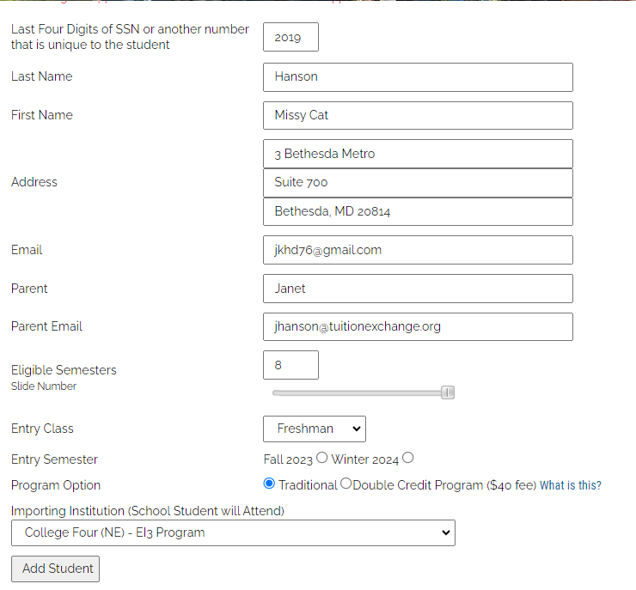
New Student Action EXPORT After Fall Enrollment
Understand FERPA rules – not sure, check with your Registrar.
Export schools monitor the TO BE Enrolled 2023-24 category and act by adding the enrolled student.
Review the Enrollment Report confirming the student added.
Be sure to print and save every copy of your Enrollment Report.
Submit the Enrollment Report to engage the Participation Fee (p-fee) invoice.
The p-fee invoice is always due upon receipt.

Slide 30
No renewal application is required if the student and parent stay with the same employer and IMPORT school.
BUT… remember, there are no guarantees
If the parent changes jobs, the current EXPORT school expires the student’s eligibility.
The new EXPORT employer confirms or denies eligibility. If eligible, a new TE-EZ online app is required.
If the student transfers to another TE member school, the former IMPORT school expires the student’s eligibility and updates the EXPORT school of the change.
The new IMPORT transfer school determines the student’s eligibility. If eligible, a new TE-EZ online app is required, returning to the EXPORT school for employee eligibility determination.
Be aware of student & family changes

Slide 31
Be aware of student & family changes
Ultimately, the student is responsible for ensuring the TE scholarship is credited to the student’s IMPORT account.
If not credited, the student must contact the Financial Aid Office at the IMPORT school.
Export schools should direct the student to contact the Import school’s Financial Aid Office.
And finally
Several TE schools require their employee to complete an internal renewal application – please review the policy asking yourself why and for what purpose.
TE Family Challenges

Slide 32
Reminders
​Updating your attendance is a manual process. Everyone completing Mandatory Training will have access to the 2023-2024 Enrollment Report on or after August 14th. You will be notified when your access is granted.
You can still do so if you forgot to print and save a copy of your 2022-2023 Enrollment Report.

Slide 33
And now for some exciting news…

Slide 34
Beginning in July 2024, all TE schools must list a primary and secondary TELO. The primary TELO will serve as the institution’s gatekeeper, adding and removing individuals as needed. Others can be provided access based on their need to know. Changes to internal procedures may be required.
Announcement Number 1

Slide 35
Announcement Number 2 Beginning with the 2024-25 application year, all TE schools must use the TE-EZ Online app process. The paper app option will not be available beyond the 2023-2024 application year. Changes to internal procedures may be required.
This Photo by Unknown Author is licensed under CC BY-NC

Slide 36
Announcement Number 2 (continued) Students “control” the initial application process
Students create a user account, and all app statuses will be visible within the account itself.
Within the user account, students complete the TE-EZ Online app independently of the user account.
Students can modify the list of school choices by removing or adding new schools.
No reported employee information can be modified.
Export school controls the EMPLOYEE eligibility requirement and approval.
All employees will be required to use the @nameofschool.edu account.
All schools will have three alpha/numeric fields to collect extra information, like employee ID.
NO MORE SILO system.

Slide 37
.
Announcement Number 3
Beginning with the 2024-25 application year, all TE applications will be certified through the student’s anticipated graduation date.
The Import and Export school can update the record should the parent or student become ineligible.
Changes to internal procedures may be required.

Slide 38
.
Announcement Number 4
Beginning with the 2024-25 application year, all TE applicants (students) will be asked to confirm (via a FERPA Acknowledgment question) that the Export and Import schools can share TE scholarship information with the listed eligible employee (parent) only.
Changes to internal procedures may be required.

Slide 39
Thank you – have you figured out our exciting news yet? Stay tuned for more announcements throughout the year!
Janet Hanson – jhanson@tuitionexchange.org – www.tuitionexchange.org

