Slide 1
TE 103
Janet Dodson and Bob Shorb
April 2019

Slide 2
Today’s Focus
TE Guidelines
What’s in yours?
Balance Sheet scenarios
Let’s do the Math
TE Central updates

Slide 3
TE Guidelines
Define
Define your program inclusions
Define
Define your audience of participants
Define
Define your process

Slide 4
TE Guidelines
Program inclusions
Undergraduate programs
Degree-completion programs
Graduate programs
Professional degree programs
Locations
Main campus
Branch campuses
Online

Slide 5
TE Guidelines
Define audience participants
Employees
Required length of employment
Type of eligible employment
Full time
Regular part-time
Adjunct
Visiting faculty
Consultant
Eligibility
Calculation and determination of years of service
Application priority deadline
What if both parents are employed at a TE school
Multiple student issues

Slide 6
TE Guidelines
Define audience participants
Who is a dependent
Biological child
Step-children
Other child issues
Employee
Employee spouse/partner

Slide 7
TE Guidelines
Student enrollment expectations
Full time
Degree seeking
Undergraduate
Eight semesters or graduation, whichever comes first
Graduate or Terminal/professional degree
Four semesters or graduation, whichever comes first
Other considerations
Less than full time enrollment
TE scholars wanting to transfer
TE scholars taking a leave of absence for more than one consecutive semester

Slide 8
TE Guidelines
Defining your process
Export
Import

Slide 9
TE Guidelines
Tuition Exchange is not an employee benefit
Consider mirroring your campus Tuition Remission guidelines
Tuition Exchange is truly a scholarship program

Slide 10
TE Guidelines
Exports
Explain how employees are approved
Years of service
First-come, first-serve
Every application is assigned a number and on X date, using www.random.org a pre-determined number of applications are approved and entered into the TE system for Import consideration
Consider implementing an application priority date
Keep employees informed
Don’t forget mitigating circumstances occur
Consider allowing prior higher education experience in your years of service calculation

Slide 11
TE Guidelines
Imports
Explain how students are approved
First-come, first-serve
Academic requirement
Geographic footprint
Wait list considerations
Consider implementing an application priority date
Keep applicants informed
Don’t forget mitigating circumstances happen

Slide 12
TE Guidelines
Continuing student renewal
Exports
Continued eligible employees
Recertify
Employees who
Resign
Loose eligibility immediately or at the beginning of the next enrollment period
Retire
depends
Reduction in Force (RIF)
depends
Pass-away while employed or on long-term disability
TE Central suggests maintaining employment eligibility
Be sure to cover yourself with a mitigating clause

Slide 13
TE Guidelines
Continuing student renewal
Imports
Continuing scholars
Enrollment
Full time each term
Academic credentials
Meet or exceed the credentials
Maintain eligibility
Below the required credentials
Loose funding at the beginning at the next term
Be sure to cover yourself with a mitigating clause

Slide 14
TE Guidelines
Where are TE Guidelines published?
Employee Handbook
College Catalogue
Student Handbook
How do you insure EXPORT families understand program expectations?
Memo of Understanding
How do you confirm IMPORT students understand program requirements?
College catalogue
Student handbook

Slide 15
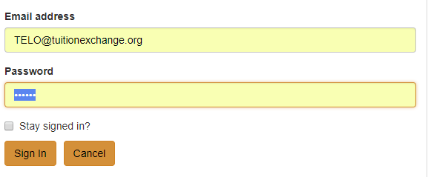
TE Guidelines
www.tuitionexchange.org
Select the TELO ONLY Resource section
TELO14
Communication folder – look for TE Guidelines template
A skeleton template is available inside the
Prospective Membership tab

Slide 16
Balance Sheet Scenarios
Four schools
Four different scenarios
Please make note of any questions you might have until the four scenarios are explained.

Slide 17
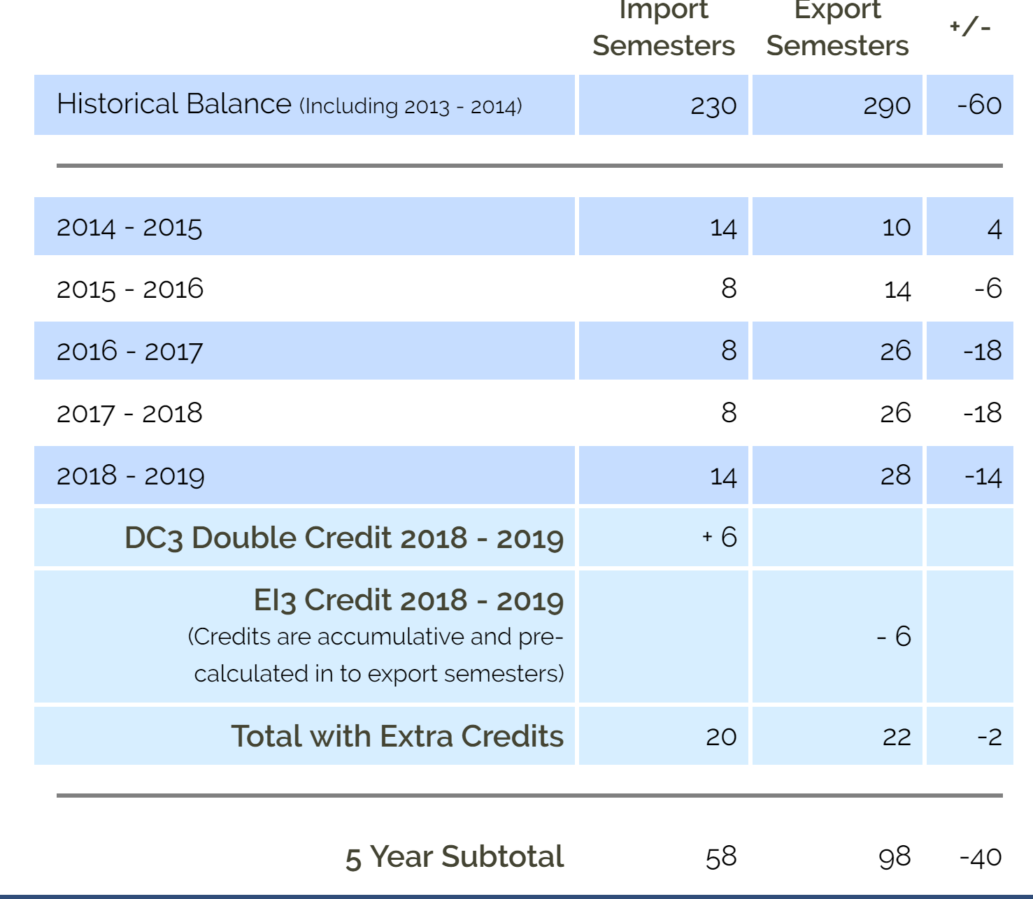
School A

Slide 18
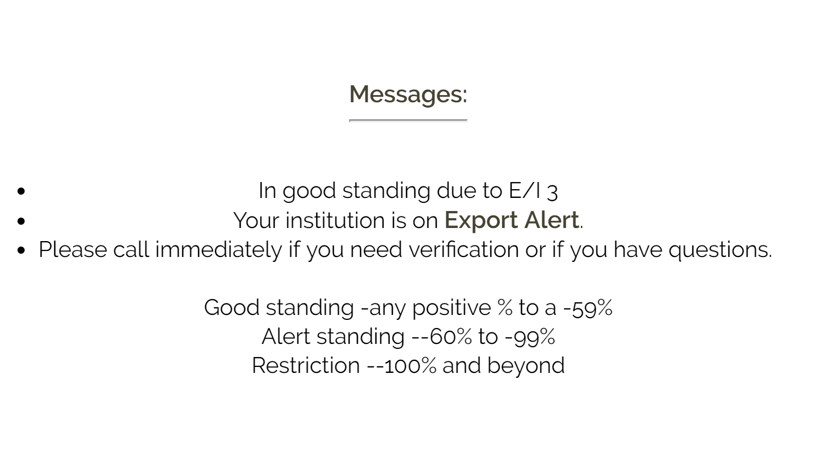
Let’s calculate School A’s status.
We always use a five year subtotal.
The numbers are reflected by semesters not headcount.
Remember formula requires an order of operation.
58 is the number of Imports
98 is the number of Exports
58 – 98 = -40
(40)/58 = .689565517241 * 100 = -68.97%
This school is on EXPORT Alert – but wait… This school is an E/I 3 school so they are still in good standing and able to export up to THREE new students annually.

Slide 19
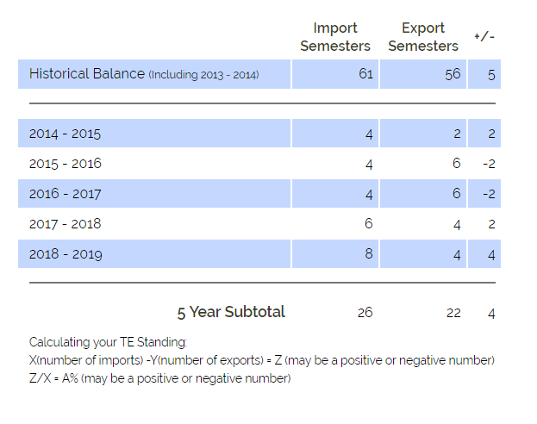
School B

Slide 20
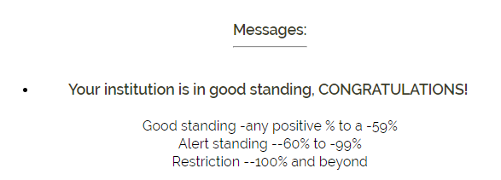
Let’s calculate School B’s status.
We always use a five year subtotal.
The numbers are reflected by semesters not headcount.
Remember formula requires an order of operation.
26 is the number of Imports
22 is the number of Exports
26 – 22 = 4
4/26 = .15384615384 * 100 = 15.38%
This school is in Good Standing

Slide 21
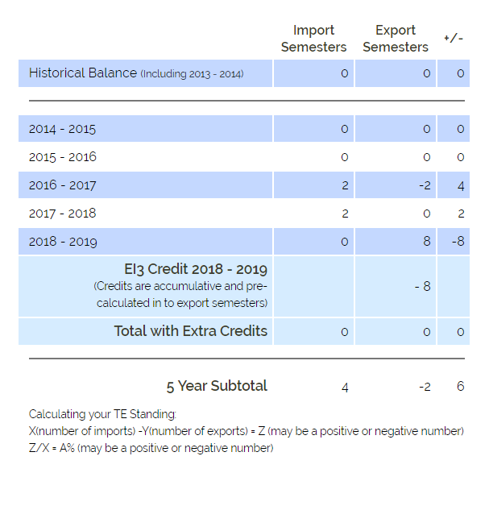
School C

Slide 22
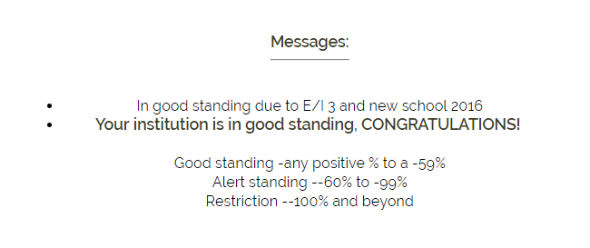
Let’s calculate School C’s status.
We always use a five year subtotal.
The numbers are reflected by semesters not headcount.
Remember formula requires an order of operation.
Without E/I 3
4 is the number of Imports 4
-2 is the number of Exports BECAUSE OF E/I 3 credits 10
4 – (2) = 6
6/4 = 1.5 * 100 = 150% -6/4 = -150%
This school is in Good Standing Without E/I 3 this school would be on Restriction

Slide 23
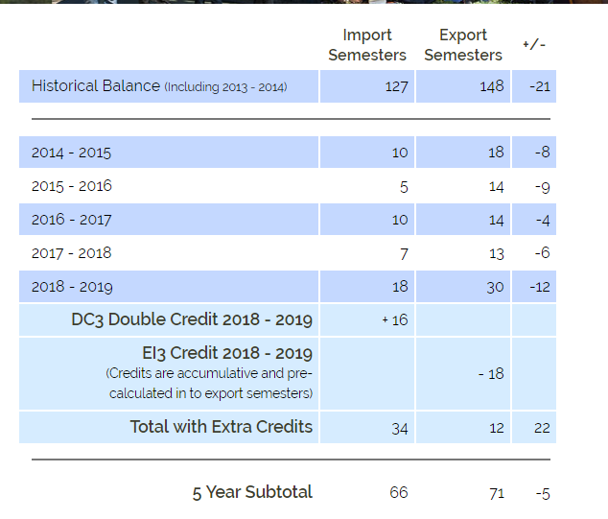
College D

Slide 24
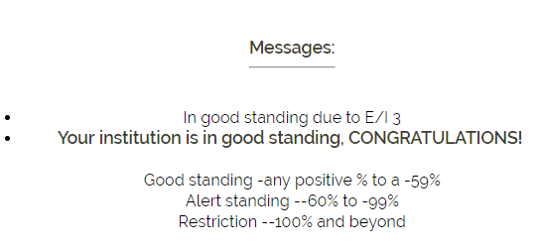
Let’s calculate School D’s status.
We always use a five year subtotal.
The numbers are reflected by semesters not headcount.
Remember formula requires an order of operation.
Without DC 3 and E/I 3
66 is the number of Imports BECAUSE OF DC 3 32
71 is the number of Exports BECAUSE OF E/I 3 credits 89
66 – 71 = -5 -57 without E/I 3 and DC 3
-5/66 = .077575757575 * 100 = -7.8% -57/32 = -178%
This school is in Good Standing Without E/I 3 and DC 3 this school would be on Restriction

Slide 25
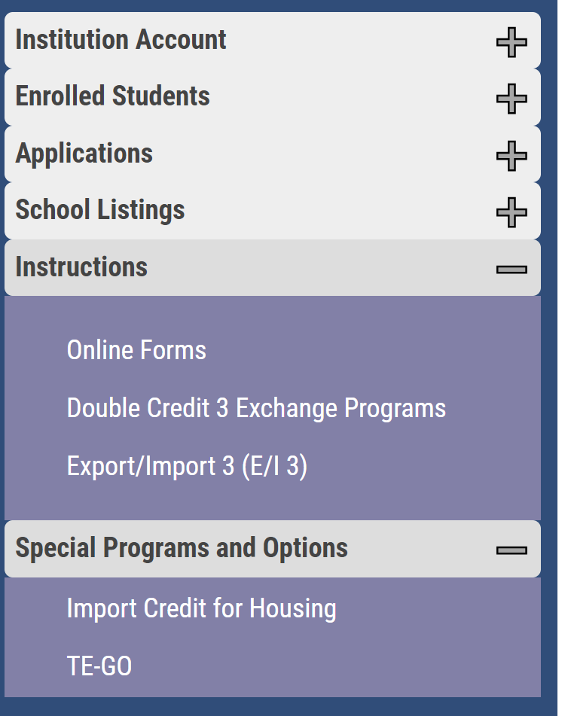
TE Program options
Feeling stressed about too many Exports and not enough Imports? Consider the following
Export/Import 3 (E/I 3)
Double Credit 3 (DC 3)
Co-Op – old program that is phasing out

Slide 26
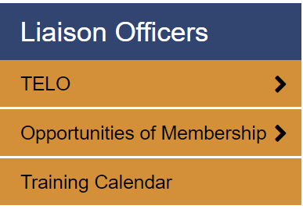
TE Central updates
Upcoming calendar events
Training calendar
Earning and receiving training credit(s)
Enrollment Report reminders

Slide 27
Import Verification
Emails sent early April to your Financial Aid Office
Many emails were out of date
We asked all TE Liaison Officers to share the why with your FA Office
Lots of push back
FA Offices did not feel it is their job to verify
Over 70 student changes
Annual event in late March/early April
Please visit with your FA Offices
Will continue to send reminders to TE Liaison Officers and FA Offices until all reports are completed

Slide 28
May 1 Seats Available survey
Tuition Exchange annual May 1 Seats Available survey will be emailed to all TELO’s and Admissions emails on file
The survey will ask if your school is still accepting applications for Fall 2019
If your school responds yes, your school will be listed on the front page of our website in the May 1 article
The purpose of this listing is similar to the NACAC College Openings
This is another tool for parents and other assisting students who have yet to complete their college decision
If you or a member of your school has questions about the process, contact Bob Shorb or me

Slide 29
Thank you for all you do to help families afford higher education. See you next month! Our final webinar of the year’s focus is 2018-19 Closeout.
This Photo by Unknown Author is licensed under CC BY

