Slide 1
TE Central Staff 2023-2024
Tuition Exchange 104

Slide 2
New TE Liaison Officer (TELO) Training Series Details
Available On-Demand
An excellent resource for new and seasoned TELOs
101 – TELO Basics
102 – TELO Website details, TE-EZ Online app
103 – TELO Guidelines, TELO Expectations & Employee Eligibility Issues
104 – TELO Monthly Training, Reporting & Frequently Asked Questions by TELOs

Slide 3
Today’s Focus
Training Information
TELO Reports
Enrollment Report
Confirmation Report
Printing Reports
Payments

Slide 4
Training Information
www.tuitionexchange.org
Liaison Officers option, click on the carrot to the right of Liaison Officers to open the Training Calendar

Slide 5
Where do I find TELO Training and Monthly Webinars details?

Slide 6
Enrollment Report

Slide 7
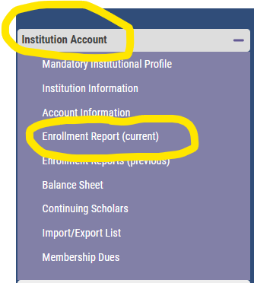
Where do I find the Enrollment Report?
Login to the TELO Portal
Institution Account
Enrollment Report (current)

Slide 8
The Enrollment Report is the REPORT!
Imports & Exports
A review is necessary
Confirm the student is in the right category and at the correct school (Import & Export school)
Confirm the Expiration date is accurate (Import school)
Confirm the employee remains eligible (Export school)
Confirm the school’s basic tuition for 2023-2024 is correct (Import & Export school)
Confirm the school’s TE scholarship for 2023-2024 is correct (Import & Export school)
Review the Report by late September, ensuring all students are reported correctly (Import & Export school)
Review once the spring term begins, ensuring all students are reported correctly (Import & Export school)
Recertify eligible students on or after February 15, 2024 (Export school)
Review after the close of the spring semester that all students are still correct AND the expiration dates are valid (Import & Export school)

Slide 9
Help, the Enrollment Report is not complete!
Missing records?
Was the Enrollment button clicked – see the next slide
If yes, contact the EXPORT school
The Export TELO failed to add the student
If the EXPORT school needs assistance, tell the TELO to contact TE Central

Slide 10
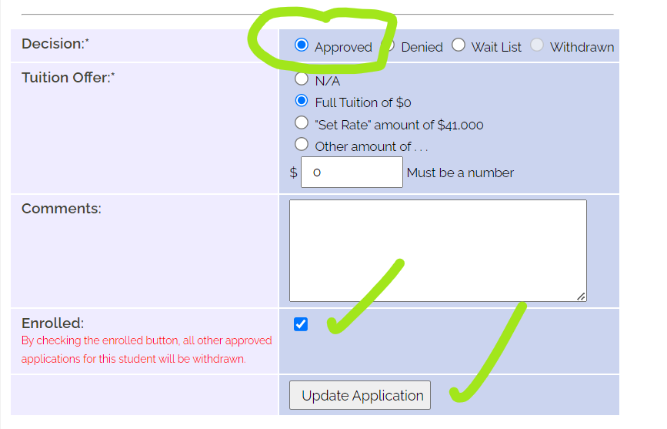
Import schools click Enrolled

Slide 11
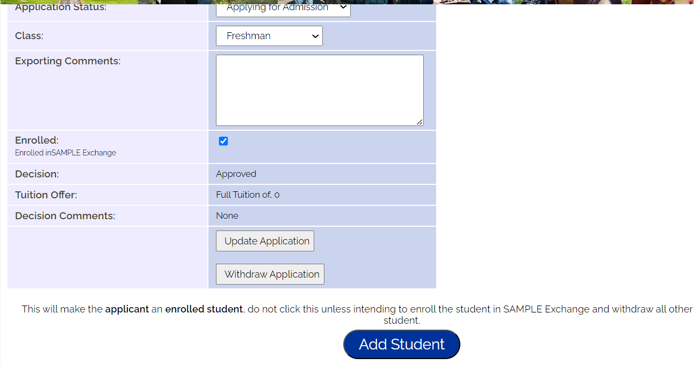
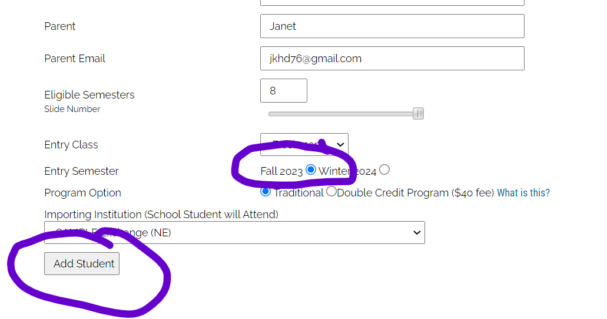
Export Schools Add Student
Open Applications – Export Applications (new)
Open To Be Enrolled 2023-2024
Click on the student’s name
Scroll to the bottom and click ADD STUDENT
Scroll to the bottom, click Fall or Spring term
Click ADD STUDENT
Review the Enrollment Report; the student is now listed
Pay your updated Participation Fee once the Enrollment Report is complete

Slide 12
Updating an Expiration Date
Enrollment Report
Click on the student’s name
Then click again
Scroll to the bottom of the student’s open record and select the correct drop option
Drop Student at End of This Semester
Is NOW
Drop Student at End of Last Semester
Is the previous concluded enrollment period (outside of summer)
If neither option is correct, contact TE Central

Slide 13
Confirming the Enrollment Report’s Accuracy
Export Responsibilities
All eligible returning students and new 2023-2024 students appear correctly
Import Responsibilities
Accept or Deny all applications
Keeping the Enrollment Report Current
The IMPORT school ENROLLS the student, and the Export schools must ADD STUDENT, to update and enroll the IMPORT to the Enrollment Report
Withdraw any employee’s students/applicants that are no longer eligible
Click the Enrolled button for all NEW students enrolled and attending as an Import
Remember – Imports and Exports share the student record
Confirm scholarship amount for each student is correct
Withdraw applicants that do not enroll or are still in decision pending/waitlist
Deny/Reject any students/applicants that are no longer eligible
Click ADD STUDENT for each new enrolled IMPORT found in the TO BE ENROLLED section
Emails keep you up to date!

Slide 14
Reminders, Warnings, and Cautions
Import schools NEVER add a missing student to the Enrollment Report
Import schools click the Enrolled Button
Export schools click the ADD STUDENT button
If a continuing student is missing:
Review last year’s Enrollment Report
Was the student listed?
If yes, review the Expiration Date
If the student expired, confirm with the other TELO that the student is still eligible
If yes, contact TE Central for assistance

Slide 15
Frequent TELO Enrollment Report Questions

Slide 16
Frequent TELO Enrollment Report Questions
Where are my new Import students?
Was the IMPORT student marked as ENROLLED by the IMPORT school?
Did the EXPORT school click ADD STUDENT?

Slide 17
Frequent TELO Enrollment Report Questions
My school is not listed on the Dropdown Box - why not?
Only the EXPORT school can add students to the Enrollment Report
The IMPORT school marks the student as ENROLLED
If yes, the EXPORT school needs to click ADD STUDENT
In the case of continuing students, contact TE Central for assistance

Slide 18
Frequent TELO Enrollment Report Questions
What is the process for updating a bad expiration date in the CURRENT academic year?
If the expiration date is outside the most recently completed term or the current term, contact TE Central for assistance
If during the current school year:
Open the current Enrollment Report, click on the student’s name, then click again.
Scroll to the bottom and click Drop Student at End of This Semester or Drop Student at End of Last Semester
End of This Semester is NOW
End of Last Semester is the semester which recently concluded (outside of summer)

Slide 19
Frequent TELO Enrollment Report Questions
A student on my Enrollment Report is not currently enrolled
If the student did not return or enroll for the current term, update the expiration date
Scroll to the bottom and click Drop Student at End of This Semester or Drop Student at End of Last Semester
End of Semester is NOW
End of Last Semester is the semester which recently concluded (outside of summer)
If the student NEVER attended, contact TE Central for assistance

Slide 20
Frequent TELO Enrollment Report Questions
The student’s biographical information is wrong or missing
Any information found in the white sections of the student’s TE-EZ Online app can be updated by either the Import or Export TELO
Enrolled Student – Edit Student
New student - the Application
Be sure to click update after revising the student record

Slide 21
Frequent TELO Enrollment Report Questions
The student is transferring to a new TE Exchange member school
NOTE: The CURRENT IMPORT school MUST update the student’s expiration date
If the Export school is agreeable to supporting the transfer, a NEW TE-EZ Online app listing the new IMPORT school is required
Be sure to remind the student that TE scholarships are not guaranteed
Both schools must agree to support the student and their TE scholarship application

Slide 22
Frequent TELO Enrollment Report Questions
The employee is moving to a new TE member school
The current EXPORT school updates the student’s expiration date
A NEW TE-EZ Online app from the new Export employer is required

Slide 23
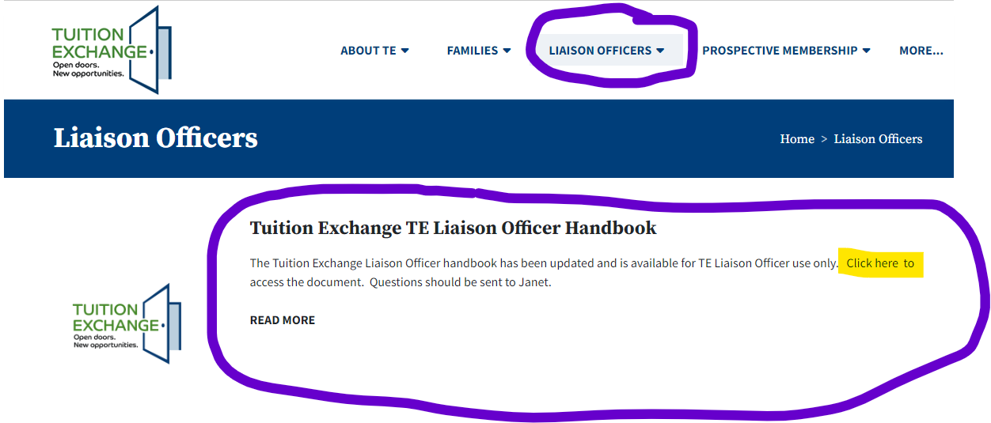
Frequent TELO Enrollment Report Questions
What about retired, deceased, contract or RIF employees?
Refer to the TE Liaison Officer Handbook – beginning on page 50
Consider utilizing a Memo of Understanding – an example is available on the home page
Liaison Officers, Training Calendar section, and in the Fall 2023 Mandatory Training Materials

Slide 24
Frequent TELO Enrollment Report Questions
Employees are pressuring me to re-certify current students
2023-2024 eligible employee re-certification opens after February 15, 2024
No school can re-certify until after February 15, 2024
Consider adding this information to all TE materials, so that your families are aware

Slide 25
Import Confirmation Report

Slide 26
Import Confirmation Report
Keeps schools in compliance, confirming the Enrollment Report is correct
Students continue to be missed on the annual Enrollment Report
Improves institutional understanding of the TE scholarship program
Complete the review before May 1
Compare the Import Confirmation Report against the Enrollment Report – all IMPORTS should be on both reports
If a student is missing, contact TE Central for assistance

Slide 27
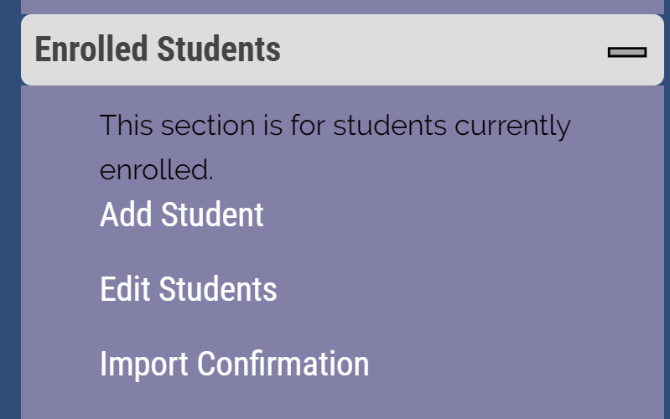
Where do I find the Import Confirmation Report?
Log into your TELO Portal
Select Enrolled Students
Import Confirmation

Slide 28
Import Confirmation Report
Work with the Financial Aid Office to confirm that all students listed were funded during the current academic year
Confirm means the student was funded at some time during the current academic year
Deny means the student was NEVER funded during the current academic year
Please complete this report in the Spring term

Slide 29
Understanding TE Membership Dues & Participation Fees (P-fees)

Slide 30
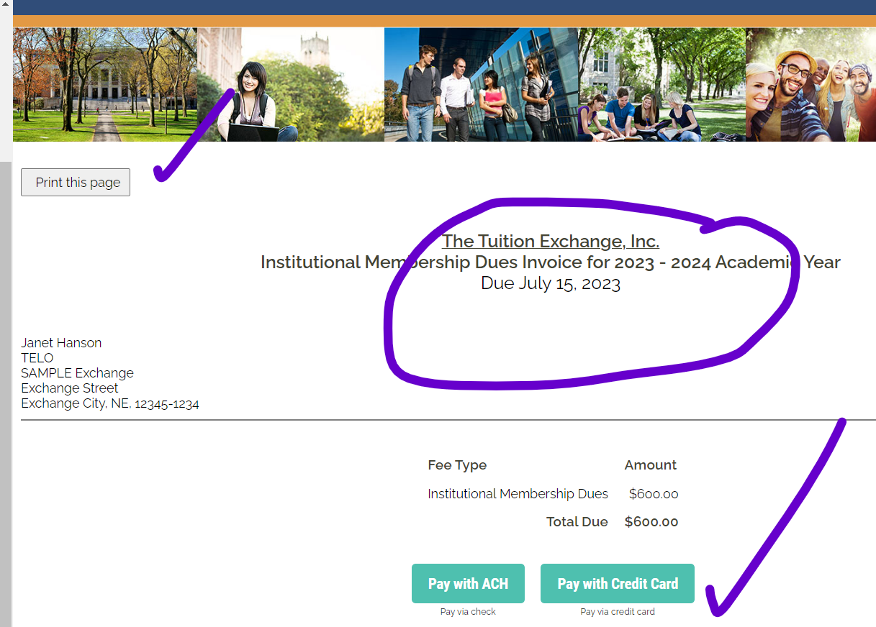
Annual Membership Dues
The Annual dues payment is due July 15 and considered late on September 15
Late fees are assessed on September 16. $50 for each month not paid beginning in October
2023-2024 dues are $600
Invoices are available inside the TELO Portal
Institutional Account – last option in the list

Slide 31
TE Participation Fees (P-Fees)
Two types of P-Fees
Export schools pay $45 per EXPORT student listed on the annual Enrollment Report
Import fee of $45 per Double Credit 3 (DC3) IMPORT student listed on the annual Enrollment Report
P-Fees are not prorated
If a student transfers mid-year, it means a new $45 P-Fee assessed to the Export school
P-Fees may be passed on to the family but
TE member schools are responsible for payment to TE Central
P-Fees are due upon receipt of the invoice

Slide 32
P-Fee Statement
Each time the Enrollment Report is submitted, a new P-Fee statement generates
Review the statement, as it may not be a new bill
P-Fee payment is always due upon receipt
TE Central accepts checks or credit card payments
No credit card fees are charged by TE Central
Students transferring mid-year to another TE school are accessed a new $45 P-Fee
Please direct your payment questions to Kristine Lev at klev@tuitionexchange.org

Slide 33
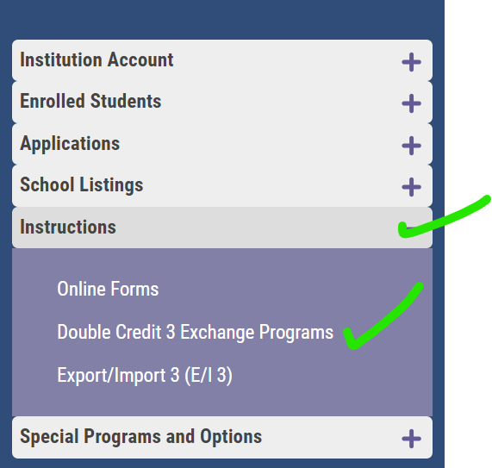
Double Credit Three (DC3)
Is your school a member of other Exchange programs?
Are you feeling stressed about importing three students to the TE program?
The DC 3 program may be your answer
Refer to The Tuition Exchange TE Liaison Officer Handbook
Home page – Liaison Officers – Training Calendar – Second option or
Check out

Slide 34
TE Central Contact Information
www.tuitionexchange.org
Robert “Bob” Shorb Janet Hanson
Executive Director/CEO Director of Communications
rshorb@tuitionexchange.org jhanson@tuitionexchange.org
518.859.7301 402.418.1081
Kristine Lev Suzanne LeAnce
Director of Administration Assistant Director of Communications
klev@tuitionexchange.org sleance@tuitionexchange.org

