Slide 1
TE 103
Janet Dodson and Bob Shorb
December 2018

Slide 2
Today’s Focus
TE Guidelines
What’s in yours?
Balance Sheet scenarios
Let’s do the Math
TE Central updates

Slide 3
TE Guidelines
Define your program inclusions
Define your audience of participants
Define your process

Slide 4
TE Guidelines
Program inclusions
Undergraduate programs
Degree-completion programs
Graduate programs
Professional degree programs
Locations
Main campus
Branch campuses
Online

Slide 5
TE Guidelines
Define audience participants
Employees
Required length of employment
Type of eligible employment
Full time
Regular part-time
Adjunct
Visiting faculty
Consultant
Eligibility
Calculation and determination of years of service
Application priority deadline
What if both parents are employed at a TE school
Multiple student issues

Slide 6
TE Guidelines
Define audience participants
Who is a dependent
Biological child
Step-children
Other child issues
Employee
Employee spouse/partner

Slide 7
TE Guidelines
Student enrollment expectations
Full time
Degree seeking
Undergraduate
Eight semesters or graduation, whichever comes first
Graduate or Terminal/professional degree
Four semesters or graduation, whichever comes first
Other considerations
Less than full time enrollment
TE scholars wanting to transfer
TE scholars taking a leave of absence for more than one consecutive semester

Slide 8
TE Guidelines
Defining your process
Export
Import

Slide 9
TE Guidelines
Tuition Exchange is not an employee benefit
Consider mirroring your campus Tuition Remission guidelines
Tuition Exchange is truly a scholarship program

Slide 10
TE Guidelines
Exports
Explain how employees are approved
Years of service
First-come, first-serve
Every application is assigned a number and on X date, using www.random.org a pre-determined number of applications are approved and entered into the TE system for Import consideration
Consider implementing an application priority date
Keep employees informed
Don’t forget mitigating circumstances occur
Consider allowing prior higher education experience in your years of service calculation

Slide 11
TE Guidelines
Imports
Explain how students are approved
First-come, first-serve
Academic requirement
Geographic footprint
Wait list considerations
Consider implementing an application priority date
Keep applicants informed
Don’t forget mitigating circumstances happen

Slide 12
TE Guidelines
Continuing student renewal
Exports
Continued eligible employees
Recertify
Employees who
Resign
Loose eligibility immediately or at the beginning of the next enrollment period
Retire
depends
Reduction in Force (RIF)
depends
Pass-away while employed or on long-term disability
TE Central suggests maintaining employment eligibility
Be sure to cover yourself with a mitigating clause

Slide 13
TE Guidelines
Continuing student renewal
Imports
Continuing scholars
Enrollment
Full time each term
Academic credentials
Meet or exceed the credentials
Maintain eligibility
Below the required credentials
Loose funding at the beginning at the next term
Be sure to cover yourself with a mitigating clause

Slide 14
TE Guidelines
Where are TE Guidelines published?
Employee Handbook
College Catalogue
Student Handbook
How do you insure EXPORT families understand program expectations?
Memo of Understanding
How do you insure IMPORT students understand program requirements?
College catalogue
Student handbook

Slide 15
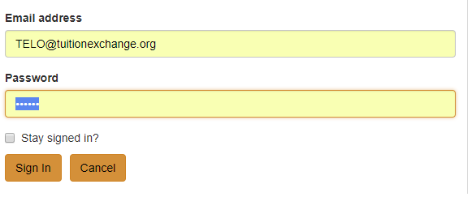
TE Guidelines
www.tuitionexchange.org
Select the TELO ONLY Resource section
Communication folder – look for TE Guidelines template
A skeleton template is available inside the
Prospective Membership tab

Slide 16
Balance Sheet Scenarios
Four schools
Four different scenarios
Please make note of any questions you might have until the four scenarios are explained.

Slide 17
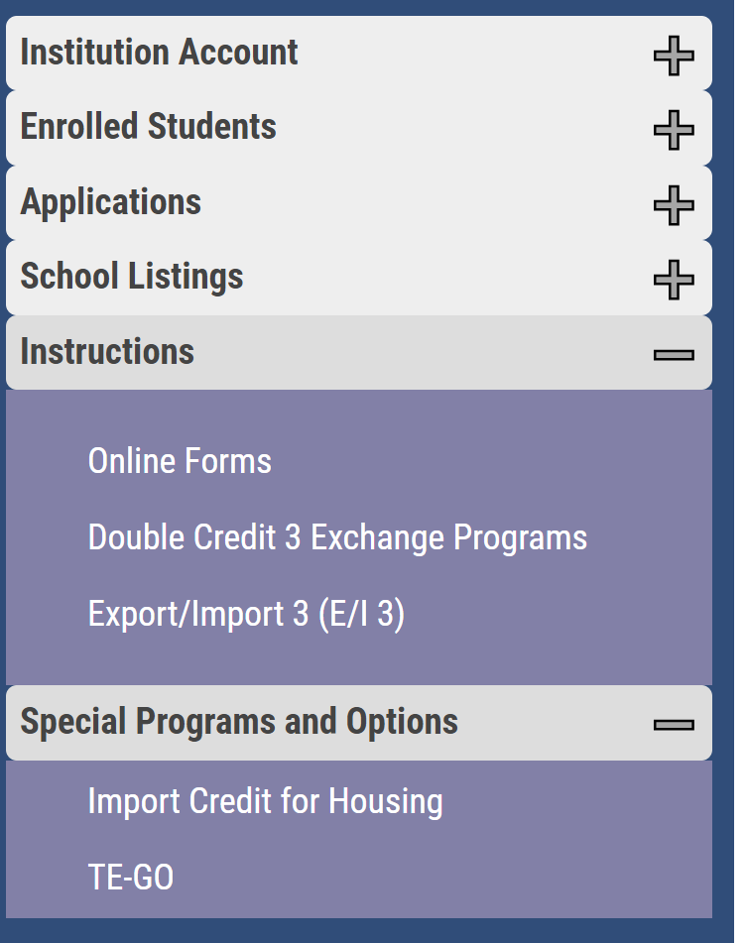
TE Program options
Feeling stressed about too many Exports and not enough Imports? Consider the following
Export/Import 3 (E/I 3)
Double Credit 3 (DC 3)
Co-Op – old program that is phasing out

Slide 18
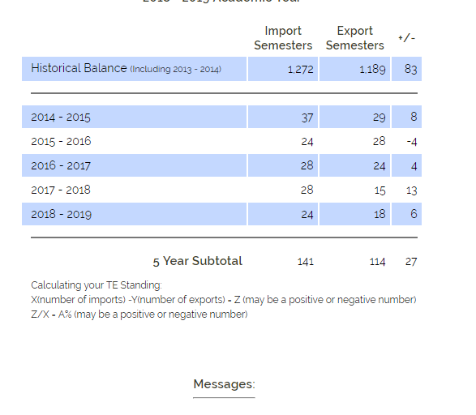
Scenario One
141 Import semesters
114 Export semesters
27 more Import semesters than export semesters
(27/141) * 100 = 19%

Slide 19
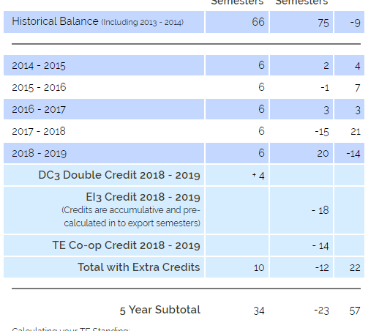
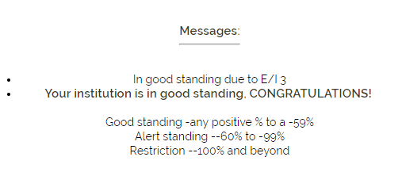
Scenario Two
7
-1
14
-8
Double Credit 3
Export/Import 3
TE Co-Op Credit
Without DC 3, E/I 3, and Co-Op credit
(34-46) * 100 = -35%
On Alert
46
-12

Slide 20
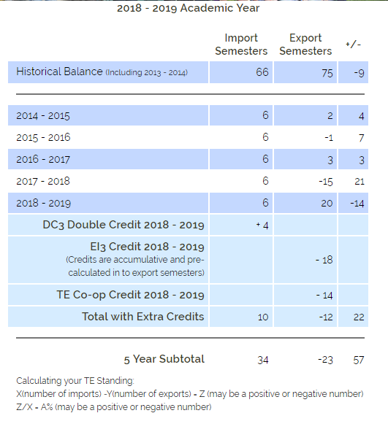
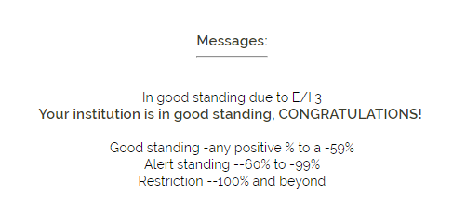
Scenario Two with DC 3 and E/I 3 credits

Slide 21
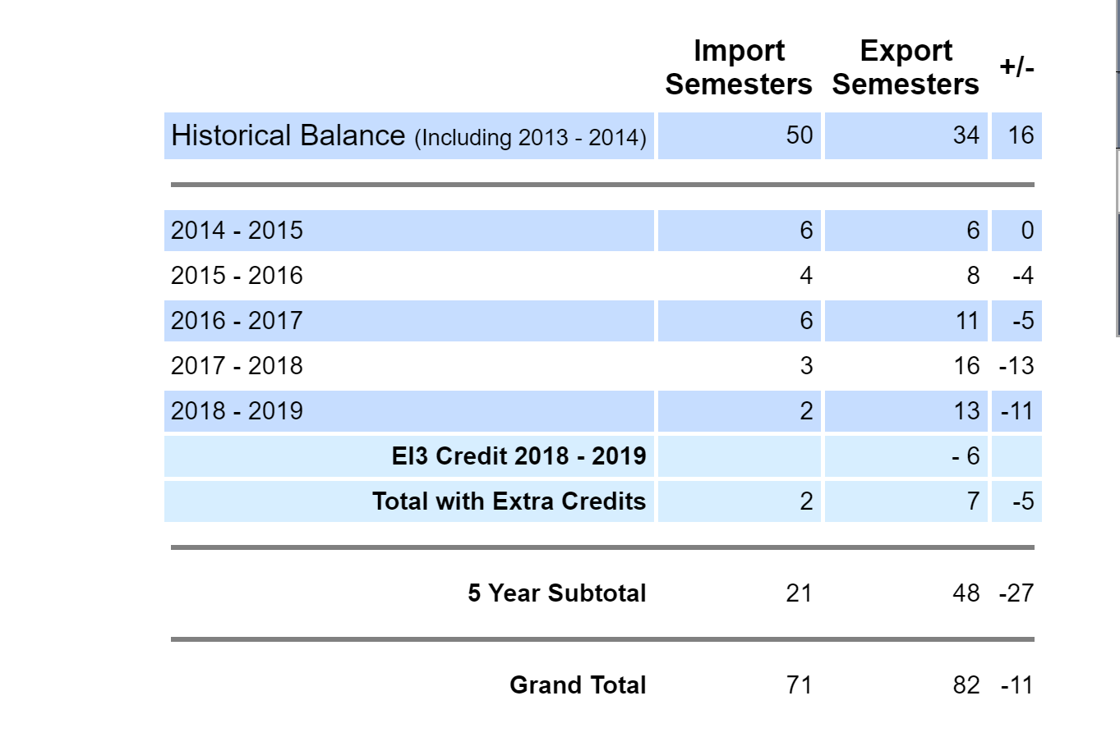
Scenario Three

Slide 22
Let’s do the math
21 – 48 = -27
(-27/21) * 100 = -128%

Slide 23
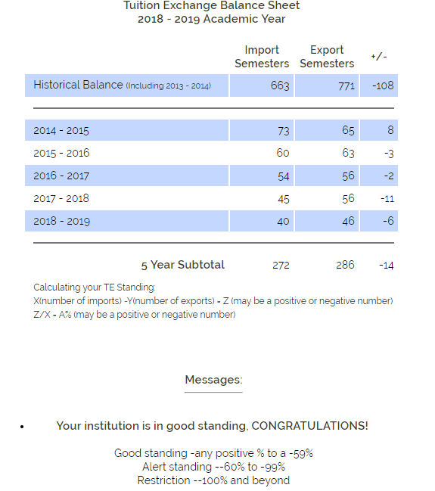
Scenario Four

Slide 24
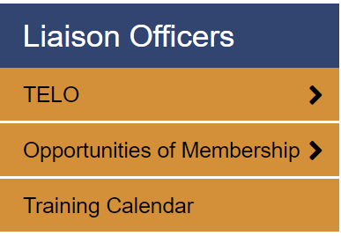
TE Central updates
Upcoming calendar events
Training calendar
Earning and receiving training credit(s)
Enrollment Report reminders

Slide 25
Thank you for all you do to help families afford higher education. See you next year!
This Photo by Unknown Author is licensed under CC BY

