Slide 1
Tuition Exchange 102
Janet Dodson and Bob Shorb

Slide 2
Training Series Details
Fall and Spring
101 – TELO basics – New TELO Training
102 – TELO website details, EZ app, FERPA
103– TELO Guidelines, Yield & Capacity
104(f) – Mandatory Enrollment Report Training – July, August, and September only
104(s) – Import Verification Training – April
Sign-up via the Training button inside the TELO portal or email sent from TE Central
For each webinar series you attend your school receives 1 semester of IMPORT credit
FINE PRINT
Beginning Spring 2019 must register via the TELO portal
Attend the full webinar
Only one staff email from each school earns the extra Import credit

Slide 3
TE 101 – 104 Training Series Objectives
TE 101 - Responsibilities, Expectations, Collaboration, and Programs
TE 102 – Website, TELO Portal, and FERPA
TE 103 – Institutional Guidelines, Marketing, Yield, and Capacity
TE 104(f) – Mandatory Training (Fall series)
TE 104(s) – Import Verification Training (April only)
All webinars are recorded and posted inside the TELO Only Resource section. Your school earns Import credits for attending the live sessions only

Slide 4
TE 102 Learning Objectives
TE website overview
EZ application process
Family
Export TELO
Errors
TELO Portal
Institution Account
Enrollment Students
Applications
New Exports
New Imports
Continuing scholars
School Listings
Instructions
Special Programs & Options
Training
FERPA

Slide 5
TE Website overview

Slide 6
TE Website overview - Families

Slide 7
EZ App
The EZ app is inside TE’s secured website
You know this because of the https:// The “s” stands for secured

Slide 8
EZ App continued
The online application process has three (3) steps:
The employee completes the online application (EZ app)
The employee’s export eligibility is reviewed and confirmed eligible (approved) or ineligible (deny) by the Export TELO
Communications are sent to the student applicant and employee once the applications are certified and forwarded.
Should the EZ app be determined ineligible for certification the employee receives a notification and the EZ app is no longer valid.
Questions about why the EZ application request was denied should be answered by the export TELO
Tuition Exchange Central does not respond to employee eligibility questions
At this point, the Import school takes over the EZ app review process
The Import school notifies the Export TELO and families once the Exchange scholarship award decision is made
Notification usually occurs in the spring and is shared via an award letter or financial aid award notification

Slide 9
EZ App Reminders
Students should be completing the Import school’s admissions process simultaneously
If the student makes an error on the EZ app information, only the Export TELO can fix it
If the student wants to add new schools to their EZ app, it is a new EZ app
TE Central will not assist the student in modifying any EZ app records
Why? We have no way of knowing the student is who he claims to be

Slide 10
EZ App status
The TE ID, birthday and student email entered here must be a perfect match with the EZ app

Slide 11
EZ App status
When the match is perfect
the family can observe the
changes.
HINT! Tell the family when
decisions will be made – they
are anxious.
TE Central does not aid families with the EZ application or the App
Status options

Slide 12
EZ App status
In this case, the EXPORT school has not yet approved or denied the families EZ application.
Schools are encouraged to set early EXPORT application dates so that all students are able to meet early
IMPORT decision dates.

Slide 13
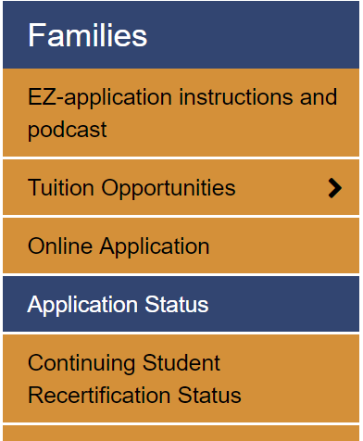
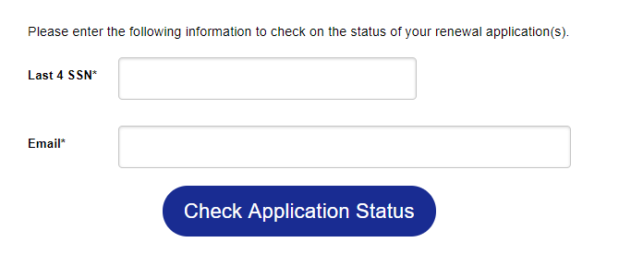
Continuing Student Recertification
Status of Approved means not yet recertified for the next academic year
Status of NEW means recertified for the school year listed.

Slide 14
TE Website search
The Mandatory Profile and Institutional Overview generates the information found inside the School search.
Check out your school’s information – is it complete? Is the information accurate?
Does the information share your school’s story appropriately?

Slide 15
Check out Agnes Scott Colleges details
Apply to this school is in reference to completing the EZ app

Slide 16
This Photo by Unknown Author is licensed under CC BY-SA-NC
This Photo by Unknown Author is licensed under CC BY-ND

Slide 17
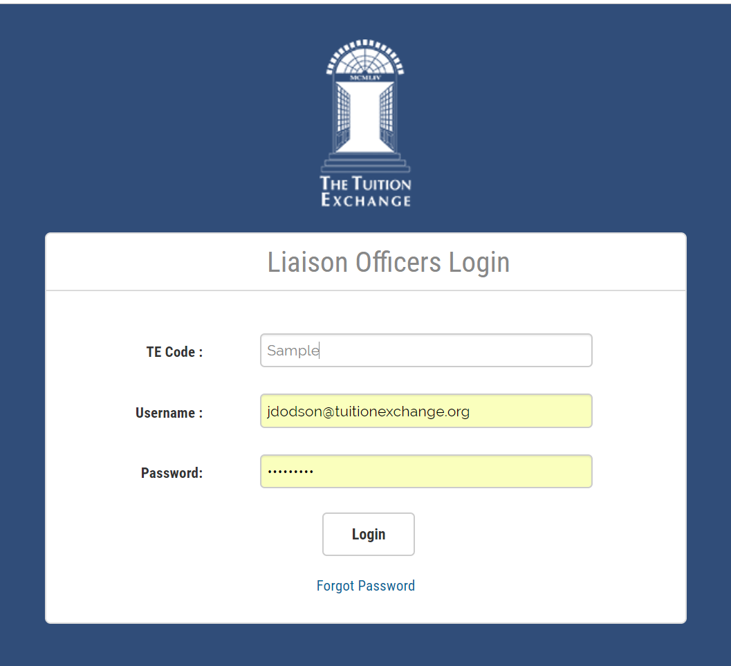
TELO portal
TE Code: assigned by TE Central
Username: TELO school email
Password: user created – needs a
capital letter and at least one number
Forgot your password, click here.
The temporary password is emailed from
noreply@tuitionexchange.org. Check your spam account

Slide 18
TELO home page

Slide 19
Institution Account
Institution Account is where…
TELO’s update information about the school
User’s update their password – must include at least one capital letter
Manage, review, and update the Enrollment Report
See the Balance Sheet
Review continuing scholars Balance Sheet style
Observe continuing scholars Enrollment Report style
Confirm Annual Membership dues are paid

Slide 20
Applications
Click here to enter a student’s EXPORT application
Better yet use the EZ app option
If you still want to enter the applications yourself, remember
you must preview the app before you can submit
Once you submit the app should the family want to add another
school, a NEW app is required listing only the
NEW school(s)
Should a student no longer be interested in a TE school
EXPORT schools Withdraw the app
IMPORT schools Reject the app (please don’t get hung-
up on the words)
The Enrollment Report is a listing of all students currently funded through a
Tuition Exchange scholarship. The report should be reviewed quarterly
for accuracy
View Submissions is all the eligible continuing students
Make sure your Exports are recertified

Slide 21
Applications
Watch the entry year
Decision Pending – the application is waiting action
Approved – the application is approved for Export or Import
Withdrawn – the Export school withdrew the application
Need to know why – contact the Export TELO
Rejected – the Import school denied the application
Need to know why – contact the Import TELO

Slide 22
Continuing Students
Enrollment Report – the report details all current academic year students receiving TE awards
Remember the Enrollment Report is organic and needs to be reviewed at least four times annually
No later than September 30
At the end of the fall semester
No later than February 15
At the end of the spring semester
Not sure your Participation Fees are paid in full? Submit your Enrollment Report to get an updated copy of your Participation Fee statement
View Submissions – is where ALL continuing student applications are found

Slide 23
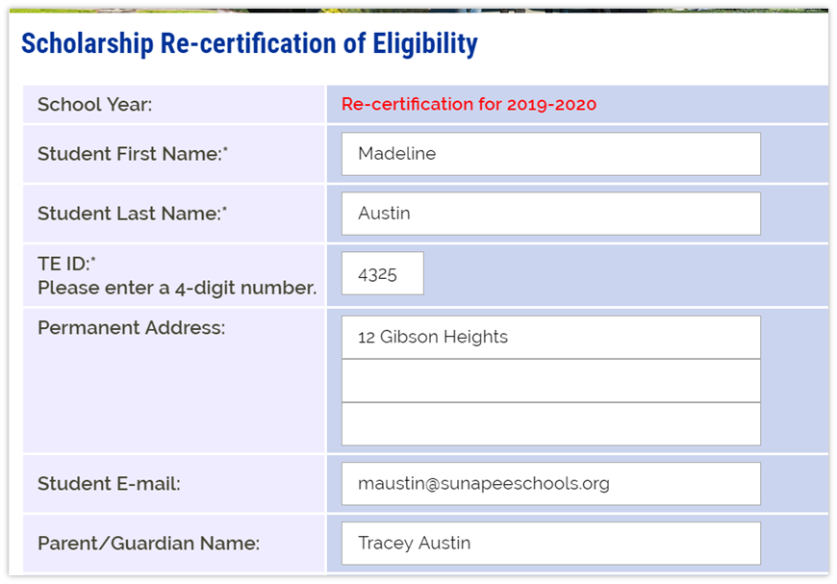
Continuing student re-certification
Click on the word RECERTIFY and follow the prompts.
Check your Enrollment Report – the student
will be updated as Recertified
If valid emails are in place, the parent and student are notified
The student will also appear in the View Submissions area

Slide 24
Deleting a TE application
If you enter an application incorrectly, you can delete the application.
You need to know the name of the Importing school and the student’s TE ID
Sissy Student TEID 1234 has two applications
for College One
One of the applications needs to be deleted

Slide 25
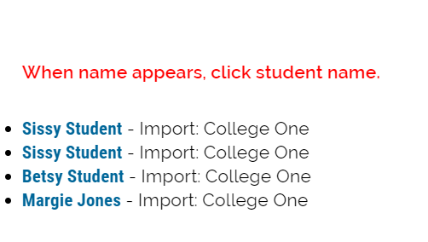
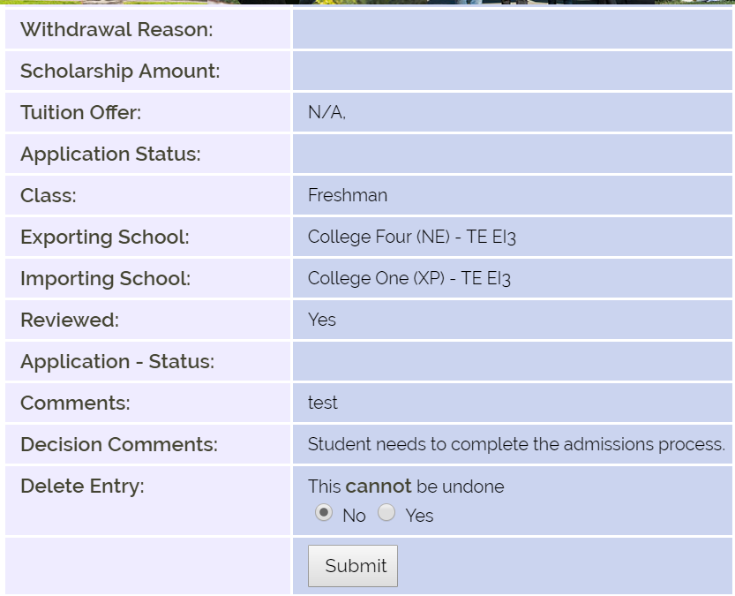
Deleting a TE application
Once you click YES, there is no turning back!

Slide 26
Reports
Click on Tools and select the Excel option

Slide 27
School listings, Instructions, et al
Need contact information for a TELO
Want to know the scholarship amount at another
school.
Need to better understand the optional TE programs?
Look no further than here…
Today the online forms folder is a work in progress. Our next big roll-out is a Leave of Absence form
I can’t wait!

Slide 28
Family Education Rights and Privacy Act (FERPA)
A Federal law designated to protect:
The privacy of education records,
To establish the right of students to inspect and review their educational records, and
To provide guidelines for the correction of inaccurate and misleading data through information and formal hearings.
At the post-secondary level, parents have no inherent rights to inspect a student’s education records.
The right to inspect is limited solely to the student.
What is your school’s policy regarding student records and parental requests?

Slide 29
FERPA notes
The school Registrar is typically the designated FERPA officer
FERPA starts at 18 or the first day of class, whichever comes first
Education records, as defined by FERPA, include all records which relate to a student and maintained by the college
Colleges must have written permission from the student before releasing information from the student’s record
Any school recognized application falls under FERPA, this includes the EZ app or paper app

Slide 30
FERPA Reminders
Those with access to education records have access for:
the sole purpose of performing their job professionally, ethically, and responsibly
have a responsibility to protect the confidentiality of education records in their possession, regardless of the record medium
Never allow the student worker or employee to certify their own or their student’s TE scholarship application.

Slide 31
What’s on your desk?

Slide 32
TE – 103 Training
TE -103 TE Guidelines - what's in yours? sharing the TE story on your campus and understanding your Balance Sheet
Checklist review of what should be in your TE Guidelines.
Ways to share the good news about the college application and funding process.
Print your Enrollment Report and Balance Sheet in advance
It will be handy to have a calculator (yes, your cell phone works too :)) and a sharp pencil.
A walk through of the math that calculates your Balance Sheet and determines your TE standing
A refresher on E/I 3 and DC 3 will be included.

Slide 33
Today’s accomplishments
TE 102
TE website overview
EZ application process
Family
Export TELO
Errors
TELO Portal
Institution Account
Enrollment Students
Applications
New Exports
New Imports
Continuing scholars
School Listings
Instructions
Special Programs & Options
Training
FERPA

Slide 34
TE Central Updates
End of semester schedule
Contact information
Member dues and Participation Fee payment reminders
Enrollment Report review reminder

