Slide 1
2017-18 Annual report
Janet dodson
Associate director, tuition exchange
August 10, 2017

Slide 2
Today’s focus
TELO portal review
Annual report
Dues and Participation Fee invoices
Mandatory profile and Institutional information
EZ-application

Slide 3
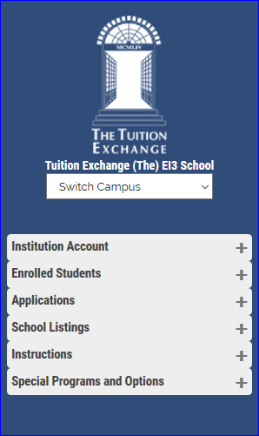
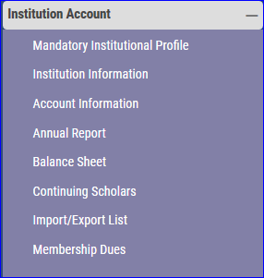
Te portal review
When you can’t find something click on the Plus sign (+) to expand the tab
Help I can’t find my annual report
Check inside the institutional account tab
Why is my Balance sheet disabled
Because you need to run your annual report

Slide 4
Annual report
Open your annual report
Review the updated instructions
Due date is September 30
Organic document

Slide 5
Open your annual Report
Print a work copy

Slide 6
Please take time to read these updated instructions

Slide 7
Updated initial due date
September
September 30
Print a copy
Annual report is organic
Review and print each time
Prior to September 30
End of first semester
After second semester begins
Conclusion of academic year
Students change their minds about school
EMPLOYEES CHANGE JOBS
Don’t forget to share te scholar recipients with financial aid
30

Slide 8
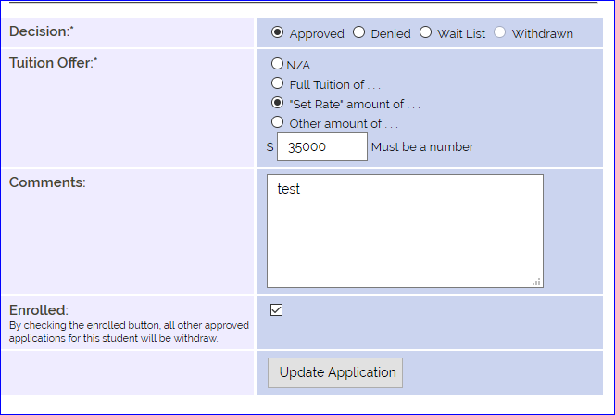
Initial annual report review - IMPORTS
So where are my new Imports?
Import school – check the ENROLL box
Import school – REJECT the approved students you know are not enrolling at your school

Slide 9
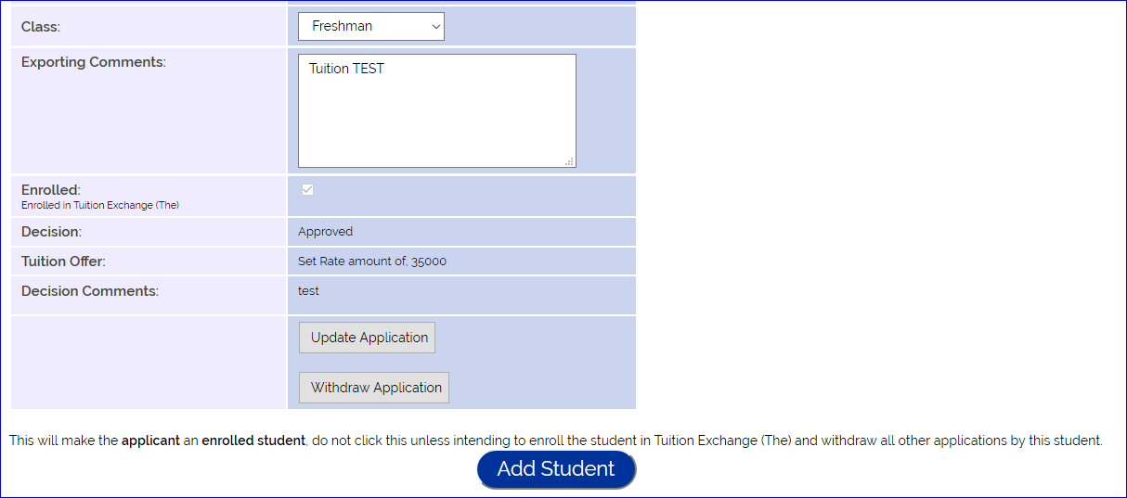
Initial Annual Report Review - EXPORTS
Export schools must click add student
If the enrolled box is checked – click add student
If you know the school the student will attend – click add student
If you don’t know and the student has just one approved school – click add student
If you don’t know and the student has multiple approved schools - Stop and wait for the correct import school’s action
Once the ADD STUDENT button is clicked – all other APPROVED applications are automagically withdrawn

Slide 10
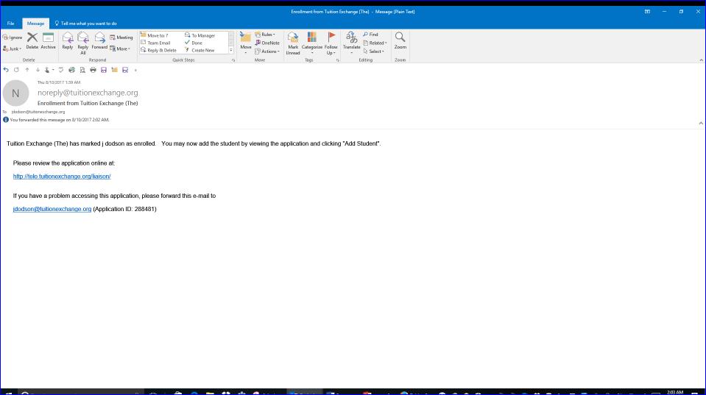
NOTIFICATIONS
WHEN THE IMPORT SCHOOL CLICKS THE ENROLLED BOX AN EMAIL IS SENT TO THE EXPORT SCHOOL. THIS IS THE EXPORT SCHOOLS NOTICE TO CLICK THE ADD STUDENT BUTTON.
CLICKING ADD STUDENT MOVES THE STUDENT TO BOTH ANNUAL REPORTS

Slide 11
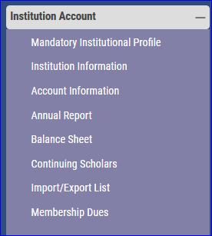
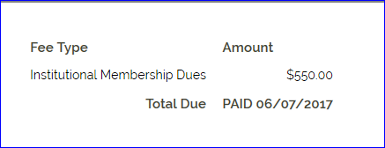
Annual dues and participation fee invoices
Annual due invoices emailed late June
Annual due date is July 1
Not sure your dues are paid
Click on the membership dues option
If paid the invoice details a paid date
Need another receipt?
Email Kristine Lev
klev@tuitionexchange.org

Slide 12
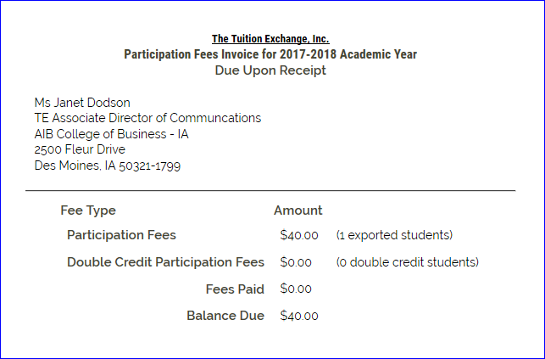
Participation fee invoice
Participation fee invoiceS appear after submitting any annual report
Don’t submit any participation fee payment until your initial annual report is complete
Once you feel your initial annual report is correct – run again, print the Annual report and retain for your records, print the participation fee invoice and submit the invoice for payment
Tuition exchange does not accept credit cards
Is your accounts office asking for a w-9
The form is available on the te website – keyword search tuition exchange w-9
All Participation Fees are due upon receipt

Slide 13
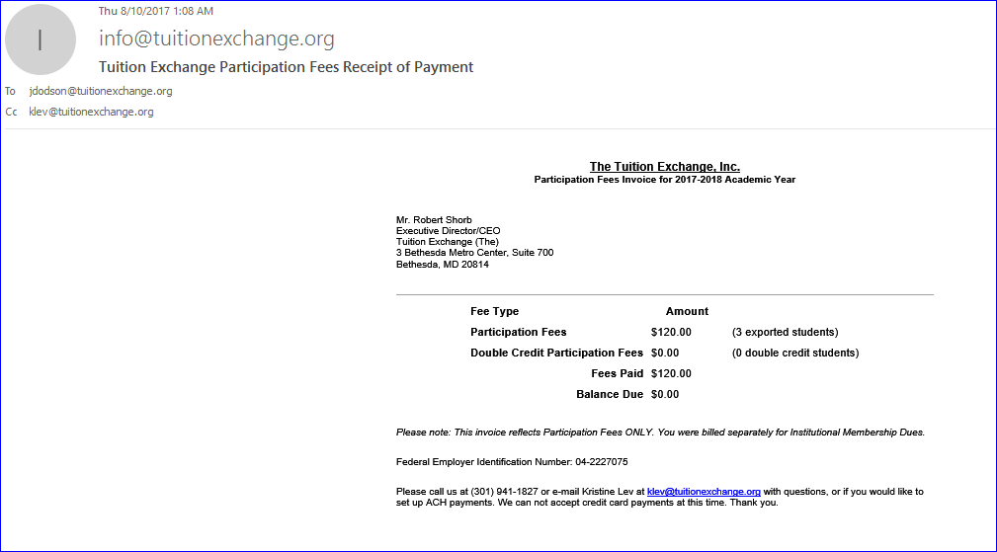
Annual dues and participation fee invoices
Tuition exchange records all annual dues and participation fee payments
You receive via email a receipt of payment
Check the subject line and balance due
Thank you for your prompt payments

Slide 14
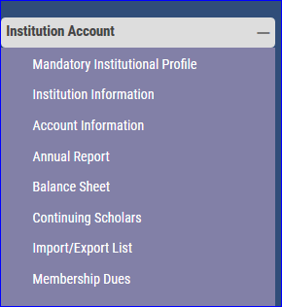
Mandatory profile and institutional information
Families want information about your school
Please be sure all of your information is current and accurate
Two new questions on the profile
Question 7 and 8
Families are not prepared for always prepared for fees - let them know up front!
Is your overview up to date?
export/import 3 program (e/i3)
Provides relief for export heavy te members
Is your school a member?
Not sure check your mandatory profile question number 9
Are you aware this information is displayed on the family search section?

Slide 15
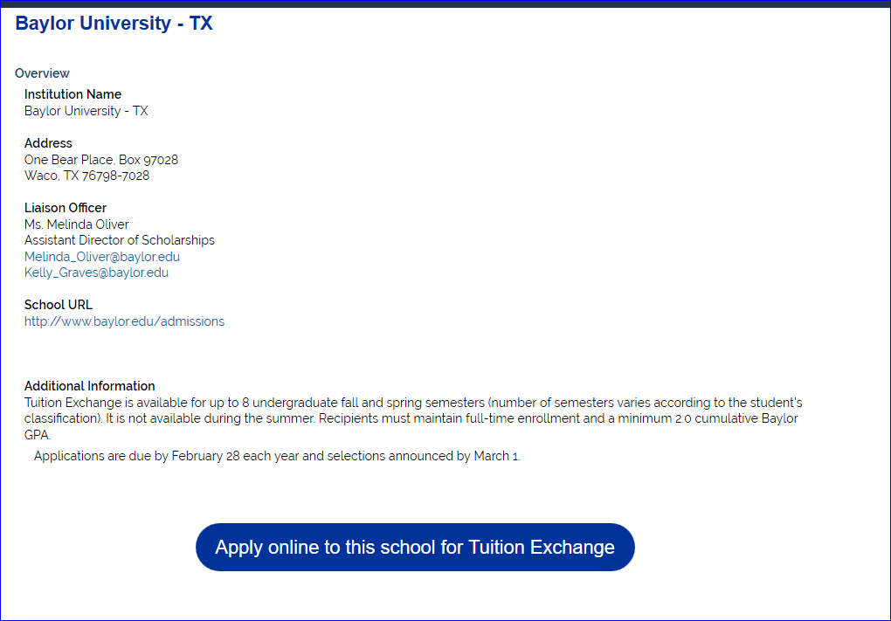
THIS INFORMATION ORIGINATES
FROM INFORMATION REPORTED
ON YOUR MANDATORY
PROFILE AND INSTITUTIONAL
INFORMATION.

Slide 16
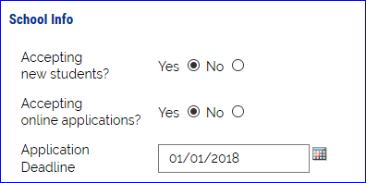
Mandatory profile and institutional information
Institutional information section
EZ-app is up and running
Review your institutional information to
turn-on the ez application option for families, and
Add your ez application deadline
The additional contact information may need your attention
Te central mails a thank you letter to each member’s president in November, please keep this information up to date

Slide 17
Ez-application
Tuition Exchange is the proud host for the FACHEX program.
Fachex is the Acronym for Faculty and Staff Children Exchange Program. FACHEX is an undergraduate tuition remission program which allows dependents eligible for tuition benefits at the “home” institution to apply for the same benefits at participating host institutions.
There are 27 Jesuit Colleges and universities in the fachex program
Five fachex schools do not have dual membership with tuition exchange. The five schools are
Boston college, college of holy cross, Loyola university – Chicago, Marquette, and university of Detroit mercy
These school names appear with the comment fachex school only in the school selection box

Slide 18
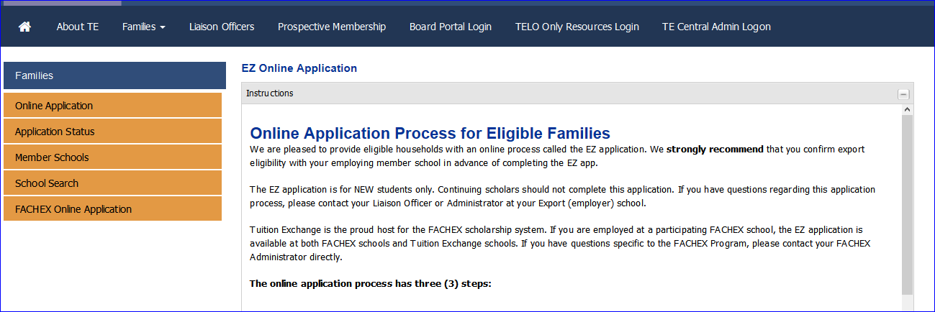
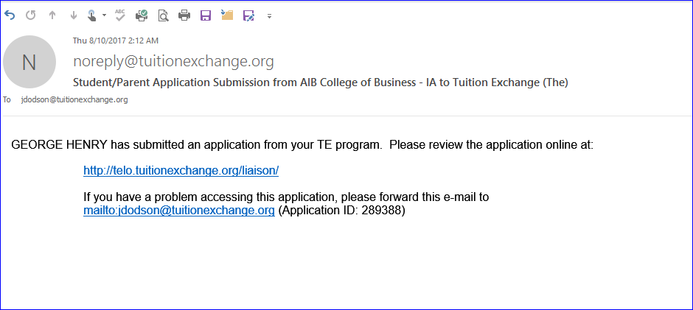
Ez-application
You control the certification process
The family enters the information
Saves you data entry time
Email notification notifies you when new ez applications arrive
TE CENTRAL ADDED A POWERPOINT AND PODCAST TO ASSIST FAMILIES
UNDERSTAND THE APPLICATION COMPLETION PROCESS

Slide 19
EZ-APPLICATION
EMPLOYEE RECEIVES THIS EMAIL WITH ADDITIONAL INFORMATION
Dear Norman, Your EZ application is now recorded and await your employer's approval. The next step is for your employer to review the EZ applications for eligibility. Your employer will approve or deny the EZ applications. You will receive email updates as action occurs regarding your EZ application throughout the process. If you have questions about the status of your dependent's applications, please use the Application Status option inside the Families tab. All approved EZ applications post with the school(s) listed on your student's EZ application. If you have questions regarding denied EZ application, email the first individual listed below . If you discover errors in your EZ application after submitting, send an email to the first individual listed below. Be sure to share your student's ID and full name, the error and the CORRECT information. If the error can be updated by your employer, the EZ application will be modified. If the error is not one that can be updated, you will be instructed to start again. If you want the EZ application sent to additional schools, that requires a NEW EZ application. The Search function on the website provides a host of useful information. Before contacting schools where your student is considering attending, review the website. The information is posted and maintained by the school. Thank you for using the EZ application process. Liaison Officer Ms Janet Dodson AIB College of Business - IA 2500 Fleur Drive Des Moines, IA 50321 -1799 jdodson@tuitionexchange.org

Slide 20
EZ-APPLICATION
REGARDLESS HOW THE APPLICATION LANDS INSIDE THE SYSTEM, FAMILIES CAN TRACK THE STATUS OF THEIR APPLICATIONS
AN EZ-APP USER POWERPOINT IS AVAILABLE AND SHARED AS A HANDOUT WITH THIS WEBINAR
YOU ARE ENCOURAGED TO ADOPT THE EZ-APPLICATION PROCESS

Slide 21
Training calendar

Slide 22
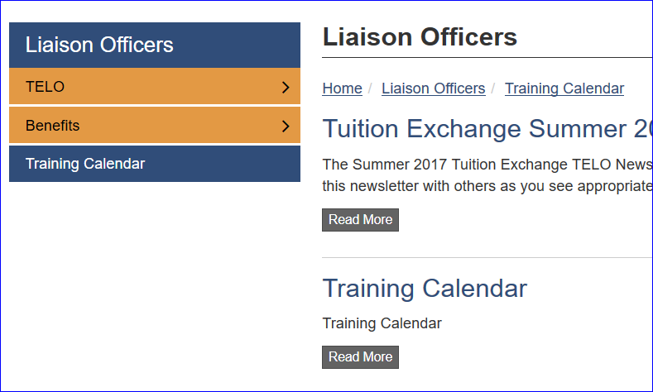
TRAINING CALENDAR
CLICK READ MORE TO SEE THE CURRENT MONTH TE CALENDAR
CHANGE THE MONTH AND SEE WHAT IS HAPPENING THAT MONTH
BE SURE TO REGISTER FOR ALL TRAINING OPPORTUNITIES
WE ALSO INCLUDED CONFERENCES THAT TE PERSONNEL WILL ATTEND
STOP BY THE BOOTH AND SEE US!

Slide 23
THANK YOU FOR ATTENDING
JOIN US NEXT MONTH ON SEPTEMBER 21REGISTRATION IS AVAILABLE ON THE TRAINING CALENDAR
THIS WEBINAR WAS RECORDED AND WILL BE POSTED INSIDE THE TELO ONLY RESOURCE SECTION. CAN’T REMEMBER THE LOGIN DETAILS – A HANDOUT IS INCLUDED WITH THIS WEBINAR
TE CENTRAL CONTINUES TO OFFER NEW TELO TRAINING THROUGHOUT THE ACADEMIC YEAR IF YOU ARE A NEW TELO PLEASE CONSIDER REGISTERING FOR OUR SEPTEMBER 13 TRAINING OPTION. REGISTRATION IS AVAILABLE ON THE TRAINING CALENDAR

Slide 24
TE CENTRAL CONTACT INFORMATION
BOB SHORB, EXECUTIVE DIRECTOR AND CEO
RSHORB@TUITIONEXCHANGE.ORG
JANET DODSON, ASSOCIATe DIRECTOR
JDODSON@TUITIONEXCHANGE.ORG OR 402.418.1081
KRISTINE LEV, ASSISTANT DIRECTOR
KLEV@TUITIONEXCHANGE.ORG

