Slide 1
EZ Application – what’s it all about???
Janet Dodson jdodson@tuitionexchange.org
Associate Director of Communications
Tuition Exchange 402.418.1081

Slide 2
Today’s focus

Slide 3
The EZ Online Application – Family section
What does the family see
What does the family need to know
What happens when the family completes the EZ application

Slide 4
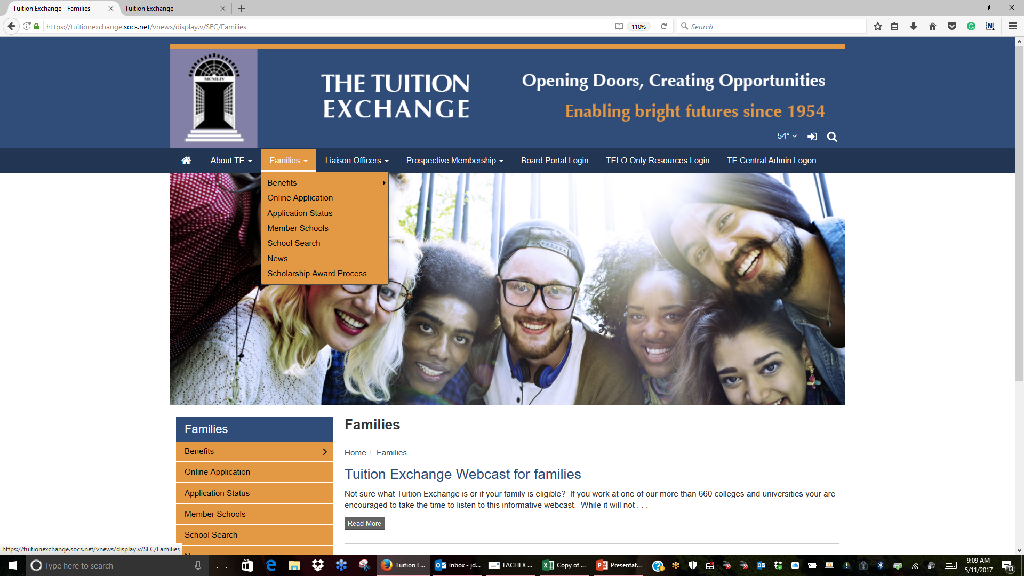
EZ application updates prior to launch
https://www.dropbox.com/s/0uf6lq2cm5w145w/Screenshot%202017-05-11%2009.09.58.png?dl=0

Slide 5
Important details
Families have the option to complete the online application
Step 1 - family completes the online application record submitting it to their employer. Family can select up to a maximum of 10 import schools using the online application
Step 2 – the application record is pending until action is taken by the Export school
Step 3 - once the application record is Approved or Denied by the Export school the application moves ahead or stops
Step 4 - provided valid emails are in place, the parent and student receive a notice of Approval certification action taken by the Exporting liaison. In the case of Application record denial only the employee receives the email and the application is not exported
Step 5 - once the Approval certification is completed, the Import liaison receives the notification email and the approval/deny process continues as it has been to date

Slide 6
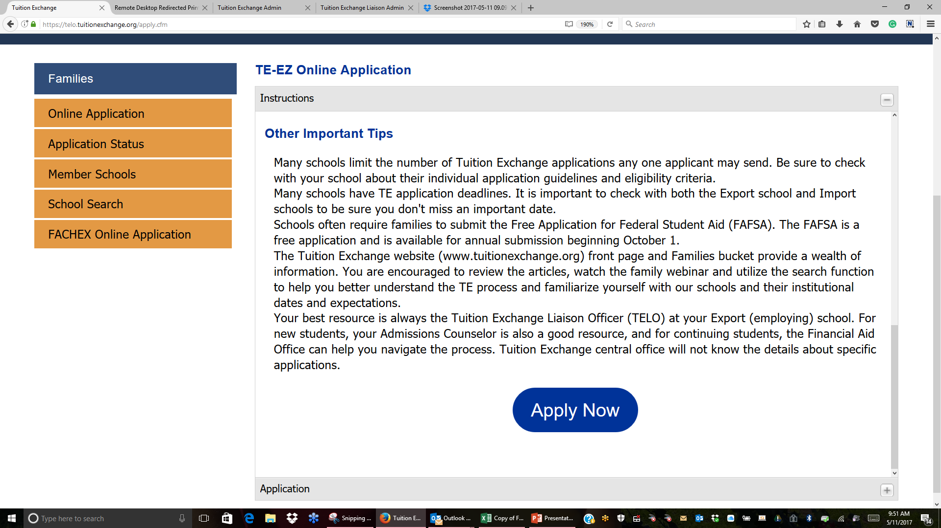
The system provides for a maximum of TEN applications per submission.

Slide 7
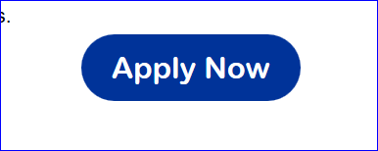
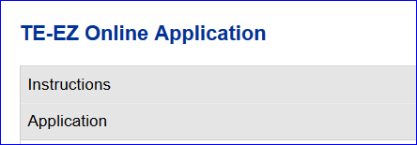
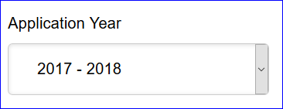
At the conclusion of the EZ applications instructions, the Apply Now button is displayed
If the applicant has
questions they can refer
back to the instructions while on the application page
The application presented is for the NEXT two full academic years.
So it is important that the family selected the correct academic
year for which the student is seeking award consideration

Slide 8
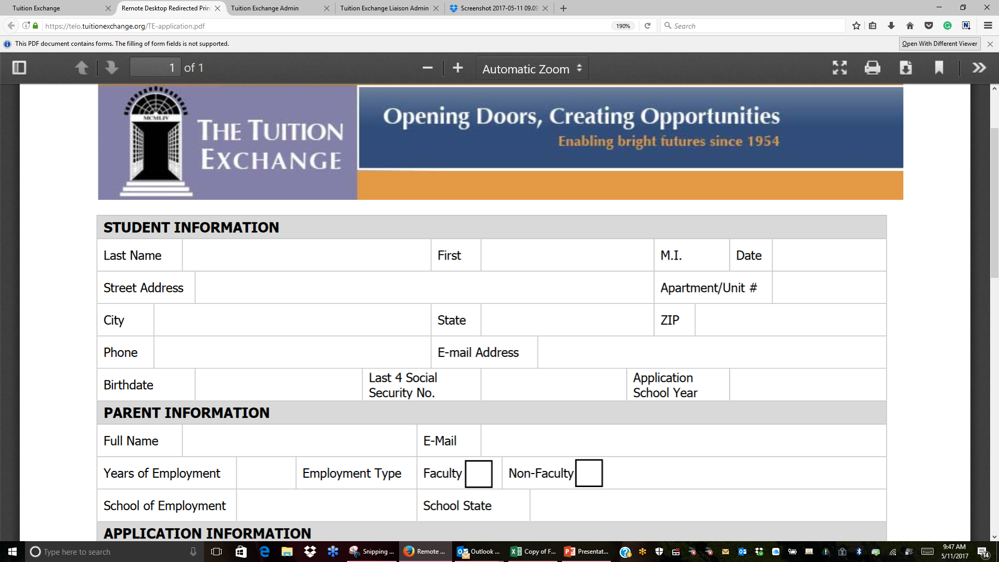

Slide 9
EZ Online Application – School
EZ Online application school process

Slide 10
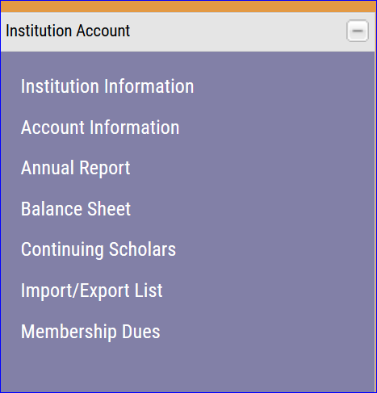
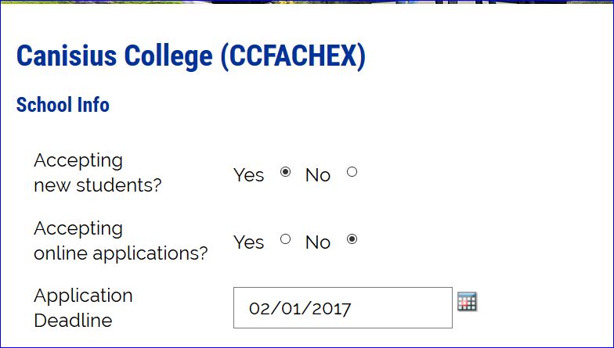
This information needs completion and/or update
We are Updating Application Deadline to Application Priority Date

Slide 11
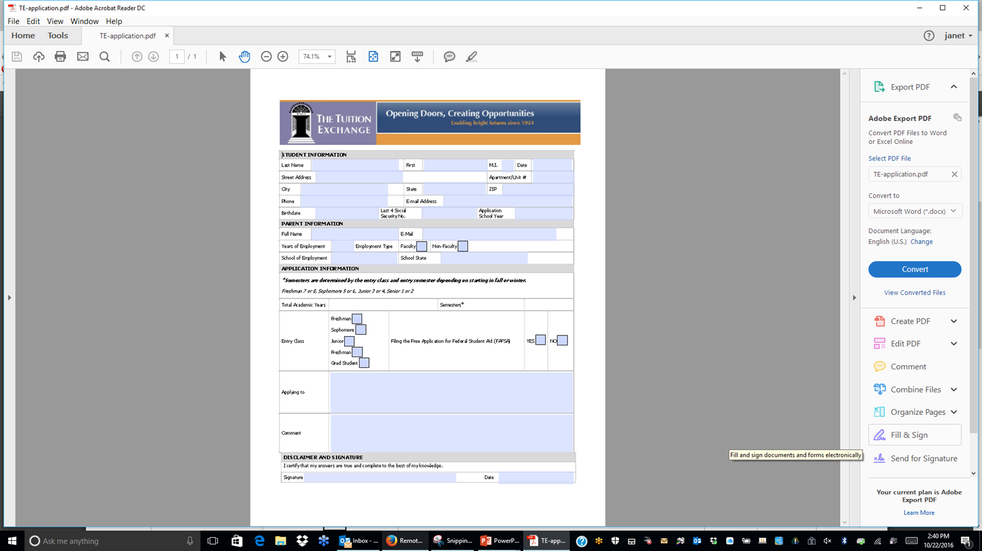
Below is a snap shot of the paper application. It can be complete online and emailed to the Liaison or printed, completed and submitted to the Liaison coordinator. You can download this application for full page review.

Slide 12
NOTES:
If you decide to NOT utilize the EZ application process, you will be entering each application into the system.
You will need to add to your internal application the student’s birthdate.
Regardless of what process is used to enter the EZ application, the family can still review the status of the
Application via the website provided the SSN, birthdate, and valid email address are entered as reported.
As a reminder, you always maintain control of each EZ application as you are the individual clicking the Approve
or Deny button for each EZ Export application submitted by a family.

Slide 13
You control the approval or denial of the initial EZ application.

Slide 14
Once the family completes the on-line EZ application you receive an email notice.

Slide 15
Schools receive an email informing you that an EZ application awaiting action is now available
To access the individual application(s) click on the student’s name.
Each application requires separate APPROVAL or DENY action.

Slide 16
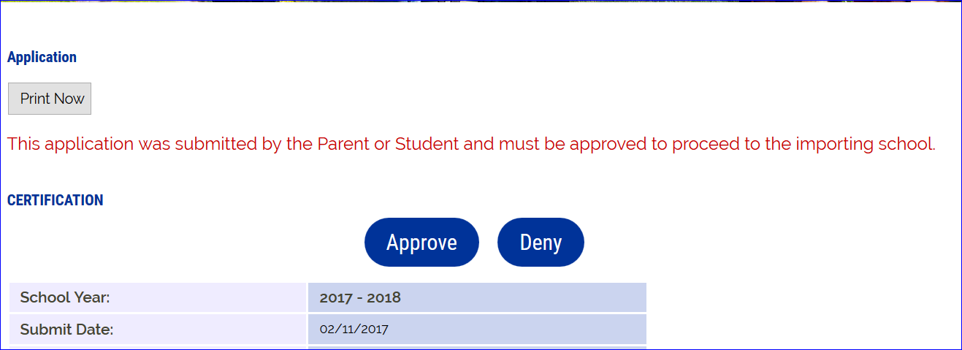
EXPORT SCHOOLS MUST APPROVE OR DENY EACH APPLICATION.
Approve means the EMPLOYEE is ELIGIBLE for award consideration. The employee and student each receives emails informing them the application is now in the system and sent to … The list of schools where the application is sent is listed on the emails.
Deny means the EMPLOYER is NOT ELIGIBLE for award consideration. Only the employee receives an email informing him/her the EZ application was denied and to contact YOU with questions.

Slide 17
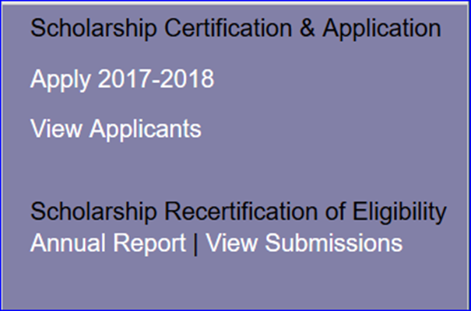
This application status has updated and moved to the Exports-Decision Pending Approved.
Approved in this case means Approved for EXPORT only
The IMPORT school stills need to review and take action.

Slide 18
This is an example of what the IMPORT school sees once the EXPORT school approves the application. This is NO different than actions of previous years

Slide 19
Using the Application Status option
Where is this option
What does it tell the family
What should the family do if they can’t access their record

Slide 20
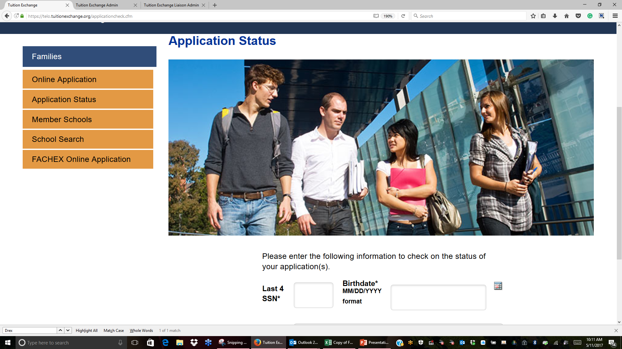
Families can monitor the status of the EZ application. It requires using the LAST 4 of the SSN or ID number entered.
If you create a new ID number, it is your responsibility to update the family. The family needs to remember the
birthdate and email addresses they enter. All three items are required for access to the Application Status option.

Slide 21
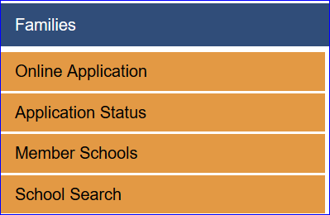
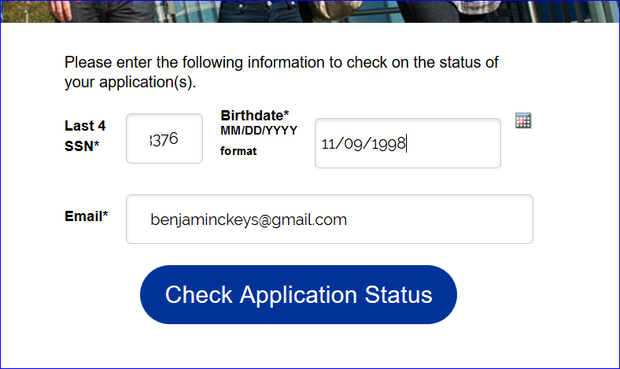
How does the student check on the status of their EZ application(s)?
The LAST 4 SSN, Birthdate and
Email address MUST match the
EZ Application exactly.

Slide 22
As the student’s application passes through the various stages review the Status updates.
See next slide for all status options and their definitions

Slide 23
Student’s application status and its meaning
Application Denied – the EXPORT school denied the initial EZ application certification
Awaiting Export School Certification – the EXPORT school has not yet approved or deny the EZ application
Withdrawn – the EXPORT school withdrew the students application. This can occur when the employee is no longer eligible OR the family notifies the EXPORT school that the student is no longer interested in attending XYZ school
Awaiting Import School Decision – the IMPORT school has not acted upon the students exchange award application
Decision Pending – the IMPORT school is in the process of reviewing the students exchange application
Approved – the students award will be funded at the IMPORT school
Rejected – the student will not receive a funding at this IMPORT school
Wait List – the IMPORT status reviewed the application and the student is being considered but typically the school is waiting for other students to accept or decline the award. This status is often used as a consideration marker by the Import school but does not mean the student will receive an award.
Currently Enrolled – this status applies to currently enrolled students only

Slide 24
Examples of Emails
Family emails

Slide 25
This email is sent to the employee once EZ app is submitted.
A. Additional language updates the family if errors are discovered after submission or if the family wants the EZ-app
sent to different schools.
B. TELO’s report receiving emails from families asking for information readily available inside the search function. This
email encourages families to research the website first.
Dear Norman, Your EZ application is now recorded and await your employer's approval. The next step is for your employer to review the EZ applications for eligibility. Your employer will approve or deny the EZ applications. You will receive email updates as action occurs regarding your EZ application throughout the process. If you have questions about the status of your dependent's applications, please use the Application Status option inside the Families tab. All approved EZ applications post with the school(s) listed on your student's EZ application. If you have questions regarding denied EZ application, email the first individual listed below . If you discover errors in your EZ application after submitting, send an email to the first individual listed below. Be sure to share your student's ID and full name, the error and the CORRECT information. If the error can be updated by your employer, the EZ application will be modified. If the error is not one that can be updated, you will be instructed to start again. If you want the EZ application sent to additional schools, that requires a NEW EZ application. The Search function on the website provides a host of useful information. Before contacting schools where your student is considering attending, review the website. The information is posted and maintained by the school. Thank you for using the EZ application process. Liaison Officer Ms Janet Dodson AIB College of Business - IA 2500 Fleur Drive Des Moines, IA 50321 -1799 jdodson@tuitionexchange.org
The Tuition Exchange | 3 Bethesda Metro Center – Suite 700 | Bethesda, MD 20814 | 301-941-1827 | info@tuitionexchange.org
A
B

Slide 26
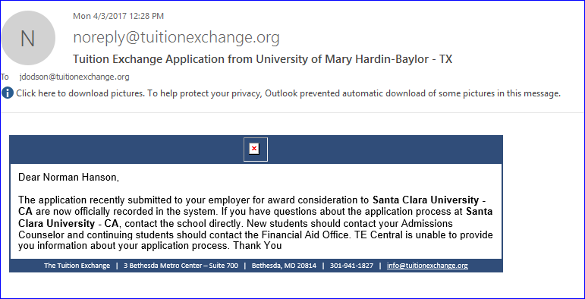
The APPROVAL message is sent to both employee and student when valid e-mails are provided

Slide 27
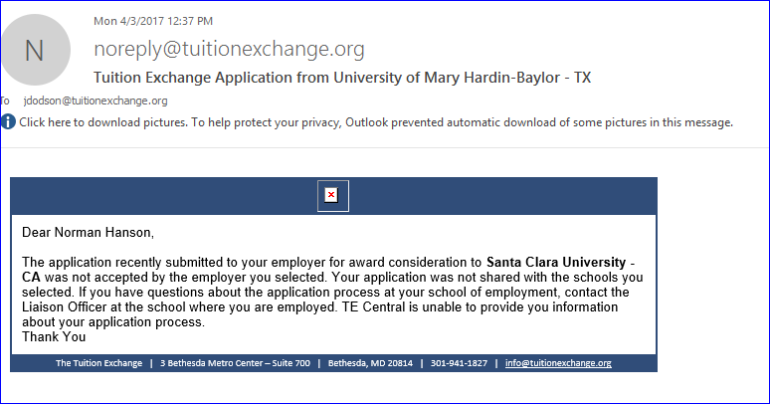
Email verbiage
The DENIAL message is sent to the Employee only.

Slide 28
All emails are sent from a noreply@tuitionexchange.org
address. This email box in NOT monitored.
Application/Certification from NAME OF EXPORT SCHOOL
Student/Parent application submission email
Name of student has submitted an EZ application.
Please review the application online at:
http://telo.Tuitionexchange.org/liaison
If you have a problem accessing this application, please
Forward this email to jdodson@tuitionexchange.org
Application ID 1234545
Name of school has submitted an application to your
school for NAME OF STUDENT. Please review the
Application online at http://telo.tuitionexchange.org/liaison/
If you have a problem accessing the application, please
Forward this email to jdodson@tuitoinexchange.org
Application ID 1234545
Please note, you are not able to access the application directly from the web address. You must log into your TE portal to access the application.
More emails

Slide 29
