Slide 1
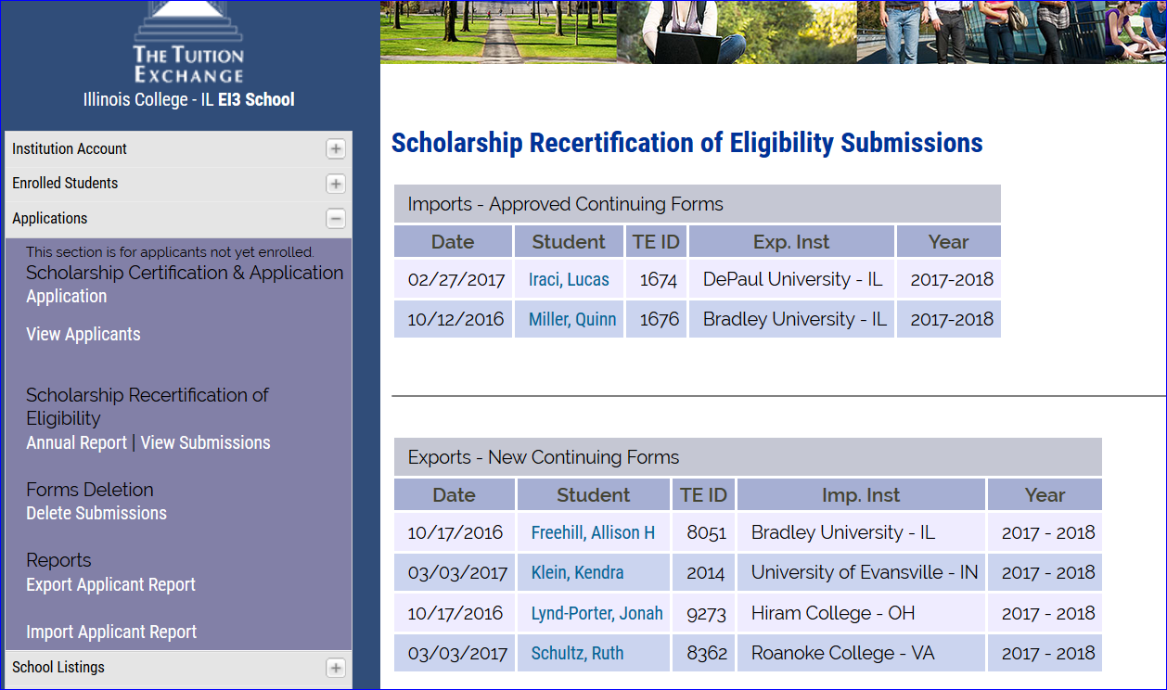
The other schools
RECERTIFIED the
Students via their
Annual Report.
You need to click
On the student’s
Name and update
The details inside
View Submissions

