Slide 1
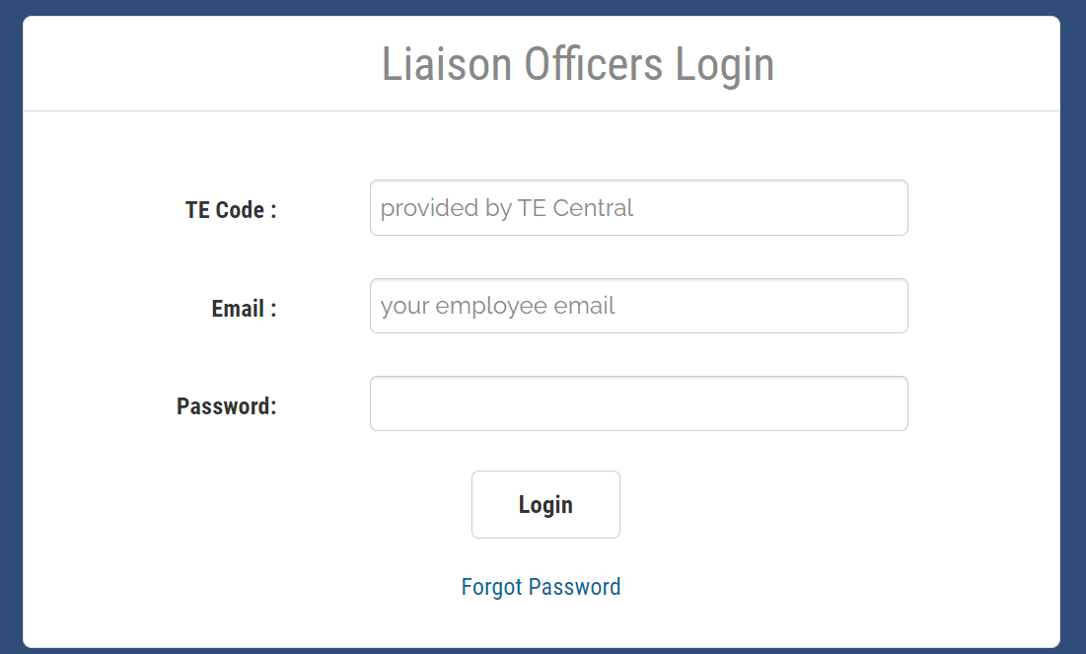
Step 1
Accessing your Tuition Exchange Liaison
Officer site (www.tuitionexchange.org)
Step 2
Click on the TELO option as circled above

Slide 2
Step 3
This is where TELO’s do their work.

