Slide 1
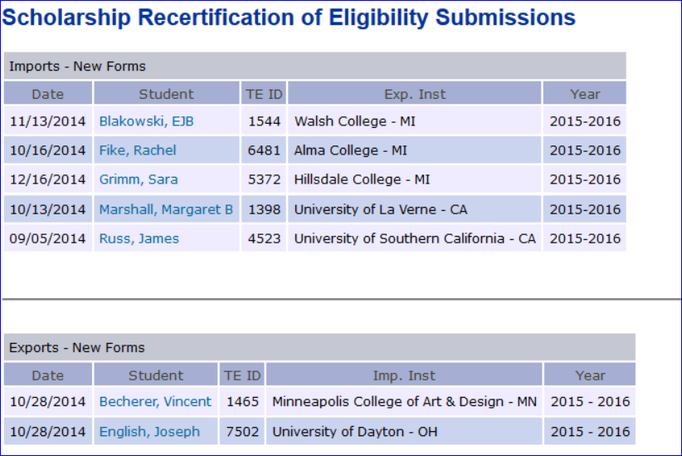
Approving a continuing student’s TE IMPORT application
Online Forms
Scholarship Certification & Application
Submit Form | View Applicants
Scholarship Recertification of Eligibility
Annual Report | View Submissions
Inside the TE Liaison portal click on
VIEW Submissions inside the Online Forms
Section.
Review Imports- New Forms

Slide 2
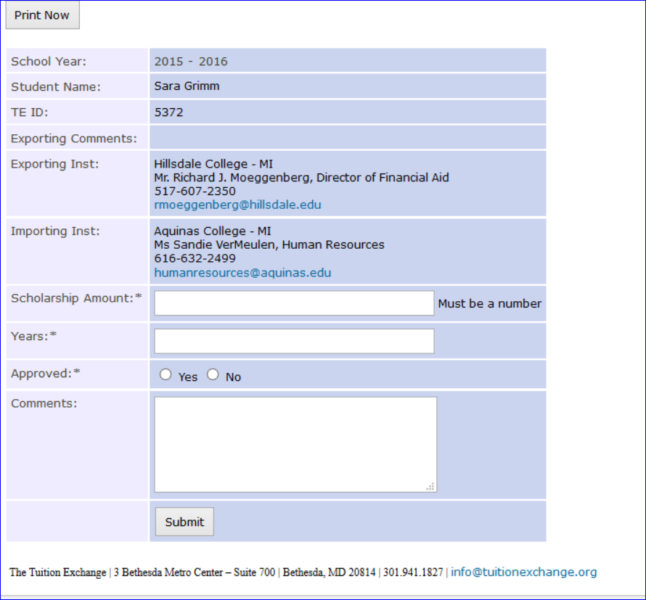
Approving a continuing student’s TE IMPORT application, continued
Confirm the student’s record
Is approved. If not, you need to
take action in each of the 3 boxes
Be sure to
Click
SUBMIT
If your approval is NO – please provide an explanation

